Slide 1
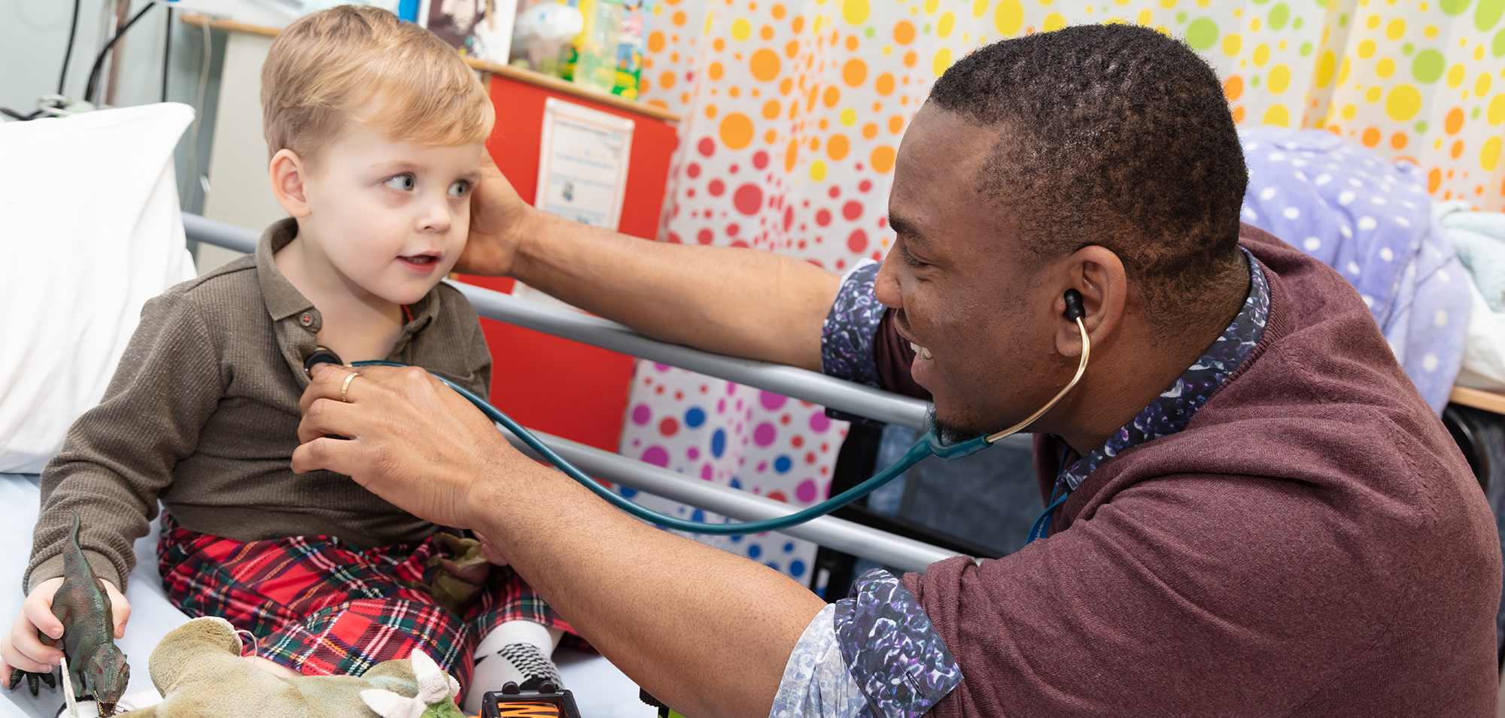
Physician Associate Assistant Practitioner Engagement Event
Kate Catterall - Physician Associate Workforce Lead
Claire Ainsworth - Primary Care Training Hub and Workforce Development Manager

Slide 2
Overview
Provide oversight to L&SC Physician Associate Assistant Practitioner (PAAP) New To Practice Physician Associate Scheme
Funding process
New To Practice Fellowship programme
Discuss the impact of physician associates in primary care: A Practice Manager prospective.
Discuss the embedding of a Band 5 Physician Associate Assistant Practitioner- a local case example by a General Practitioner
Understand training and supervision requirements
HEE preceptorship grant

Slide 3
Who are Physician Associates?
Physician associates are medically trained, generalist healthcare professionals, who work alongside doctors and provide medical care as an integral part of the multidisciplinary team. They work across primary, secondary and tertiary care, and across the interphase! Physician associates are dependent practitioners working with a dedicated medical supervisor, but are able to work independently and autonomously with appropriate support.
https://youtu.be/Nq-O3mSH5IA

Slide 4
Background and training
All PAs must have completed a:
relevant three-year undergraduate degree (for example bioscience or healthcare-related) and
MSc/PgDip in Physician Associate studies which takes two years of full time study to complete – equivalent of three academic years akin to the clinical years of medicine
Intensive postgraduate course in medical science and clinical reasoning; this consists of 50% theory and 50% practice.
1,600 hours of clinical placement experience in both acute and community settings, with a strong focus around primary care
Students must pass both their university programme and the UK Physician Associate RCP national examination (200 MCQ paper and 14 station OSCE)
Once qualified must: maintain 50 hours of CPD each year, CBD, mini-cex and reflections
Pass a recertification examination every 6 years
Join as a member of the FPA Managed Voluntary Register (MVR)

Slide 6
What can PAs do!? PAs are trained to work within a defined scope of practice and limits of competence to perform the following duties:
taking medical histories from patients
carrying out physical examinations
seeing patients with undifferentiated diagnoses
seeing patients with long-term chronic conditions
formulating differential diagnoses and management plans
carrying out diagnostic and therapeutic procedures
developing and delivering appropriate treatment and management plans
requesting and interpreting diagnostic studies
providing health promotion and disease prevention advice for patients
However, currently PAs are not able to:
prescribe
request ionising radiation (eg chest X-ray or CT scan).

Slide 7
Physician Associate Assistant Practitioner
Role developed for graduate PA students, who have completed their training and are ready to work, but who are yet to qualify (sit national exams) to join the workforce
Initially developed by FPA due to COVID-19
Previous PAAPs in secondary care C&M and across the UK
Initial pilot 2021
2 month fixed term training grant with the benefits of…
Increase capacity
Diversify the workforce in primary care
Showcase primary care as a great place to wok
Supervision
On boarding into primary care/PCN models
Peer to peer mentorship
Team building and embedding new roles
Join after completion via direct employment/PCN employment
NTP

Slide 8
Examples of role
History taking
Clinical examination
Diagnostics
Interpreting lab results
Chronic and acute presentation
Suggest investigations and management plans to a senior supervising colleague, and initiate/refer when appropriate.
30 minute appointments, followed by debriefs
Working under direct supervision of a GP initially

Slide 9
Expectations
Practice induction
Orientation to practice or practices within PCN that they will be working in
Policies/Procedures
Introduction to staff member
Support to attend Physician Associate Assistant Practitioner to attend all education sessions provided.
GP supervisor who will complete bi-weekly supervision to ensure the individual is comfortable within the role.
To provide opportunity to spend time with each member of the MDT to encourage full MDT role awareness.
Evaluation and move onto Primary care preceptorship/ARRS

Slide 10
PAAP New to Practice
New To Practice Fellowship education programme
Focussed on training needs of the individual
Weekly teaching via MS Teams
Themed weeks
CBD
External CPD inc. Red Whale update, regional respiratory teaching, haematology update
Peer to peer mentorship
Personal development plans
Physician associate local network

Slide 11
Spielberger State-Trait Anxiety Inventory (STAI) score suggests reduced levels of trait and state anxiety following NTP (52 – 48)
Increased levels of confidence in managing an unwell children
Increased confidence in chronic disease management
Exceeds supervisor expectations (reports working at FY2 + level)
Further cohort planned

Slide 12
“The potential hurdles which we have talked come would be the prescribing element and the lack of clarity or the clinical responsibility or the cases. We are aware that as in any job it is the individual who defines the job and hence it will be a learning process for both of us.”
“Patients not understanding or accepting the PA as the medical care provider In my experience most newly qualified PAs require significant support, supervision and mentorship. This requires a lot of time which can be difficult in practice.”

Slide 13
Funding overview
£5,200 training grant – upon appointment
Invoice to L&SC training hub
No further funding for education support
£5,000 HEE primary care preceptorship funding

Slide 14
NTP fellowship
12-24 month programme
NTP GP/GPN
Introduction to the Primary Care Networks (PCNs) and the Integrated Care System (ICS)
Leadership development programme
AQUA Quality improvement course
Action Learning Sets (ALS).
Develop individuals to support improvement across their practices and PCNs
Conjunction with portfolio opportunities and development inc. skills assessment, QI E-learning activity, workbook and pre-reading.
Continued CPD, case based discussion, peer mentorship, networking
Opportunity to present audits/QIPs

Slide 15
Stage 1
Stage 2
Months 7-12
Stage 3
Pre Work
Skills Assessment
Workbook & pre-reading
Virtual Workshop 1
Introduction to QI
Stakeholder Engagement
Virtual Workshop 2
Virtual Workshop 3
Leadership
QI E-Learning
Process Mapping
Aim Statements/ Driver Diagrams
Presentation of Projects to PCN
Measurement & Evaluation
Project Update/ALS
Poster
Presentation
Vlog
ALS

Slide 16
Impact of physician associates in primary care: A Practice Managers prospective
Ann Neville
Business Manager, Darwen Healthcare
Darwen PCN Practice Manager Lead

Slide 17
Embedding of a Band 5 Physician Associate Assistant Practitioner a local case example by a General Practitioner
Santhosh Davis
GP Principal, Burnley Wood Medical Centre

Slide 19
Making the most of your PA.

Slide 20
Factors affecting career aspiration choices
Flexible career paths/developing specialist interests
Visible career paths
Engaged with a degree of responsibility in service provision
Career identity
Desires to work across both primary and secondary care
Training pathways for PAs post qualification in clinical leadership, NHS management, research and medical education
Contributing to the wider MDT
Leadership

Slide 21
Barriers
Ignorance regarding the PA role and unrealistic expectations
44.8% reported that staff did not know about the role
61.3% reported that staff did not know what clinical work they should undertake
Risk of unrealistic expectations

Slide 22
First year guidance
Identifying times for dedicated supervision/ Personal development plan
set at 3, 6 and 9 months ideally
Identifying opportunities for learning e.g. DN/ acute visiting team, intermediate care beds, Macmillan, shadow HV.
Establishing key presentations with PA e.g. URTIS/UTIs/Paeds/ derm – ensure reception staff know who to book in
No fit notes!
Factor in time for QI/audits/QOF if appropriate

Slide 23
+ 50 hours CPD
(internal & external)
+ patient/colleague feedback
(360 TAB)
+ annual appraisal

Slide 24
Notes:
Themed weeks
Acute focussed vs chronic disease
Set presentations
Thrown in at the deep end!

Slide 25
Preceptorship (then)…
…now
Newly qualified and inexperienced
Ill-defined role and expectations
Required ++ supervision
30 min appointments, mainly acute
Specialised clinics e.g. diabetes lead
Like-for-like appointments
Leading MDTs
Acute care home visits
Supervising medical students/ FY2s
Management of complex patients
Palliative care/end of life planning
Integrated as part of the team
Leadership
Continuity of care

Slide 26
ARRS
100% reimbursable via The 2020/21 Network Contract DES
Indictive Salary AfC 7 AfC PA Preceptorship mid point AfC 6
Max reimbursable amount over 12 months (with on cost) – £53,724
Notes:
https://www.e-lfh.org.uk/wp-content/uploads/2020/10/Physician-Associate.pdf
https://www.e-lfh.org.uk/programmes/new-roles-in-primary-care/

Slide 27
Physician Associates ARRS role
Clinical Consultations
Review specialist requests/advice and action this
Medication queries/requests
Nutrition
Mobility
Advanced care plans
COVID care plans
Mental Health
Referrals to/liaise with community services
PAs can be involved in the delivery of Enhanced Health in Care Homes via the PCN/ NHS long Term Plan (2019) Framework
Many PCNs have recruited PAs to work both in general practice and care homes
Innovative digitalisation roles e.g. digital ward rounds and telemed clinics reduce F2F requirements and exposure

Slide 28
A day in the life
8:00-9:00 | Docman/bloods/tasks
9:00-10:30 | Acute same day appointment adults
10:30-10:45 | Paediatric urgent appointment
10:45-11:00 | Online e-consults queries
11:00-12:00 | Pre-bookable (discuss bloods/medication reviews)
12:00-12:30 | Face to face appointments
12:30- 13:00 | Admin
13:00-14:00 | MDT
14:00-14:30 | Admin
14:30-16:30 | Chronic disease clinics
16:30- 17:00 | QI/ audit/mentorship

Slide 29
Hints & Tips
Develop a supportive supervisor relationship
Allow opportunities to work with the wider MDT e.g. acute visiting service
Engage your PA into the practice team
Upskill through CPD, courses to meet the demands of your surgery
Expect a steep learning curve
Offer preceptorships
Facilitate peer-to-peer support
Think innovatively

Slide 30
Upcoming
The MAP Career Framework
Progression
Education
Professional guidance e.g. Competency & curriculum framework
Education standards
MAP Oversight Board
Registration
Fitness to Practice
Re-validation
Ionising radiation & prescribing
Notes:
Legislation needs to be passed to allow the GMC to regulate Physician Associates and Anaesthesia Associate - expected Autumn 2022
2-year timeline to gain registration – a transition from current Physician Associate Managed Voluntary Register (MVR)
Demonstrate:
Knowledge and skills to work safely as a PA or AA in the UK
No outstanding concerns about your fitness to practise (declaration)
Have your say “Regulating healthcare professionals, protecting the public” Consultations (consultation closes 16 June 2021)

Slide 31
HEE preceptorship requirements
£5,000 HEE primary care preceptorship funding
New to primary care within 12 months of MVR registration
Taking up their first post in primary care since gaining registration who has moved from secondary care with a maximum of 3 years’ experience.

