Slide 1


Building Digital Skills & Competencies
Notes:
This short course is to give an overview of the digital tech used in practices to support patient services. It provides the foundation for nurses to develop their own skills and start to embed some digital into there every day practice

Slide 2
Digital Champion Locality Lead Nurses
The Nurse Leads provide support to the L&SC Primary Care Training Hub (and its constituent locality Hubs) and ICS to deliver on the Digital Workforce Strategy and Primary Care Digital First Agenda, as a Digital Champion Locality Lead, to share and embed the use of digital technology.
Leadership is required to ensure that the national recommendations related to a primary care digital first approach and supported by national and local digital strategies are adopted and embedded in practice. Examples of current projects included in the Digital First Agenda include the digital front door triage, on-line and video consultation programmes of work, supporting greater use of innovative technology and increasing self-management using digital technology.
Notes:
The digital champion lead nurses offer support for practices or individuals and link with the ICS digital team to help deliver the local and national strategies with practices

Slide 3
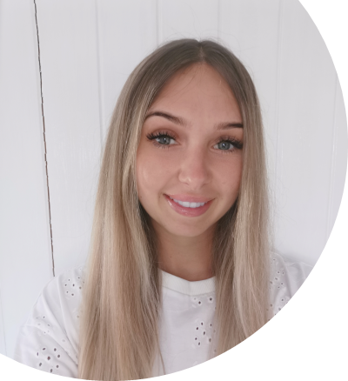
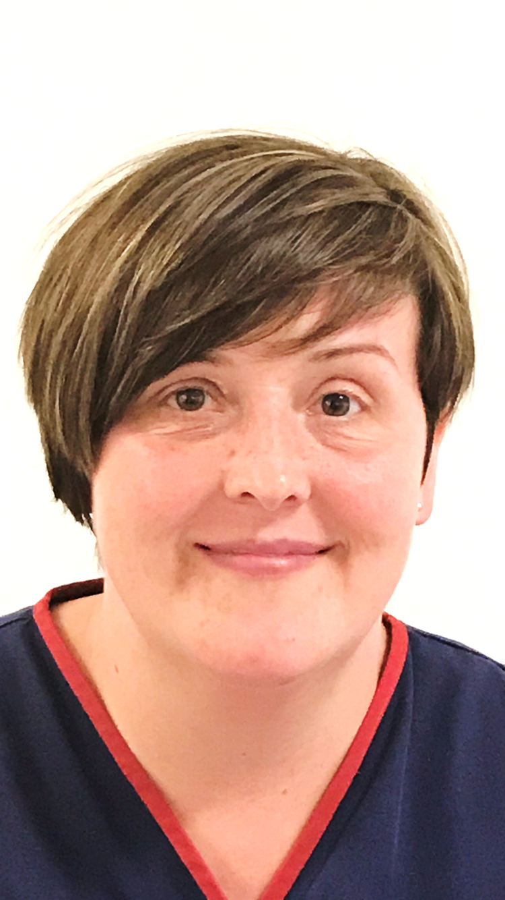
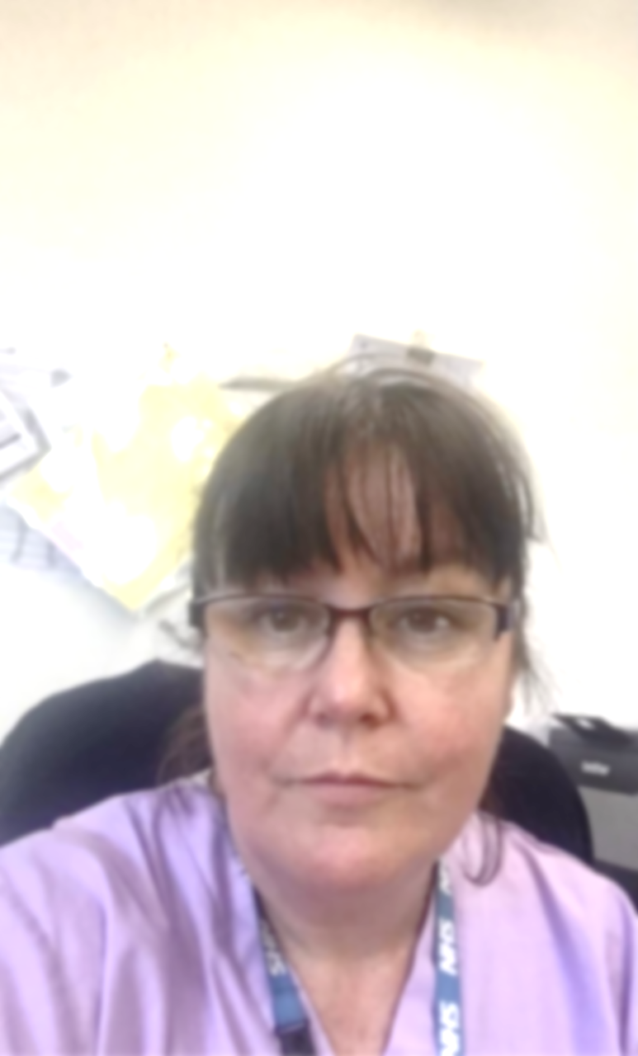
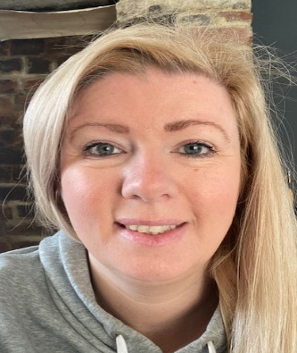
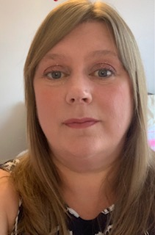


Meet our Digital Champion Locality Nurse Leads Supporting Primary Care
Embedding capability and confidence in using digital technology
Jenny Mather
West Lancashire Training Hub
jenny.mather@nhs.net
Angela Ormrod
Pennine Lancashire Training Hub
angela.ormrod@nhs.net
@ormrod_angela
Morecambe Bay
TBC
Corrie Llewellyn (Lead)
Lancashire & South Cumbria Training Hub
Corrie.llewellyn@nhs.net
@corriellewellyn
Sara Baldwin
Greater Preston & Chorley South Ribble Training Hub
sara.baldwin1@nhs.net
@lizzy_bitz
Carrie Locker
Fylde Coast Training Hub
Carrie.locker@nhs.net
@carrielocker12
Powered by

Slide 4
Background - National & Local Context
https://www.longtermplan.nhs.uk/
https://www.england.nhs.uk/gp/gpfv/
https://www.england.nhs.uk/gp/digital-first-primary-care/
https://www.england.nhs.uk/publication/we-are-the-nhs-people-plan-for- 2020-21-action-for-us-all/
https://www.england.nhs.uk/ournhspeople/
https://www.rcn.org.uk/clinical-topics/ehealth/every-nurse-an-e-nurse
https://www.england.nhs.uk/wp- content/uploads/2020/08/C0716_Implementing-phase-3-v1.1.pdf
https://www.healthierlsc.co.uk/digitalfuture
2
Notes:
There are several resources that support the digital agenda

Slide 5



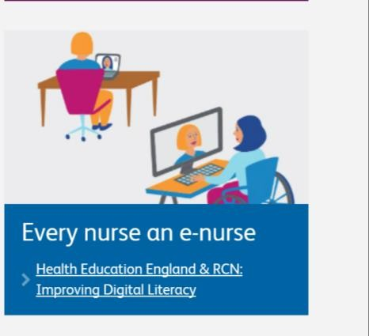
Notes:
Current papers that are shaping the future in practice and please note the digital sections in the papers

Slide 6

Building Skills & Competencies
Notes:
Whilst we improve our digital skills it can also be beneficial to see why this is useful
Talk around the model and the benefits using digital can have prompt to how we have increased tech over covid for multiple purposes

Slide 7
Our aims are for individual participants to:
Use at least two modes of technology enabled care service in their practice (and have at least 20% of patients signed up to GP Online)
Use Closed Facebook and/or WhatsApp and/or other trusted apps to support patients with long term conditions and create a focus on preventative interventions Encourage patients’ intelligent use of GP Online (e.g. those with long term conditions accessing their medical records to enhance their understanding of their health condition and treatments/tests)
Reduce the proportion of face to face consultations e.g. substitution by video consultation / use of clinician/patient texts
Notes:
Highlight here what you did and your action plans and how it improved practice can link here some of the case studies

Slide 8
Continued
Increase access to self-care information and then shared management of long term condition
Provide a consistent professional approach to TECS by general practice (and other) nurses and clinicians across the health economy; and enthusiastic clinical engagement in digital delivery of general practice care.
Understand how the application of TECS can promote health and wellbeing and prevent avoidable illness.
Support patients to adopt and access preventative interventions which are illustrated in PHE’s All Our Health framework such as obesity, smoking and antimicrobial resistance
Notes:
Use some examples here such as the vimeos done any case studies you can bring in here

Slide 9
Action Learning Sets
To Develop your Digital Skills and Become a Digital Champion
Use Two new ways of adopting digital into your work and evaluate using Action Learning Sets
Report these back to your Locality Digital Champion Lead
Notes:
The action learning sets are great to develop own work and will provide evidence of improved care for revalidation and will allow new actions to be evaluated and can be used as case studies for your area and supports peers to become digital champion themselves
My digital story - Jenny Mather on Vimeo

Slide 10
Partnership
On-line & Video Consultations & and Total Front Door Triage - The NHS Long Term Plan commits that every patient will have the right to be offered digital-first primary care by 2023-24.
Notes:
Please discuss all the ways video consultations have been adopted and rapid uptake of this into normal day practice following pandemic. Can give over view of how a long term review can be done in this way

Slide 11
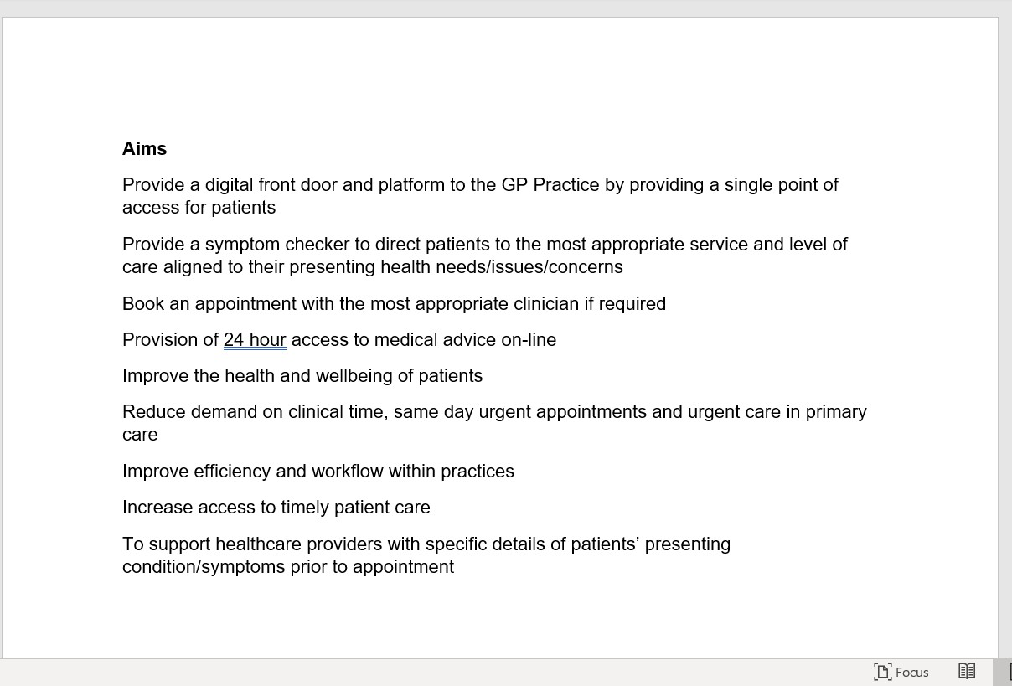
Total Front Door Triage-
NHSE Blueprint
Partnership working across Lancashire and South Cumbria

Slide 12
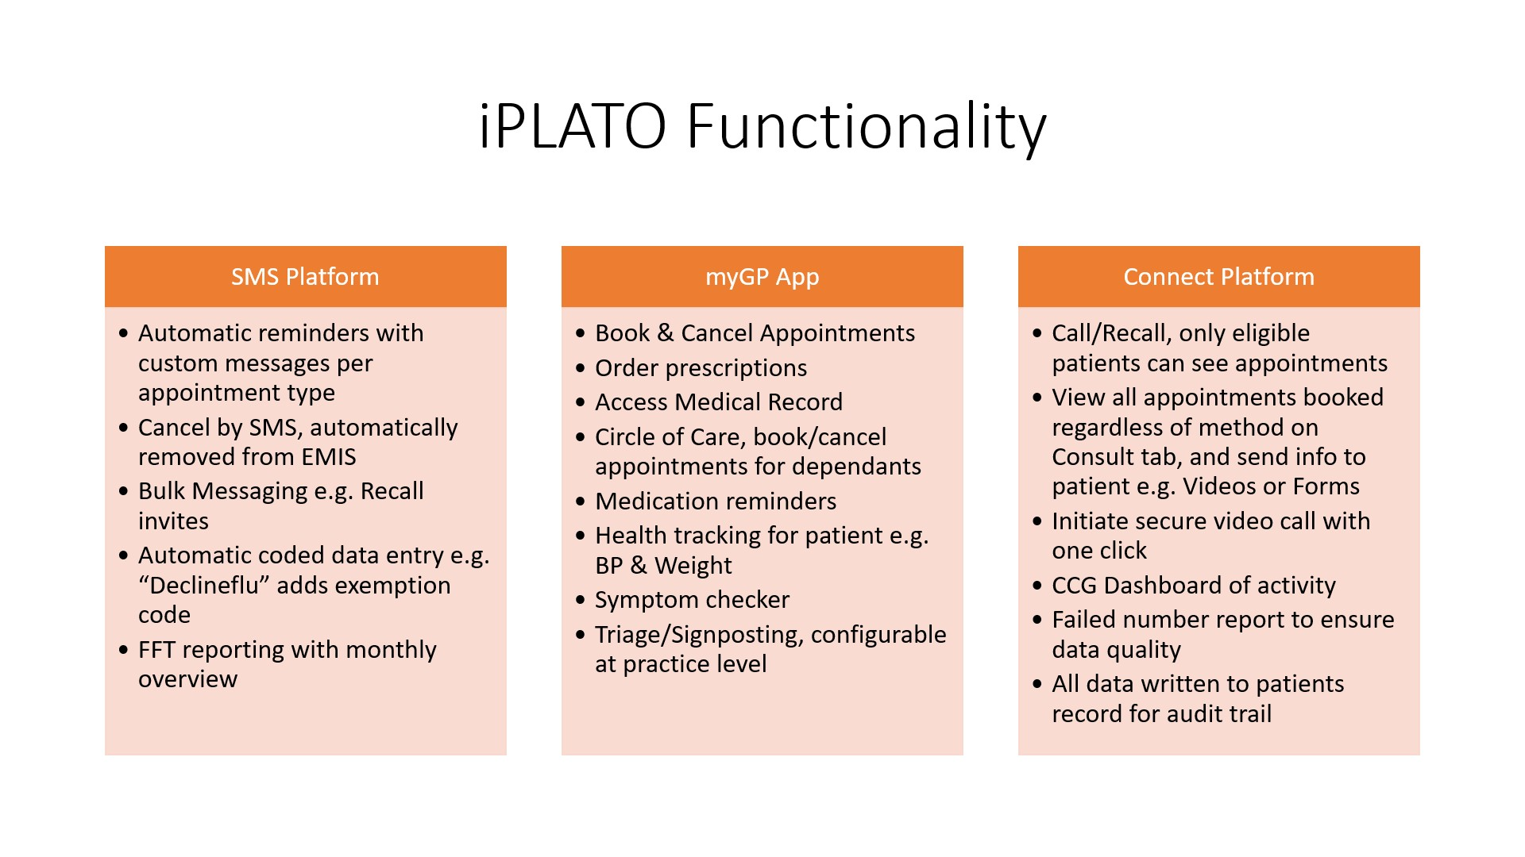
iPlato
.
Notes:
Our first and biggest brand, myGP (operating in the UK since 2016), embodies our belief in the power of simplification – for the patient as well as the practitioner.
myGP’s features tackle the most pressing problems for primary care practices: missed appointments, time pressures, and dwindling resources. It also connects practices with their patients via an app which has been specifically designed to patients to take an active, empowered role in their own health and wellbeing.
As the clinical environment becomes ever more complex and the challenges mount, it’s clear that the time is right for a single, simple solution which translates easily around the world. myGP is our first and best test case; improving the interaction between primary care providers, complimentary health services, and the patients that they serve.
If you use mygp as a patient discuss its benefits

Slide 13
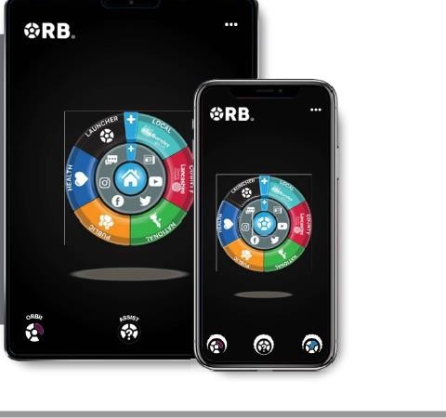
The Orb
ORB is an application available for people to download and use for free, it can be adapted to an individual’s specific needs by allowing personalisation and customisation of any element, so a person can create their own digital space to meet their individual requirements.
Notes:
https://youtu.be/69CqhI-b49s The ORB is a free application that allows users to access any app or website in one central location.
Devised for both use as a clinician and for patients has all services for lancashire south cumbria

Slide 14
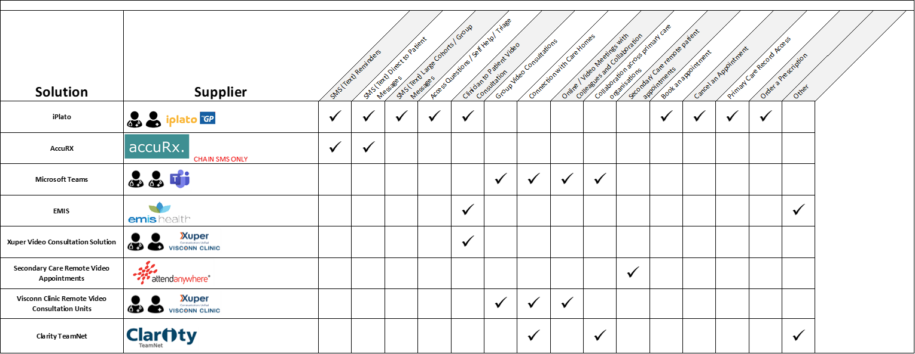
On-Line & Video Solutions across L&SC
Notes:
Play vimeo discuss use of consultations and give overview of the varied solutions

Slide 15

Case study: Dr Colvin Library House
Vimeo Link here

Slide 16
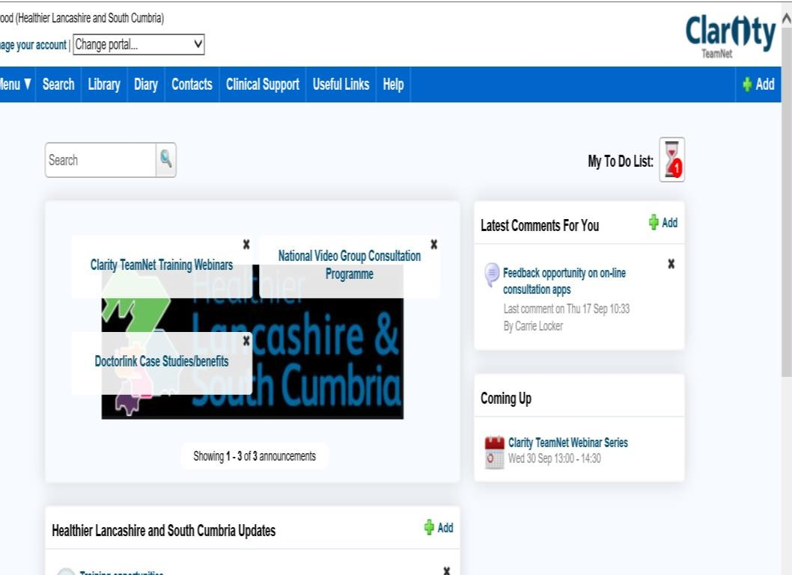
Clarity TeamNet
All L&SC CCGs and practices have the opportunity to have a portal
Notes:
Play video

Slide 17
Clarity TeamNet
View the FULL Clarity TeamNet Overview on Vimeo here

Slide 18
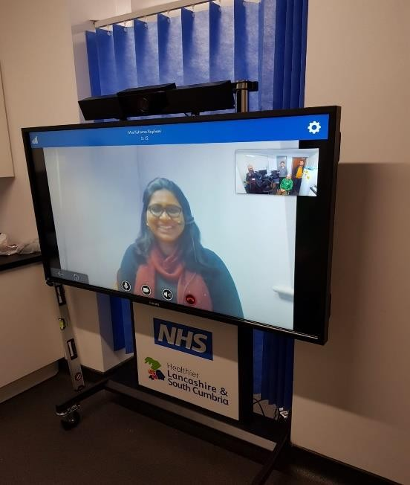
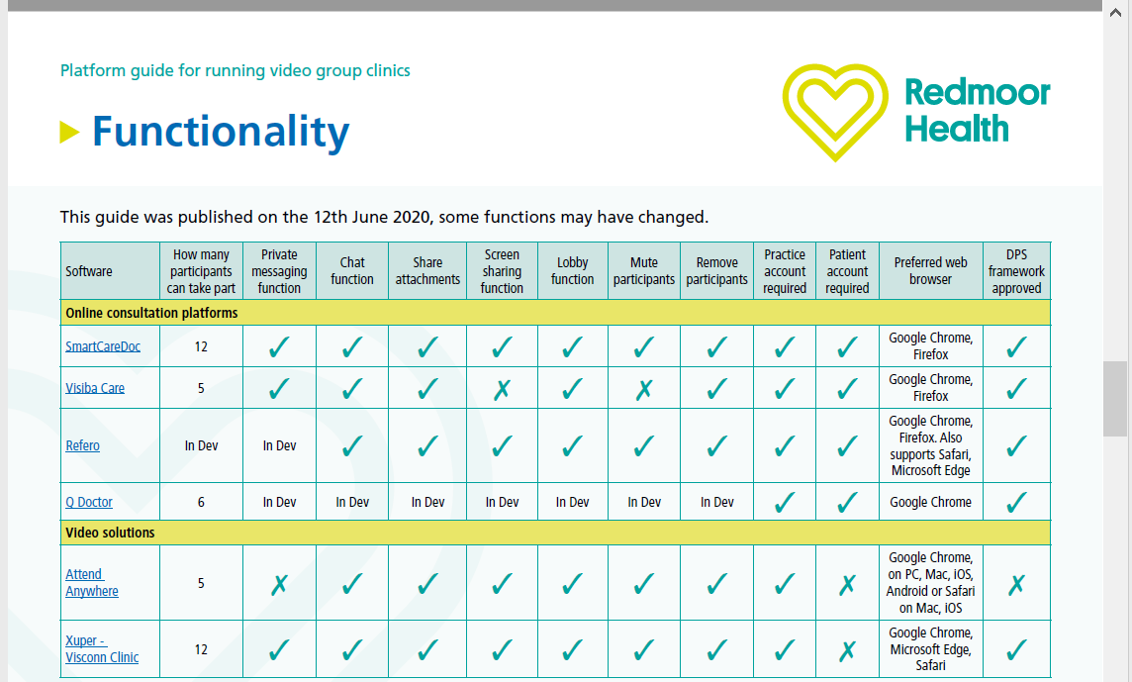
Visconn Hub and Xuper Video Licences
PCN Resource
Video Group Consultation Functionality
DPS Framework

Slide 19
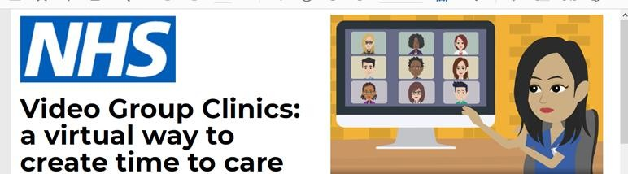
Video Group Consultations
Maggi Bradley - Vimeo link here

Slide 20
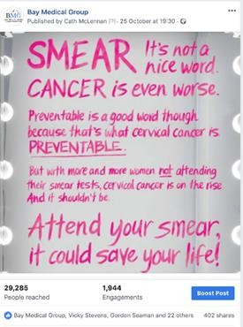
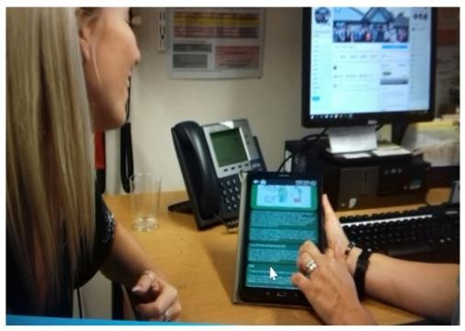
Digital Champions embedding technology into practice
CliniTecs resource website http://www.clinitecs.uk/

Slide 21
Digital Champions embedding technology into practice
Case Study 1 : Kelly Greenwood - Practice Nurse
Vimeo link here

Slide 22
Digital Champions embedding technology into practice
Case Study 2: Sarah Bland and Elley Sowerby – Practice Nurses
Vimeo link here

Slide 23
Digital Champions embedding technology into practice
Case Study 3: Kathleen Grimshaw - Practice Nurse
Vimeo link here

Slide 24

Apps-Orcha and EMIS Apps Library
Notes:
Can show an app here

Slide 25
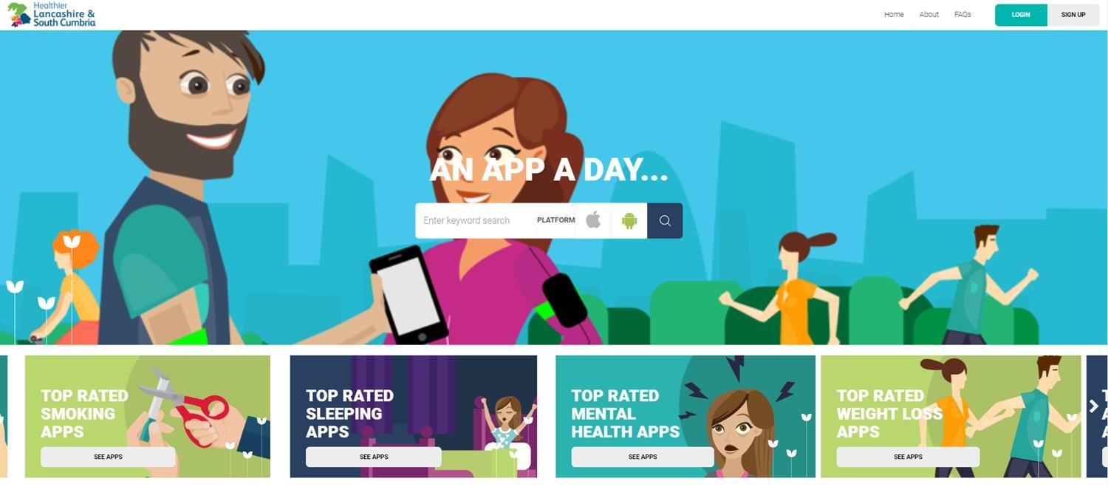
Orcha Apps Library-Approved apps

Slide 26
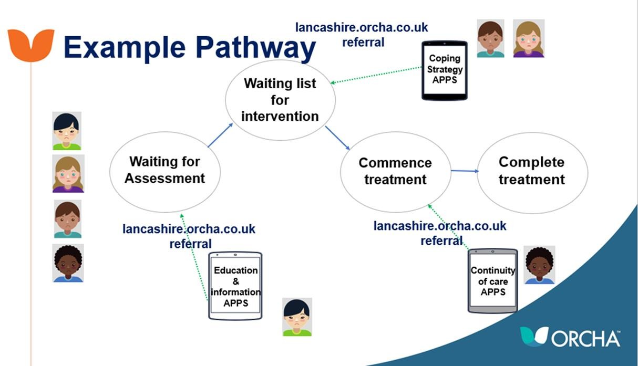
Can you see where apps could add value as part of your care pathways?
Notes:
Open it up for discussion

Slide 27

Digital Clinical Supervision
Notes:
Pilot done last year with specific digital supervision platform very useful way to improve supervision collaborative work across PCNs and impress CQC

Slide 28
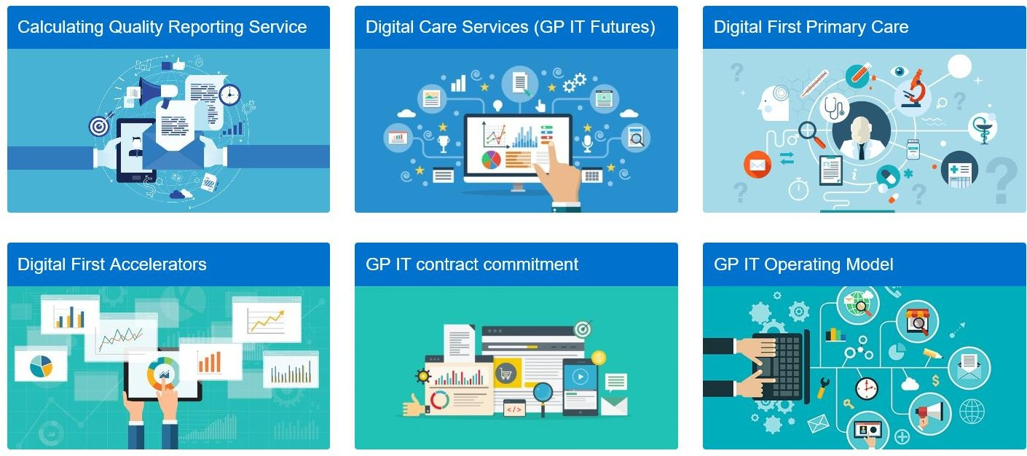
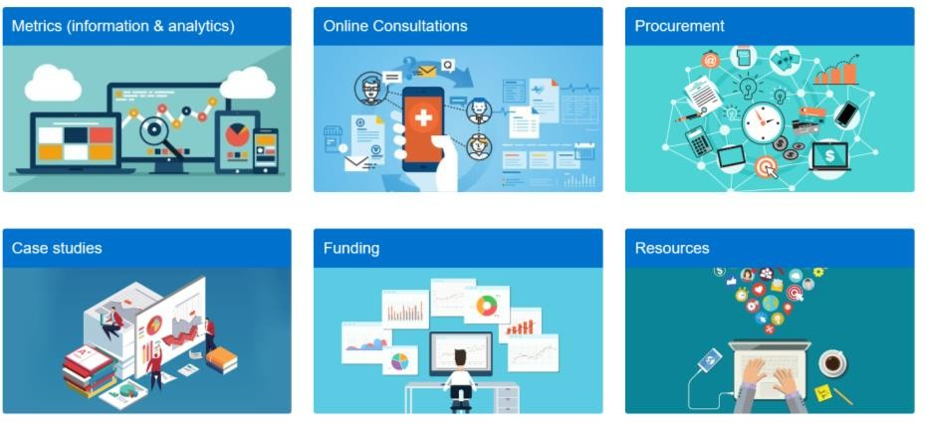
.

Slide 29
The future includes
Remote point of care testing/monitoring and diagnostic solutions across
primary care e.g. image sharing and sensor technology
Workforce- development increased remote & flexible working
Population health management and targeted interventions for the most vulnerable and high -risk groups including regulated care, LD etc
AI solutions
Notes:
Could mention some of the projects currently involved in in ICS especially digital inclusion

