Slide 1
Business administrator apprenticeship – medical pathway

Slide 2
Introduction to Damar
40-year history in the training and apprenticeships industry
Specialists in business and professional qualifications - accounting, legal, admin, customer service, management and travel
Working with SMEs, levy payers and public sector organisations across England
Supporting thousands of apprentices and employers every year
Rated ‘good’ by Ofsted

Slide 3
What is an apprenticeship?
An apprenticeship is a nationally recognised qualification that develops the knowledge, skills and behaviours related to a specific job role.
The content is set against a national standard, which was created by employers representing a variety of sectors.
It involves a period of “on-programme” learning alongside the apprentice’s day-to-day role before they are ready to sit an “end-point assessment” (EPA) conducted by an independent body.
Knowledge
Behaviours
Skills

Slide 4
Build the Future
Attract:
Recruit the right people for your business
Progress in the role and career you want
Train:
Future proof your workforce
Develop knowledge, skills and behaviours with a recognised qualification
Retain:
Improve productivity, retention and quality
Progress on a long-term career plan
Achieve:
Meet and exceed organisational objectives
Fulfil your potential

Slide 5
Benefits
Productivity: The productivity gain of a trained apprentice is £10,000pa and £1,670pa whilst the apprentice is in training (Centre for Economic Research)
Workforce skills and quality: 86% of employers report benefiting from ‘the development of skills relevant to the organisation and 75% report ‘better quality of products or services’ (DfE)
Retention: It is easier to retain apprentices than graduates – average retention over 3 and 5 years shown in graph
Recruitment: The average apprentice costs £2,305 to hire - £2,400 cheaper than the average graduate hire (Institute of Student Employers)

Slide 6
Maximising the Benefits
Our People: An experienced team of coaches, technical specialists and account managers to guide, challenge and support you and your apprentice, to not just achieve the qualification, but to have an impact on your organisation now and in the future.
Our Processes: A seamless and efficient enrolment and onboarding process, leading into planned, manageable chunks of learning with one-to-one and group interaction and additional support to prepare for end-point assessment.
Our Systems: Designed our systems to be accessible and engaging, including
OneFile to track progress
Profiler to demonstrate development and identify further areas for improvement
Damar OpenLearning for a wealth of interactive learning resources
Forums for apprentices to network, share best practice and provide support.

Slide 7
Maximising the Benefits (2)
Our medical administration apprenticeships have many unique features which maximise the benefits of apprenticeship training for healthcare organisations:
We have extensive experience in working with healthcare organisations, including the NHS
We are able to match each apprentice with the most relevant coaches and subject specialists to help them achieve their full potential
We offer an account managed service, with employers able to view and track the progress of all of their apprentices
We provide the opportunity for apprentices to engage with each other, through the use of group workshops and discussion forums

Slide 8
Who is it for?
Business Administrators – Medical Pathway
 | Support and engage with different parts of the organisation and interact with internal and external customers
 | Develop, implement, maintain and improve administrative services within a medical environment e.g. medical secretaries
 | Contribute to the efficiency of an organisation
 | Support functional areas, work across teams and resolve issues
 | Demonstrate strong communication skills
 | Have a proactive approach to developing skills
 | Show initiative, managing priorities and time
 | Show problem-solving and decision-making skills, and the potential for people management responsibilities
Reference: Institute of Apprenticeships Business Administrator Apprenticeship Standard

Slide 9
Apprenticeship Overview
Level: 3
Length: 16 months
Modules: 9 Business Administration + 5 AMSPAR
EPA Organisation: Pearson
Funding: Via Apprenticeship Levy or 5% co-investment
Non-fundable costs: £300+VAT

Slide 10
How does it work?
Planning
Profiler assessment
Induction
On-programme learning
6-week modules
Pre-learning
End-point assessment (EPA)
Gateway meeting
Knowledge test, portfolio-based interview and project presentation
Group workshops
Individual coaching
Completion of assessments & learning journal
Programme planning
Independent EPA
Functional skills also required

Slide 11
Technical Requirements
The apprentice will need to meet the following requirements:
Internet access to gain access to online course resources and attend the live workshops
Access to word-processing software (either Microsoft Word or Open Office), Microsoft Teams and Zoom.
Email address so they can receive essential course-related information and communications.

Slide 12
The Role of the Supervisor
Ask us about our ‘Super Supervisor’ Guidance
Planning
Helping to set objectives for the apprentice through the Profiler tool
Ensuring that the apprentice has booked their coaching sessions and review meetings using the MS Bookings tool
Supporting
Making sure apprentices set time aside for learning and coaching sessions
Sharing experience and providing the opportunities and environment for apprentices to learn and develop
Reviewing
Making time available to meet with the apprentice’s coach for programme reviews (around every 12 weeks)
Offering feedback on performance against objectives, celebrating successes and highlighting where performance could be improved

Slide 13
On-Boarding and Launch
On-Boarding | Launch
Enrolment with Damar, including the apprentice and line manager Complete Individual Training Plan Welcome email, including introduction video and details on BKSB diagnostics Coach introduction and booking of launch | Meeting with Damar coach, including the apprentice and line manager Introduction to programme Discussion of training plan Introduction to OneFile and Damar OpenLearning Complete Profiler

Slide 14
Profiler
INTENT: Defining individual starting points and required outcomes.
IMPLEMENTATION: Development of knowledge, skills and behaviouirs. Ongoing review and assessment of progress and development.
IMPACT: Demonstrable impact on the individual and organisation. Confirmation of competence at final gateway.

Slide 15
Content – Apprenticeship Standard
Knowledge | Skills | Behaviours
The organisation and the part that the role plays Customers (internal and external) and other stakeholders Relevant law and regulation Business fundamentals The organisation’s policies and processes The impact of market forces, political and other external factors | Relevant IT packages How to produce accurate documents and records Decision making Influencing and communication skills Effective planning and organisation Project management | Professionalism Integrity, reliability, motivation Adaptability Responsibility Proactivity

Slide 16
Content – AMSPAR Level 2 Award in Medical Terminology for Non-Clinical Professionals
AMSPAR Modules | Programme Details
Basics of medical terminology – word building Major bones of the body Common roots, prefixes and suffixes Prescription writing and abbreviations Classification of drugs Anatomy and physiology of the body systems Instruments and investigations Medical specialities and personnel | 2 weeks per module – total of 12 weeks 6-8 hours self-study per module Completed post-gateway Three intakes – March for June exam, August for November exam and November for February exam Primarily run online but with mentored support from a coach Final 1 hour exam – Can be undertaken at the employers’ premises (with appropriate invigilation)

Slide 17
Modules and Objectives

Slide 18
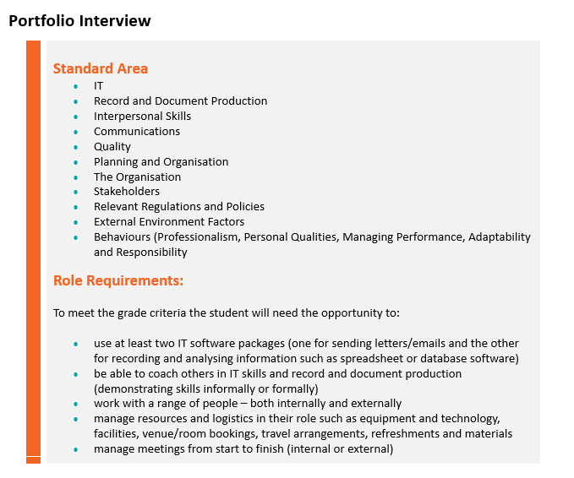
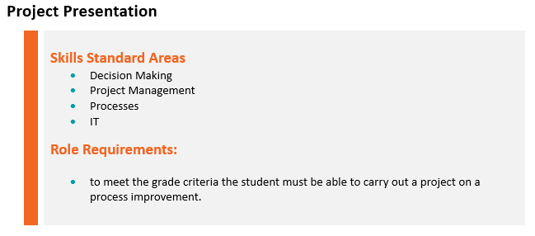
Role Requirements

Slide 19
End-point assessment
The EPA Knowledge Test is a 1 hr multiple choice exam which contains 50 questions - this can be taken remotely or at the employer premises.
EPA Knowledge Test
20%
Portfolio Based Interview
40%
The interview can be face to face or remote and usually takes place after the Knowledge Test
Project Presentation
40%
The project presentation is completed on the same day as the interview and MUST be based on an improvement to a process

Slide 20
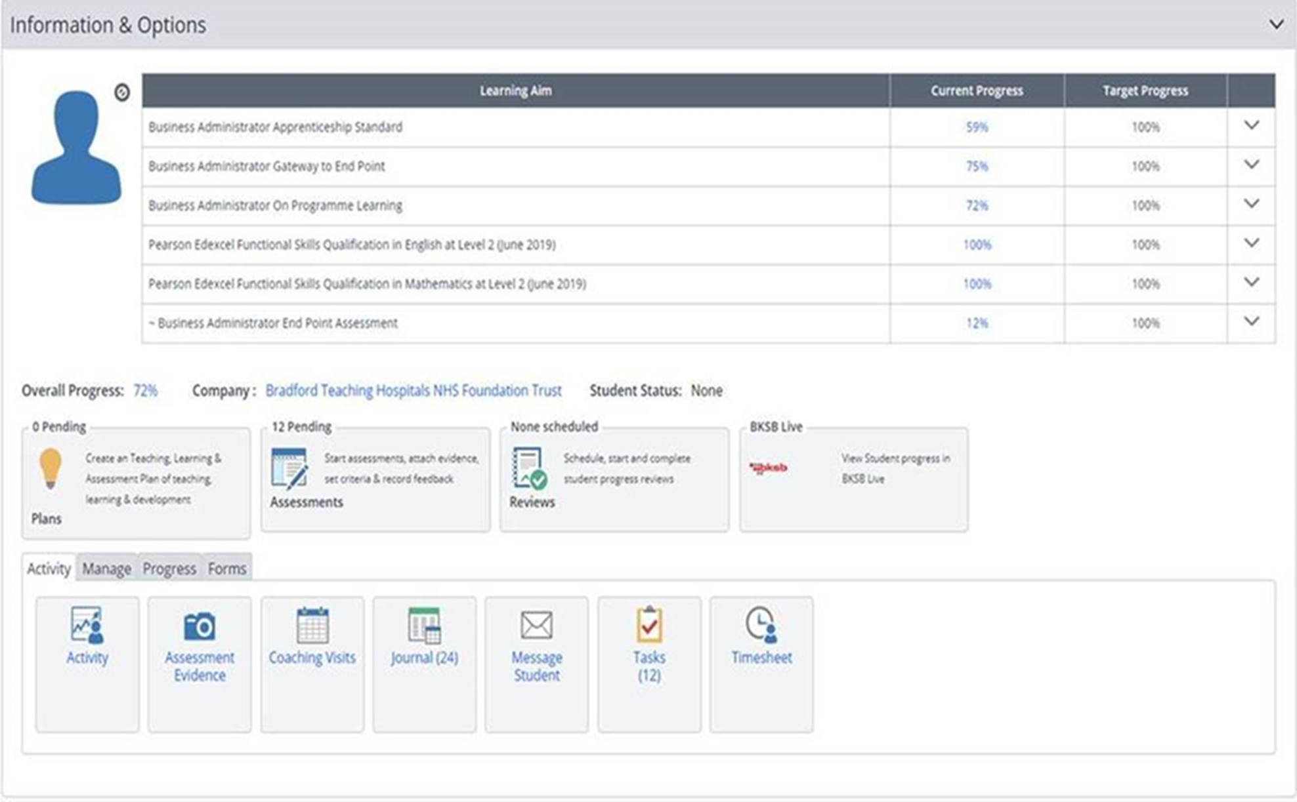
Functional Skills
Maths and English qualifications are integrated into the programme
Learning is linked to “real world” skills and scenarios
Some will have exemptions
Maths
Single exam paper:
Section A – non calculator
Section B – calculator
English
Reading – onscreen test
Writing – onscreen test
Speaking & Listening – talk/presentation and discussion

Slide 21
Functional Skills – Taking the Exams
Maths and English exams are to be taken at the employer premises or remotely invigilated
The speaking and listening component for English is carried out in a group via Teams
Exams at the employer
The student is invigilated at work by a colleague
A ‘test player’ system is required to be downloaded to the student’s desktop
Full guidance is sent to the invigilator upon student booking
A paper-based exam can also be requested
Exams via remote invigilation
Student is invigilated via a video recording. This requires a camera, a microphone and a second device such as a smart phone or tablet
Upon booking the student will be sent the necessary guidance to prepare for this including testing their system meets the requirements

Slide 22
Other Components
Safeguarding
Prevent
British Values
Equality and Diversity
Induction
Embedded in learning activities
Reviews
Further learning topics

Slide 24
Questions
Ask us about ‘We invest in apprentices’ accreditation

