Slide 1
National bundle of care for children & young people with asthma
CLAIRE UTTLEY
GEORGINA FOULDS
Specialist Asthma Nurse Practitioners for Children and Young People
JANUARY 2023

Slide 2
Claire Uttley Senior Specialist Asthma Nurse Practitioner claire.uttley1@nhs.net
RN Child
BSc Specialist Nursing Practice
PgDip SCPHN (School Nursing)
Asthma Diploma
23 years qualified paediatric nurse
Acute setting for 12 years
School Nurse
Complex Needs
Team Leader - Children’s Respiratory Nurse Specialists at ELHT for the last 7 years

Slide 3
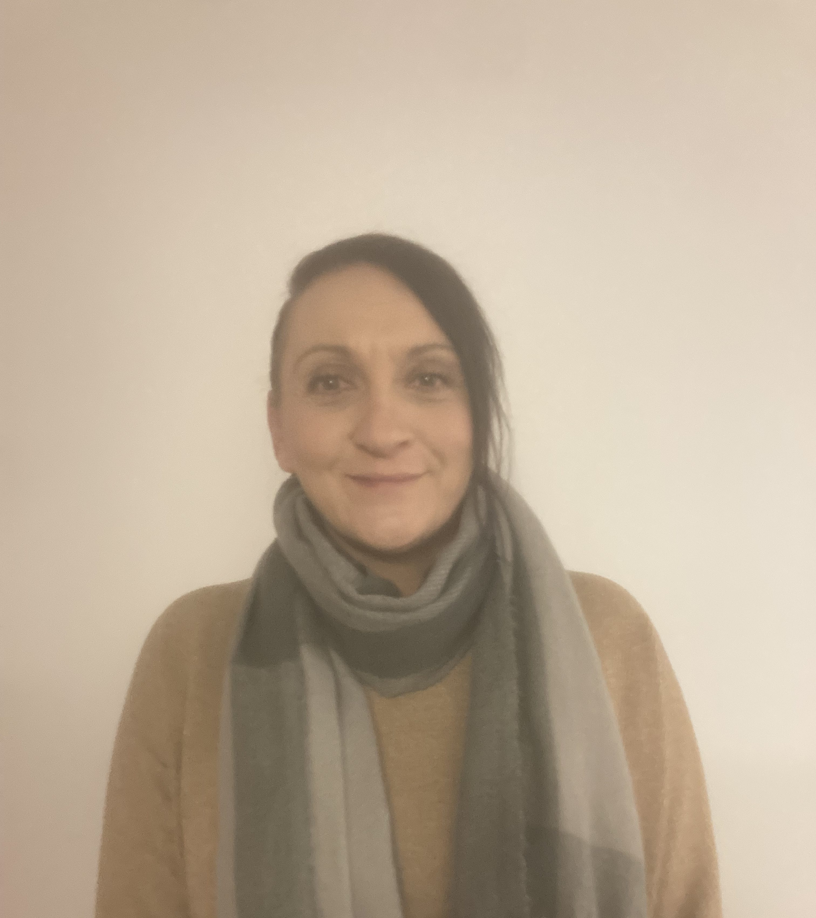
Georgina Foulds Specialist Asthma Nurse Practitioner georgina.foulds1@nhs.net
RN Child
BSc Nursing
Non Medical Prescriber
Asthma Diploma
21 years qualified as paediatric nurse
Worked across ELHT paediatrics:
Children’s Observation and Assessment unit
Children’s Community Team/Paediatric Urgent Care
Paediatric Asthma Team
Specialist Respiratory Nurses
Manager of the Children’s Observation and Assessment Unit

Slide 4
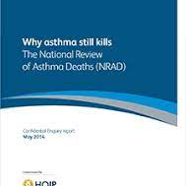
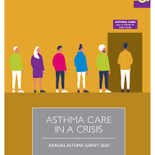
National Reports from 2014-2022

Slide 5
National bundle of care for children & young people with asthma (nhs England & NHS Improvement 2021)
Organisation of Care
Environmental Impacts
Early & Accurate Diagnosis
Effective, Preventative Medicine
Managing Exacerbations
Severe Asthma
Data & Digital
Competencies, Training & Education

Slide 6
COMPETENCIES, TRAINING & EDUCATION NEEDS
HEE Training Courses – Tiers 1-5
PRACTICE EDUCATORS / TRAINING LEADS
Education Staff
VCFSE Sector
School Nurses
HCAs
Primary Care Networks
Practice Nurses
Asthma Nurses
GPs
Secondary Care
Ward Nurses
ED Staff
Specialist Nurses
Medical Staff

Slide 7
EFFECTIVE PREVENTATIVE MEDICINE
A structured asthma / wheeze review should include:
Assessment of symptoms & current asthma control
Identification of potential triggers
Creation of a PAAP in conjunction with CYP and family
Review of inhaler technique
Concordance with medication
Discussion around housing & potential triggers within the home.
Smoking cessation advice as appropriate
Promotion of healthy lifestyles (weight management, activity)
Asthma education & signposting (eg: Asthma UK, Digital Health Passport)
Mental health & well being
EDUCATION PACKAGE
TEMPLATE TO STANDARDISE STRUCTURED REVIEW
PRIMARY CARE NETWORKS

Slide 8
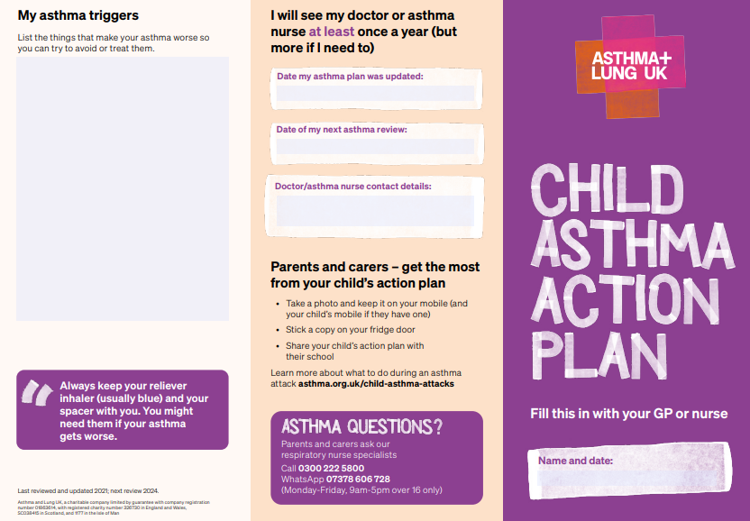
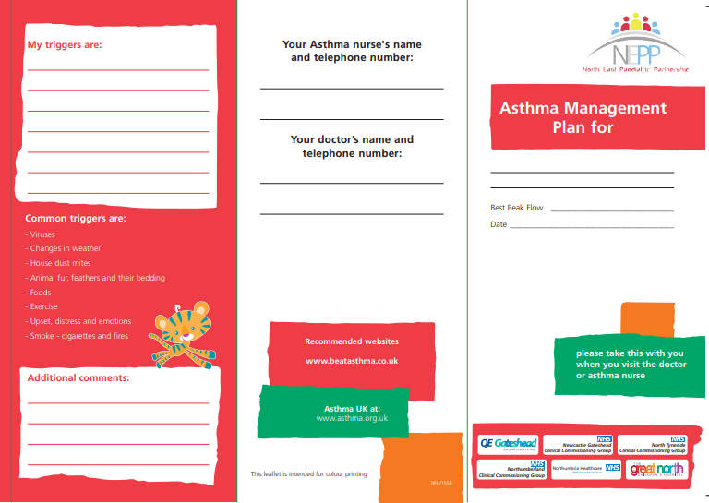
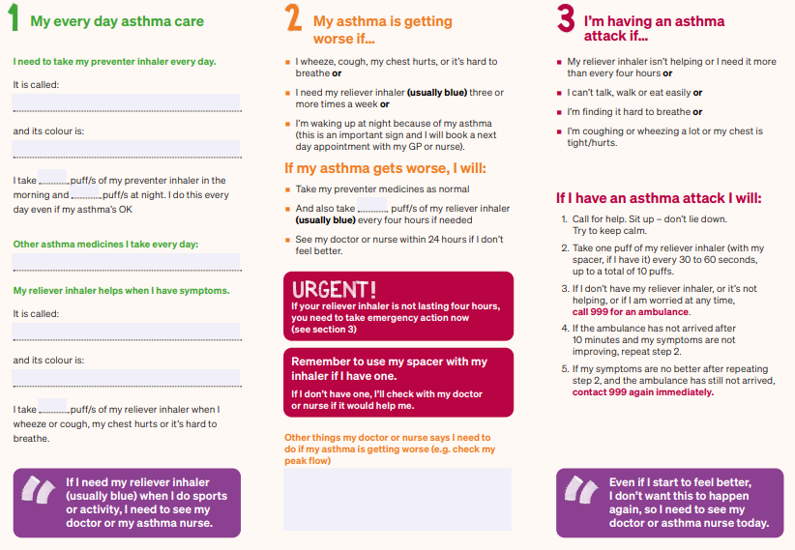
Asthma Care
x90356_GR_cover_p3_cg (beatasthma.co.uk)
childrens-asthma-plan_may22_cc_editable.pdf

Slide 9
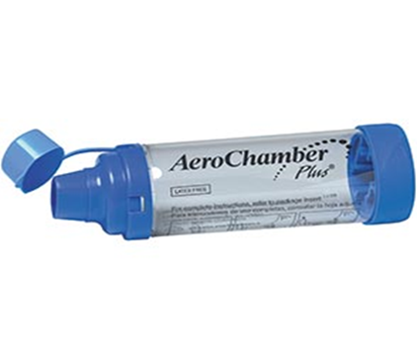
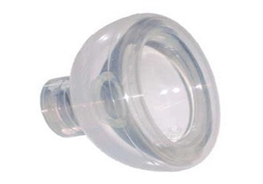
Spacer and Inhaler Techniques

Slide 10
How to use your dry powder inhaler

Slide 11
Stepwise Approach BTS

Slide 12
OPTIMISATION OF MEDICATION

Slide 13
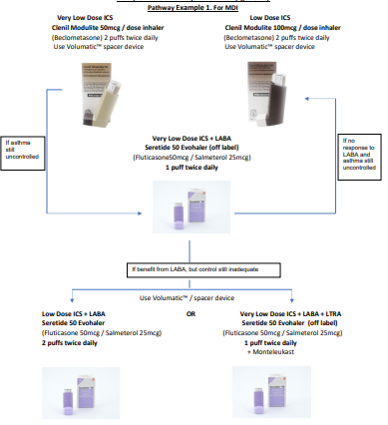
MLCSU (lancsmmg.nhs.uk)

Slide 14
DATA & DIGITAL
PERFORMANCE & INFORMATICS
Highlight PCNs where asthma outcomes are poorest for CYP
Targeted support for these areas where CYP are at increased risk
repeated ED attendances / hospital admissions
multiple prescriptions for inappropriate medications
high use of SABA / repeated doses of steroids or dexamethasone

Slide 15
Risk Stratification Tool - Eclipse
Allows continual live analysis of your patients.
Identifies patients with reversible risk
Provides Centralised Validated Risk Stratification.
Reduces variability by identifying relative strengths and weaknesses.
Enables Central Management of High Risk Cohorts by Medicines Management, Practice Based Pharmacists working closely with practice teams of GPs, Nurses and HCAs
Enables accurate and standardised validation of your projects.

Slide 16
Data and Digital - Eclipse

Slide 17
Eclipse direct contacts:
lucas.vajas@prescribingservices.org
paul@prescribingservices.org
eclipsecypasthma@prescribingservices.org

Slide 18
Data and Digital
DIGITAL TECHNOLOGY
Access for all CYP
Digital Health Passport
funding agreed
personalisation of triggers
air quality notifications
upload, update & share PAAP
emergency interventions eg:AAI

Slide 19
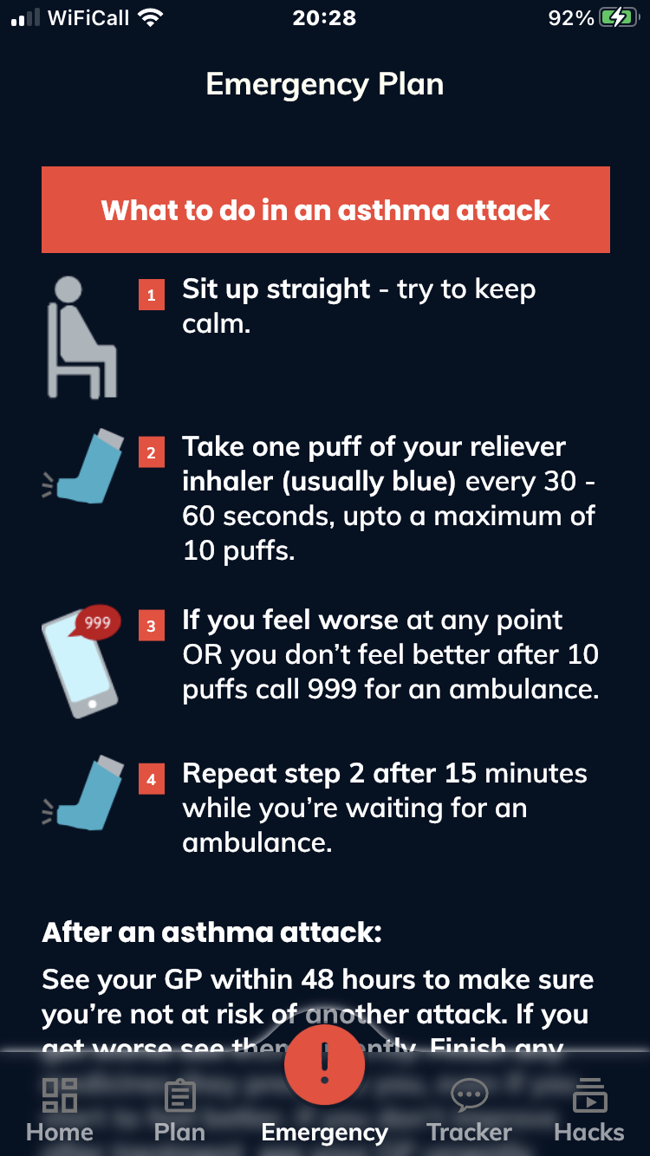
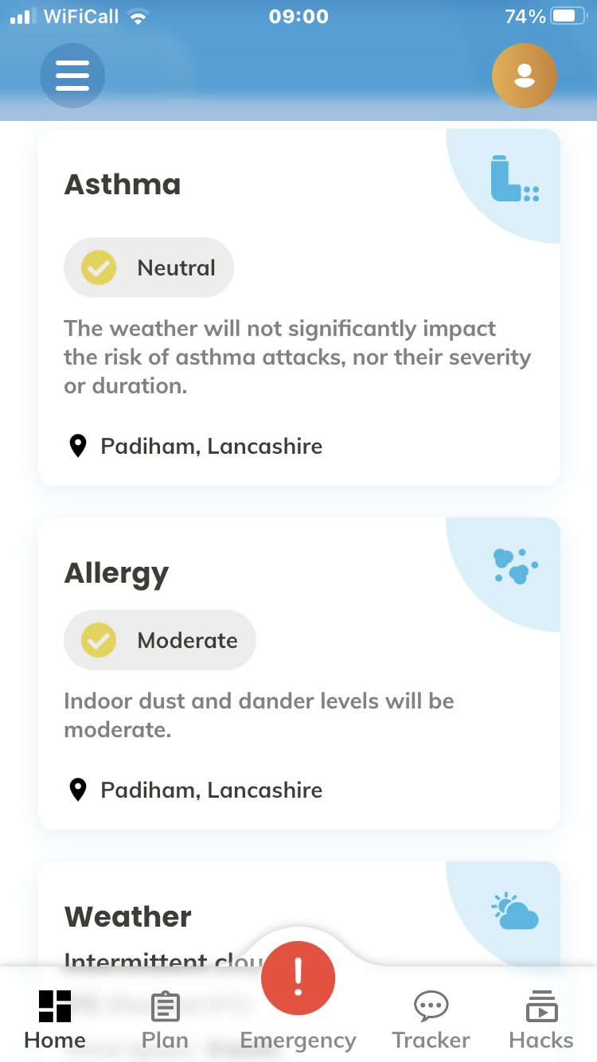
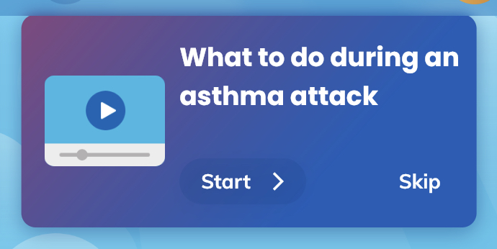
Digital Health Passport

Slide 20
Model of Rollout – Upskilling the workforce & joint working with primary care
Identification of High Risk Children
Early review by practice nurse using Beat Asthma template
Medication review in 4-8 weeks
Liaise with Georgina & Claire for difficult to manage children
Joint working between asthma practitioners & Primary care
https://www.beatasthma.co.uk/wp-content/uploads/2021/03/Annual-Review-Sheet-2021.pdf

Slide 21
USEFUL LINKS
HEE TRAINING:
https://www.e-lfh.org.uk/
BEAT ASTHMA ANNUAL REVIEW:
https://www.beatasthma.co.uk/wp-content/uploads/2021/03/Annual-Review-Sheet-2021.pdf
FENO TOOLKIT AND TRAINING MODULES:
https://wessexahsn.org.uk/programmes/56/feno-fractional-exhaled-nitric-oxide-for-the-diagnosis-and-management-of-asthma
https://wessexahsn.org.uk/projects/422/education-toolkit
INHALER TECHNIQUE:
https://www.asthma.org.uk/advice/inhaler-videos/facemask-child/
https://www.asthma.org.uk/advice/inhaler-videos/child-no-facemask/

Slide 22
Thank you

