Slide 1
Dental Nurse Apprenticeship North West Employer Engagement Webinar
February 2023

Slide 2
Welcome
Housekeeping
Please introduce yourself in the chatbox.
Please remain on mute during the presentations.
We will have opportunities for Q&A at points during the webinar.
Please add questions and comments into the chatbox at any time.
During the Q&A please use the ‘raise hand’ function.
Slides will be shared following the webinar to those who attended.

Slide 3
Welcome
Webinar team
Donna Holden - Regional Dental Dean
Natalie Bradley, Talent for Care Apprenticeship Relationship Manager, HEE NW
Kay Robey and Edward Atkinson - Aspiration Training

Slide 4
Welcome
Agenda
Item |  | Time | Presenter
1 | Welcome and introduction | 1:00pm – 1:05pm | Natalie Bradley
2 | Scene setting | 1:05pm – 1:15pm | Donna Holden
3 | Key considerations for Employers | 1:15pm – 1:30pm | Natalie Bradley
4 | Programme design | 1:30pm – 2:15pm | Aspiration Training
5 | Q&A | 2:15pm – 2:30pm | All

Slide 5
Setting the Scene
Donna Holden - Regional Dental Dean, Health Education England

Slide 6
Current position
Impact of Pandemic
Many dental nurses left the profession
New opportunities led to change in roles
Difficult to recruit
Not a desirable role
Career prospects limited in most dental practices
Low salary
Once qualified - GDC registration, indemnity and maintaining CPD identify additional cost to the individual
Churn in the system
Recycling the same individuals
Unstable workforce impacting on service delivery and patient care

Slide 7
Key information
Level 3 Dental Nurse Apprenticeship was approved for delivery since November 2015.
Details of standard here – Institute for Apprenticeships & Technical Education.
Banding tariff for this apprenticeship is £6,000 (maximum).
Typical duration is 18 months
North west Procurement exercise has taken place, 1 provider, Aspiration training have been awarded the contract for the North West delivery.

Slide 8
Employers – Key Considerations
Natalie Bradley, Talent for Care Apprenticeship Relationship Manager, HEE NW
natalie.bradley@hee.nhs.uk
North West Employer Webinar

Slide 9
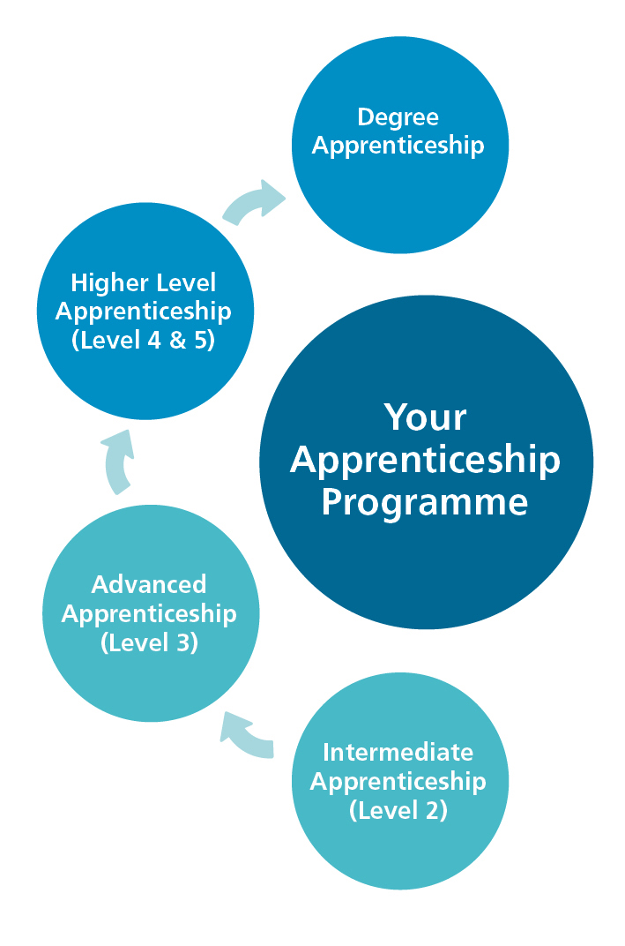
What is an apprenticeship?
An apprenticeship is a job with training.
Apprentices will gain the technical knowledge, practical experience and wider skills and behaviours they need for their immediate job and future career.
The apprentice gains this through formal off-the-job training and the opportunity to practise these new skills in a real work environment.

Slide 10
Employer Commitment
Pay the apprentice
Suitable contract of employment
Off the job learning
Workplace induction
Uniform
Employment checks
Ideally a post available upon completion

Slide 11
Apprenticeship Eligibity
Be able to complete the apprenticeship within contract length
Must not be asked to commit financially to the cost of the apprenticeship training.
Must not use a student loan to pay for any element of their apprenticeship
Must spend at lest 50% of their working hours in England over the duration of their apprenticeship
Have the right to work in England and eligible residency status
Must meet the provider and employer entry criteria

Slide 12
Employer Responsibilities
Apprentice Recruitment
Who is your target audience?
Existing workforce?
New entrants?
Or a mix?
Entry requirements – maths and English
Job Role
Must have a productive purpose
Should provide the apprentice with the opportunity to embed and consolidate the knowledge, skills and behaviours gained through the apprenticeship

Slide 13
Employer Responsibilities
Off-the-Job Training
Off-the-Job Training is a Statutory requirement.
Training which is received by the apprentice, during the apprentice’s normal working hours (paid hours excluding overtime), for the purpose of achieving the knowledge, skills and behaviours of the apprenticeship.
Apprentices must spend at least 6 hours of their working hours doing OTJ training.
Off-the-job training must be directly relevant to the apprenticeship.

Slide 14
Apprenticeship Funding
There are three ways to access funding to pay for apprenticeship training, this funding does not cover salary costs you will have to fund the apprentice’s salary.
1. Apprenticeship Levy | Employers with a pay bill over £3 million each year, pay the apprenticeship levy. Levy paying employers can spend their apprenticeship levy funding on apprenticeship training.
2. Reserve government co-investment | If you don’t pay the apprenticeship levy you can reserve funding, where the government pays 95% of the training costs and the employer pays the remaining 5%.
3. Levy transfers | Levy paying employers can transfer some of their annual levy to other employers. These transfers cover 100% of the training costs of the apprenticeship (you still need to cover salary).

Slide 15
Functional Skills
North West Provision
Basic Key Skills Builder (BKSB)
Helps someone to improve their own skills in maths (numeracy), English (literacy) and IT (digital skills).
To study towards a functional skills exam (e.g., if you want to enrol onto an apprenticeship, or other programme of study that requires the equivalent of a pass at GCSE (grade 4, previously a C grade) in English and maths but do not have this level).
To generally improve competence and confidence, for job satisfaction and retention
To improve quality of care and patient safety.
Contact your L&D department (your organisation may already be signed up).
If they are not, contact hee@bksb.co.uk with the following info: name of employer, details of contact person and anticipated number of learners.
For further details on all of the above, and to arrange your 30-minute consultation, please click on the dedicated webpage here.
North West Quality Framework for Functional Skills
Quality framework for the provision of functional skills learning and exams
Providers quality assessed
For further details contact natalie.bradley@hee.nhs.uk

Slide 16
Q & A opportunity

Slide 17
Apprenticeship information
Aspiration Training
North West Employer Webinar

Slide 18
North-West NHS Employer Brief
Notes:
Welcome everyone to the session and tell them who you are

Slide 19
Welcome
Notes:
Welcome everyone to the session and tell them who you are

Slide 20
20 years
nationwide delivery
3000+ learners on programme
2000+ employers
~200 employees
EPA Excellence
OFSTED Grade 2
Notes:
Welcome everyone to the session and tell them who you are

Slide 21
Programme of Delivery
Notes:
Welcome everyone to the session and tell them who you are

Slide 22
Dental Nurse – Fully Integrated Apprenticeship Stanard - Level 3
Partnership Meetings/Launch Plans and Initial Screening
Group Session & 121 session delivery
End Point Assessment (EPA)
Enrolment, Induction & Learner Journey
Mock assessments & preparation for professional practice
Notes:
Road map
Stages of development
Internal training programs
Induction
Dental nurse apprenticeship training and cpd
Next stage of development
Come and talk
We are now also looking at our next stage of development for our VR environment. Some things in development include be-spoking the product for dental practices to use it as part of induction and internal training programmes
Additional scenarios for use in dental nurse Apprenticeship training and ongoing CDP
Come and talk to me at the end if you are interested in working with us.

Slide 23
On Programme Support
16-month programme, followed by 3 x months End Point Assessment (EPA)
21 x Group Teaching Sessions
14 x 121 Vocational Coach Sessions
4 x planned observations in practice (5 if required)
3 x simulations (2 remote and 1 face to face)
3 x Virtual Reality Training Scenarios delivered as part of observation days
2 x Expert Witness Testimonies
Skills Coach support where Functional Skills required
Additional Learning Support given where required

Slide 24
End Point Assessment
3 Bespoke revision sessions
3 Mock 121 EPA sessions
Gateway meeting with Learner/Manager/Vocational Coach
Knowledge Test (90 minutes) facilitated by Aspiration Training
On site observation (60 minutes & 15 x minutes Q&A) undertaken by an independent assessor at City & Guilds
Interview (45 x minutes) undertaken by an independent assessor at City & Guilds
Results issued for each component within 7 x working days

Slide 25
Virtual Reality
Treatment Scenarios
Developed over the past 2 x years we now have the following treatment scenarios built into our delivery model:
Amalgam Restoration
Surgical extraction (including sutures)
Emergency appointment into temporary restoration
A mix of tutorial scenarios
Notes:
Welcome everyone to the session and tell them who you are

Slide 26
Recruitment and Learner Support
Notes:
Welcome everyone to the session and tell them who you are

Slide 27
Recruiting learners
Vacancies will be handled by our Dental Careers Advisors
To advertised roles, we will require a full job description, hours of work, hourly pay, employer description of setting and any employee benefits
You will need to set your Apprenticeship Service Account permissions to allow Aspiration Training to advertise your vacancy on your behalf
All vacancies will be advertised through Aspiration Training Website, National Apprenticeship Service, Indeed, Google Jobs and Get my First Job

Slide 28
Screening and interviewing learners
Candidates who have applied will be screened and vetted for suitability for the role based on your criteria and the apprenticeship fully explained
Suitable candidates will be sent to local managers for consideration for interview
Interviews with potential candidates will be arranged with local managers at a time suitable for both parties either face to face or on zoom / teams
Feedback will be required for all interviewees attended, and the successful candidate will be notified by telephone and in writing by our Career Advisors
An employment start date and apprenticeship enrolment date will then be agreed

Slide 29
Enrolling learners
Health and Safety Vetting for each setting will be required
The apprentice at enrolment will need their contract of employment, evidence of right to work, certificates of prior attainment in Maths and English or allow us permissions to access their prior learning record, ID evidence and national insurance number
All apprentices will complete a skills assessment prior to enrolment in Maths and English to ascertain current levels
Enrolments will be arranged remotely by our Enrolment Officers on Zoom / Teams with Managers present for all or at least at the end of the enrolment
Enrolments can take 45 mins to 1.5 hours; preparation is key to keeping streamlined

Slide 30
Enrolment requirements
The enrolment will encompass the following:-
Service Agreement
Initial assessment
Additional Learning needs assessment
Apprentice application details
Employer details
Outlining the overview of the apprenticeship standards
Off the job training
Dental code of conduct
Outlining learning plans, responsibilities and commitments by all parties
Setting of the Dental Introductory Workbook with apprentices

Slide 31
Additional learning support
Dyslexia ​
Dyscalculia
​
Autism ​
Asperger’s ​
Education Health Care plan (EHCP) ​
Visual/hearing impairment ​
Emotional/behavioural difficulties
​
Mental health difficulty ​
All learners enrolled onto programme are assessed for additional learning needs as part of the enrolment process.​
​
Where additional learning needs are highlighted a sperate and confidential 121 session takes place with each learner to establish the specific learning needs and to create an Individual Development and Support Plan.
Notes:
Welcome everyone to the session and tell them who you are

Slide 32
Functional Skills
Where learners do not have an English and or Maths Level 2 qualification, they will be expected to undertake these with the support of a designated Skills Coach during the first 8 months of their apprenticeship programme.

Slide 33
Functional Skills Delivery Model
The delivery model consists of the following support mechanisms:
Monthly group sessions
121 support sessions in line with identified additional learning support requirements
An online diagnostic and development platform
It is a gateway requirement for the learner to have completed their Functional Skills qualifications (where required) prior to entering End Point Assessment.​

Slide 34
Quality Assurance
Notes:
Welcome everyone to the session and tell them who you are

Slide 35
Awarding Body
Long standing professional relationship
Regular external quality assurance visits
Awarded Excellence in EPA delivery
Notes:
Welcome everyone to the session and tell them who you are

Slide 36
Quality Assurance Policy - Assessment
In line with Aspiration Training Quality Assurance Policy each apprenticeship portfolio will be quality assured through the following processes:
Formative sampling (during learner journey)
Summative sampling (prior to gateway)
When requested by a learner/employer/coach

Slide 37
Quality Assurance Policy – Vocational Coaches
The Vocational Coach team are quality assured in the following way:
Monthly Standardisation Meetings
Individual development plans
Countersigning if unqualified
Observations against teaching & learning activity

Slide 38
Key People and Contacts
Notes:
Welcome everyone to the session and tell them who you are

Slide 39
Supporting the learner journey
Supporting the learner journey
Vocational Coach – Delivers all 121 sessions, assessment feedback and has overall​ responsibility for the learner journey​
​
Knowledge Coach – Delivers the Group Teaching Sessions as scheduled with each individual learner​
​
Skills Coach – Supports the learner with Functional Skills and identified Additional ​Learning support​
​
Internal Quality Assurer (IQA) - Oversees the progression, quality and integrity of the learner portfolio ​
​

Slide 40
Aspiration Training Vocational Coach
Experience/Qualifications/Regulatory | Equipment Issued
A minimum of 3 x year's, experience as a Dental Nurse | Laptop
CET (Teacher Qualification) | Smartphone
Cava (Assessor Qualification) | Virtual reality headset
4 months CPD per month undertaken | Training Defibrillator
Bespoke Development Plan, undertaken annual | CPR Manikin
GDC registered | Interactive Resource bank
Indemnity Insurance

Slide 41
Key people & contacts
Head of Operations – Edward Atkinson
eatkinson@aspirationtraining.com
Lead Internal Quality Assurer – Bethan Mulchinock
bmulchinock@aspirationtraining.com
Head of Business Development – Kay Robey
krobey@aspirationtraining.com

Slide 42
Thank you

Slide 43
Notes:
Welcome everyone to the session and tell them who you are

Slide 44
Benefits of using Aspiration- provider has been through an employer led procurement – passed high level quality checks
Next steps – EOI to be sent out to all who have attended the session- Contracting Via salisbury – completion of URN form

