Slide 1
30 Days Wild – June 2023
Greener NHS and The Wildlife Trusts
Communications Toolkit – NHS Organisations

Slide 2
Background
As part of the NHS’s 75th Birthday celebrations we are partnering with The Wildlife Trusts to shine a light on the great work of colleagues from across the NHS who have created, maintain and make the best use of our green spaces for the good of patients and staff.
With the aims of –
Promoting the work of colleagues and teams from across the NHS who have created, maintain, and make the best use of our green spaces for the benefit of patients and staff.
Demonstrating how NHS organisations are supporting biodiversity and enhancing green space in a range of ways to support our net zero ambition.
Growing, supporting and fuelling our community of NHS staff to be champions for a Greener NHS within their role, field and location.

Slide 3

Background
The Wildlife Trusts represent 46 individual Wildlife Trusts formed by groups of people getting together and working with others to make a positive difference to wildlife and future generations, starting where they live and work.
30 Days Wild is an annual event from The Wildlife Trusts which takes place every June. People are invited to sign-up and try one ‘random act of wildness’ every day, for 30 days in June.
You find out more at Home | The Wildlife Trusts

Slide 4
Key messages
Having delivered Britain’s first heart transplant in 1958, Europe’s first liver transplant in 1968, the world’s first CT scan on a patient in 1971, and the world’s first test-tube baby born in 1978, the NHS has a proud history of firsts. In October 2020, the NHS became the world’s first health service to commit to reaching carbon net zero, in response to the profound and growing threat to health posed by climate change. As part of the NHS’ 75th Birthday celebrations, the Greener NHS programme at NHS England is partnering with The Wildlife Trusts to shine a light on the great work of colleagues from across the NHS who have created, maintain, and make the best use of green spaces for the benefit of patients, staff and the environment.
There is a substantial body of evidence supporting the value of green spaces to our health, and these spaces are also important for helping to maintain or enhance the wider environment and to support biodiversity. Green spaces and gardens – even as small as pocket parks, street trees, green walls and roof gardens – mediate potential harms posed by the local environment. They can help to reduce exposure to air pollution, reduce urban heat, and mitigate excessive noise and reduce flood risk, all of which impair both physical and mental health, and our ability to deliver health services.
Being regularly exposed to nature, or “nature connectedness” is known to improve health and aid patient recovery. The health benefits of nature exposure are being recognised by health providers and patients to support both inpatient and outpatient mental health recovery in the UK, and there is evidence that in-bed recovery time is around 20% shorter for patients whose view includes greenery.
NHS organisations and teams are working hard to support biodiversity in a range of ways: from rooftop gardens, to allotments, to wildflower meadows. To support our net zero ambition, each trust and integrated care system has a Green Plan laying out how they will help the NHS reach net zero. As part of their green plans, a number of trusts are developing or have developed biodiversity plans to help improve the environment for patients, staff and the public.

Slide 5

Greener NHS activity
We will be focusing engagement on our digital channels through stories, photos and videos, including:
A new video from Manchester University Hospital NHS Foundation Trust, featuring the patient garden in the Stroke Rehabilitation Unit.
Spotlighting NHS gardens and greenspaces across England on our social media channels throughout the month.
Sharing case studies on the Greener NHS Knowledge Hub and in our monthly email bulletin.
Supporting NHS teams, organisations and staff to get involved in 30 Days Wild, and shout about the great work being done at their organisation.

Slide 6
How to get involved!
NHS organisations/teams
Share stories, photos and videos of your gardens and green spaces across your channels.
Get in touch with the Greener NHS team and share the stories from your organisation that you think should be featured on our channels
Post on social media using #30DaysWild and tagging @GreenerNHS and @Wildlife Trusts
NHS staff and volunteers
Sign up to take part in 30 Days Wild, and receive a free pack, with lots of inspiration for activities.
Make your organisation’s green space part of your 30 Days Wild Challenge
Share it on social media using #30DaysWild and tagging @GreenerNHS and @Wildlife Trusts

Slide 7
Sample social media posts
This month we are supporting #30DaysWild and #GreenerNHS to shine a light on the amazing work of our staff who maintain the green spaces at [your organisation] for the good of patients, staff and the environment. ​
Find out more – [link to your organisations page, or The Wildlife Trusts news story (TBC)]
Did you know that being regularly exposed to nature is known to improve health and aid patient recovery?
This month we are supporting #30DaysWild from @WildlifeTrusts to shout out the​ amazing green spaces at [your organisation] and the staff that work hard to maintain them. ​
Find out more – [link to your organisations page, or The Wildlife Trusts news story (TBC)]
#GreenerNHS
As part of the NHS’ 75th Birthday celebrations @GreenerNHS is supporting #30DaysWild from @WildlifeTrusts to shout about some great NHS green spaces! ​
Watch this space for some great stories from [your organisation] throughout June.​
Find out more - – [link to your organisations page, or The Wildlife Trusts news story (TBC)]

Slide 8
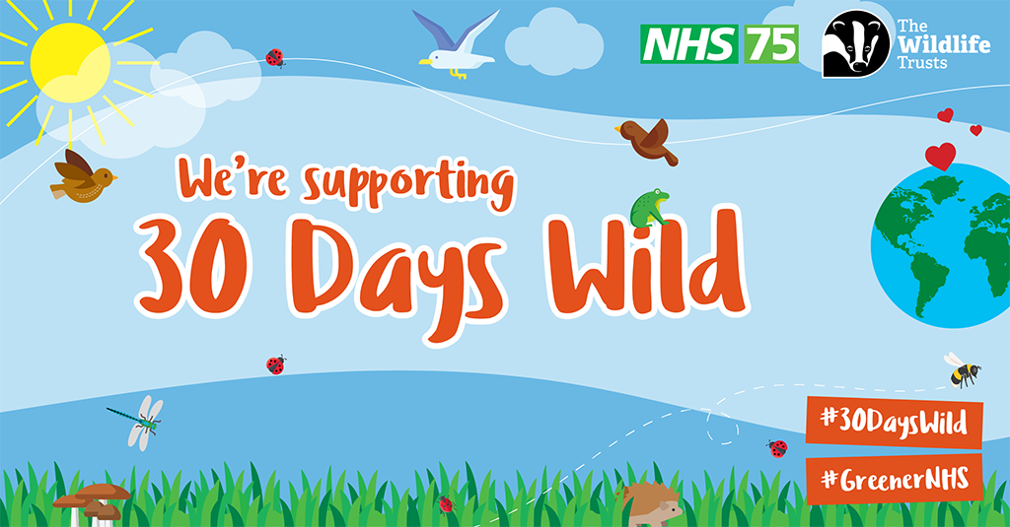
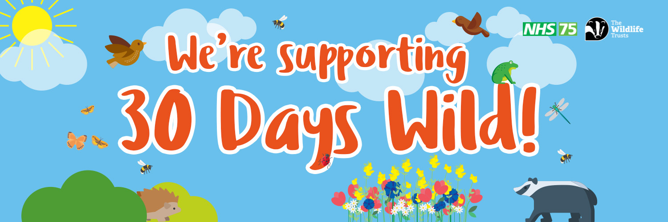
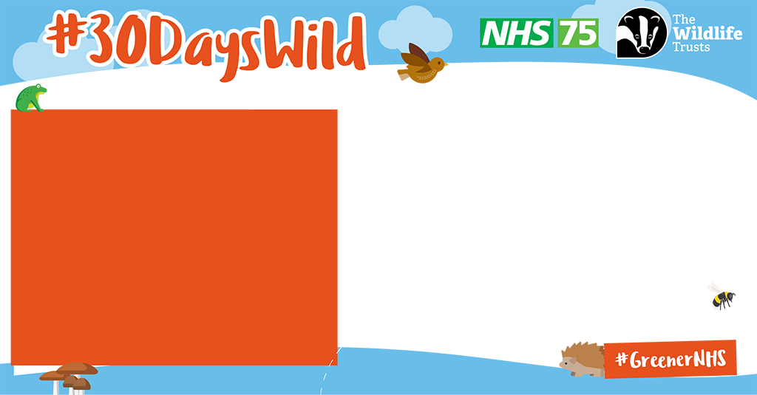
Social media graphics
Social media card to announce support for 30 Days Wild
Social media header to support for 30 Days Wild
A template for photos and quotes
You can download these via 30 Days Wild: Greener NHS and The Wildlife Trusts - Greener NHS Knowledge Hub - FutureNHS Collaboration Platform

Slide 9
Sample short copy
This can be used for bulletins/websites/press releases, depending on your activity.
As part of our 75th birthday celebrations, the NHS is partnering with The Wildlife Trusts throughout June to shine a light on the great work of colleagues who have created, maintain and make the best use of our green spaces for the benefit of patients and staff.
30 Days Wild is an annual event from The Wildlife Trusts which takes place every June and encourages people to spend more time in nature and greenspace. We are supporting this year's campaign to demonstrate how [your organisation] are supporting biodiversity in a range of ways to help improve the environment for patients, staff and the public while also supporting climate change mitigation and adaption.
We are supporting this year's campaign to demonstrate how [your organisation] gardens and green spaces are improving health, aiding patient recovery and supporting staff wellbeing, while improving biodiversity and air quality.
Find out more

Slide 10
Sample long copy
This can be used for bulletins/websites/press releases, depending on your activity.
Having delivered Britain’s first heart transplant in 1958, Europe’s first liver transplant in 1968, the world’s first CT scan on a patient in 1971, and the world’s first test-tube baby born in 1978, the NHS has had many historic firsts. In October 2020, the NHS became the world’s first health service to commit to reaching carbon net zero, in response to the profound and growing threat to health posed by climate change.
As part of the NHS’ 75th Birthday celebrations, the Greener NHS programme at NHS England is partnering with The Wildlife Trusts to shine a light on the great work of colleagues from across the NHS who have created, maintain, and make the best use of green spaces for the good of patients, staff and the environment.
30 Days Wild is an annual event from The Wildlife Trusts which takes place every June. With more than a million participants to date, a record 650,000 people took part in 2020. People are invited to sign-up and try one ‘random act of wildness’ every day, for 30 days in June. Fans join a supportive online community for inspiration, practical advice, and wildlife-watching tips.
We are supporting this year's campaign to demonstrate how [your organisation] gardens and green spaces are improving health, aiding patient recovery and supporting staff wellbeing, while improving biodiversity and air quality.
Find out more

Slide 11
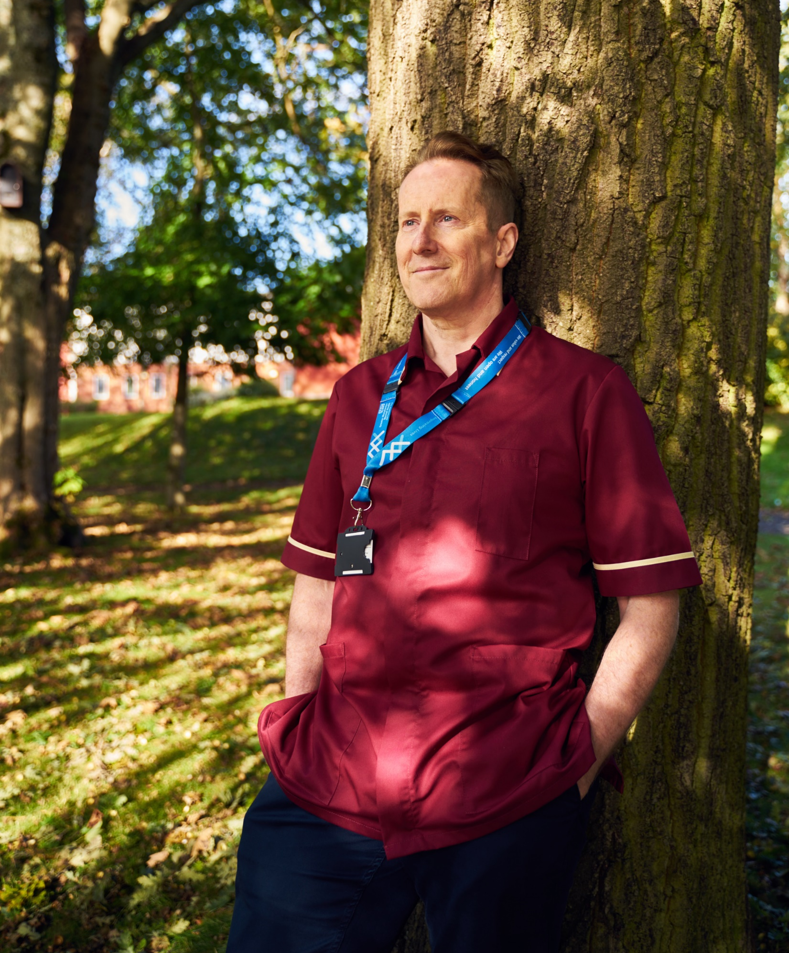
Find out more
Visit the Greener NHS Knowledge Hub on Futures NHS for further information
Reach out to your local Wildlife Trust to see what they are planning
Sign up for 30 Days Wild
Sign up to our newsletter
Follow us on social media
Email - greener.nhs@nhs.net

Slide 12
How can I find out more about Greener NHS?​
​Find out more about the work of the Greener NHS team, and the progress towards the net zero goal:​
​
Visit www.england.nhs.uk/greenernhs​
Sign up to our newsletter – www.england.nhs.uk/email-bulletins/greener-nhs​
Follow us on social media - @GreenerNHS​
E-Learning module from Health Education England ​
The Greener NHS has endorsed this E-Learning Module on Environmentally Sustainable Healthcare, developed by NHS Health Education England and E-Learning for Healthcare, in partnership with the Centre for Sustainable Healthcare.
Carbon Literacy Project
In partnership with the Carbon Literacy Project and E-learning for Healthcare we have developed a new training pathway. Join the webinar on 5 June 2023 - 12:00-13.00 to hear about the brand new, Greener NHS approved Carbon Literacy E-learning Pathway, and how this could benefit you or your team.

