Slide 1
Easy guide on how to navigate PARE

Slide 2
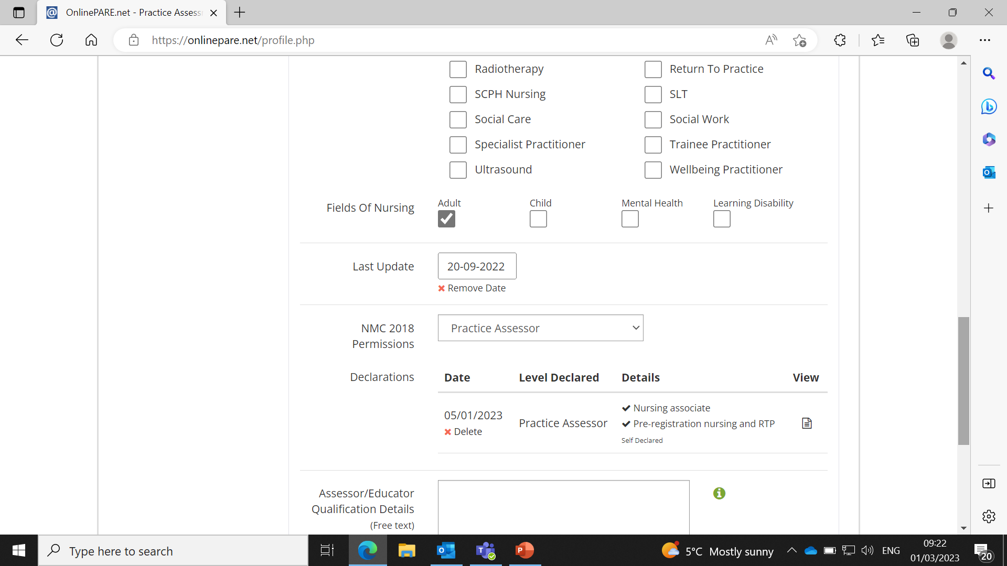
When you log on to PARE, this is the initial screen you will see. Firstly, you should click on ‘view profile’ (on the left)and scroll down to the bottom to sign the self declaration form.
You should also enter the date you received your assessor update training
Signing the self declaration form is a confirmation of the type of students you will be supporting, eg nurse and nurse associates, and also to confirm you meet the NMC requirements to be an assessor.

Slide 3
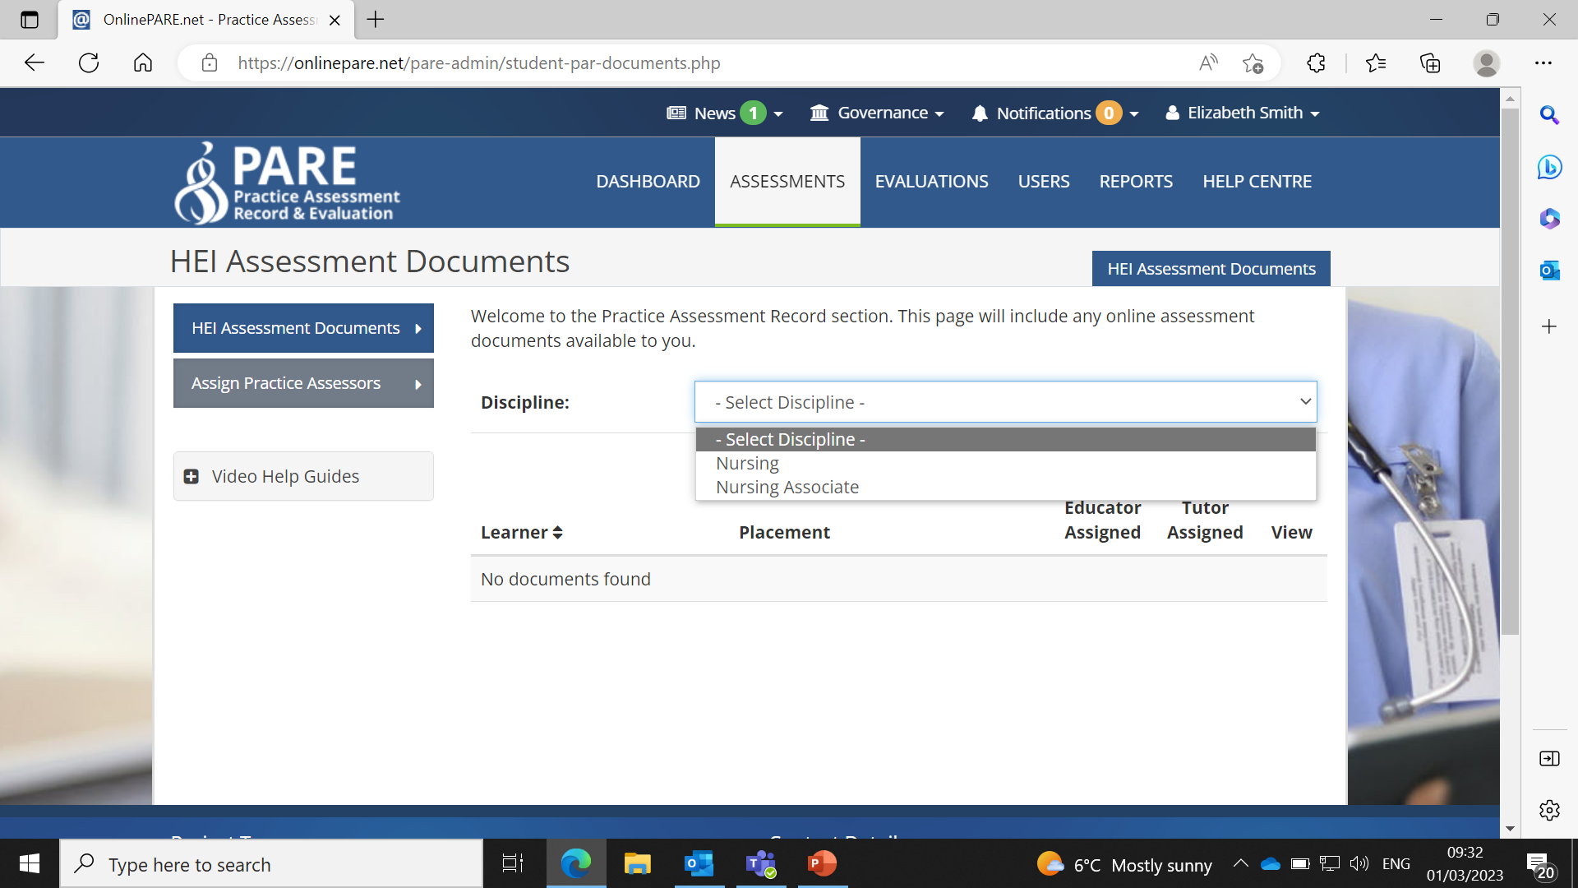
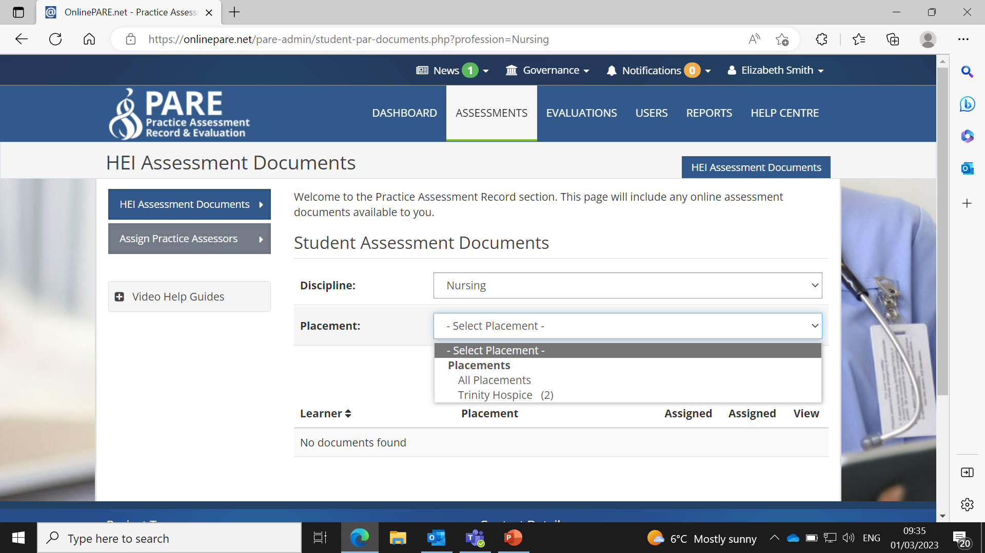
If you then click on assessments at the top of the page, then select discipline and click on either nursing or nurse associate, depending on the type of student you are expecting on placement.
Then, select placement, and in the drop down box it should show your placement area.

Slide 4
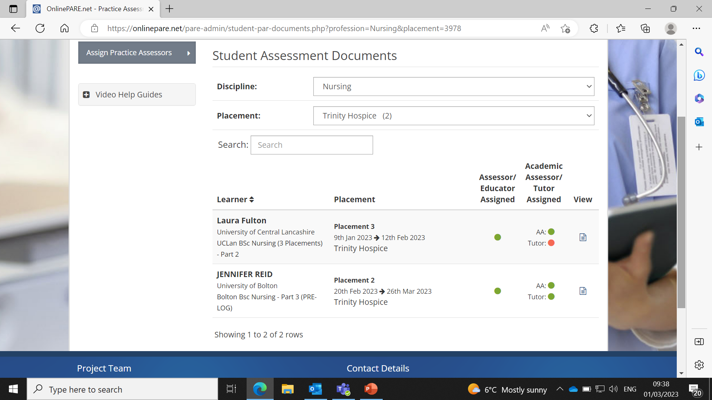
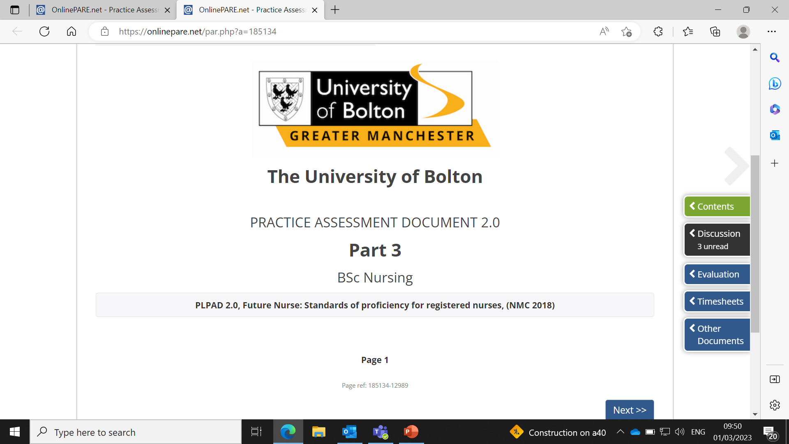
A screen like this should then appear and show the students that have been assigned to your area. The students name, cohort, placement number and dates of placement should be displayed.
You should also be able to see whether they have been assigned an practice assessor, academic assessor and personal tutor.
If you then click the view icon at the side, it will then open you up on to that particular students documents.
Once you have clicked on ‘view’, this page will open and it will state the students details at the top along with who their academic assessor and personal tutor are. This is now the main page from which you will navigate all the documents.

Slide 5
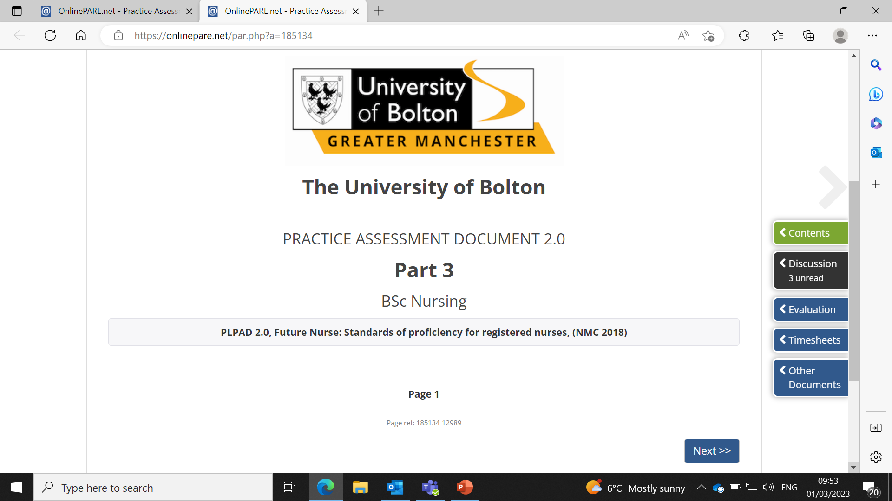
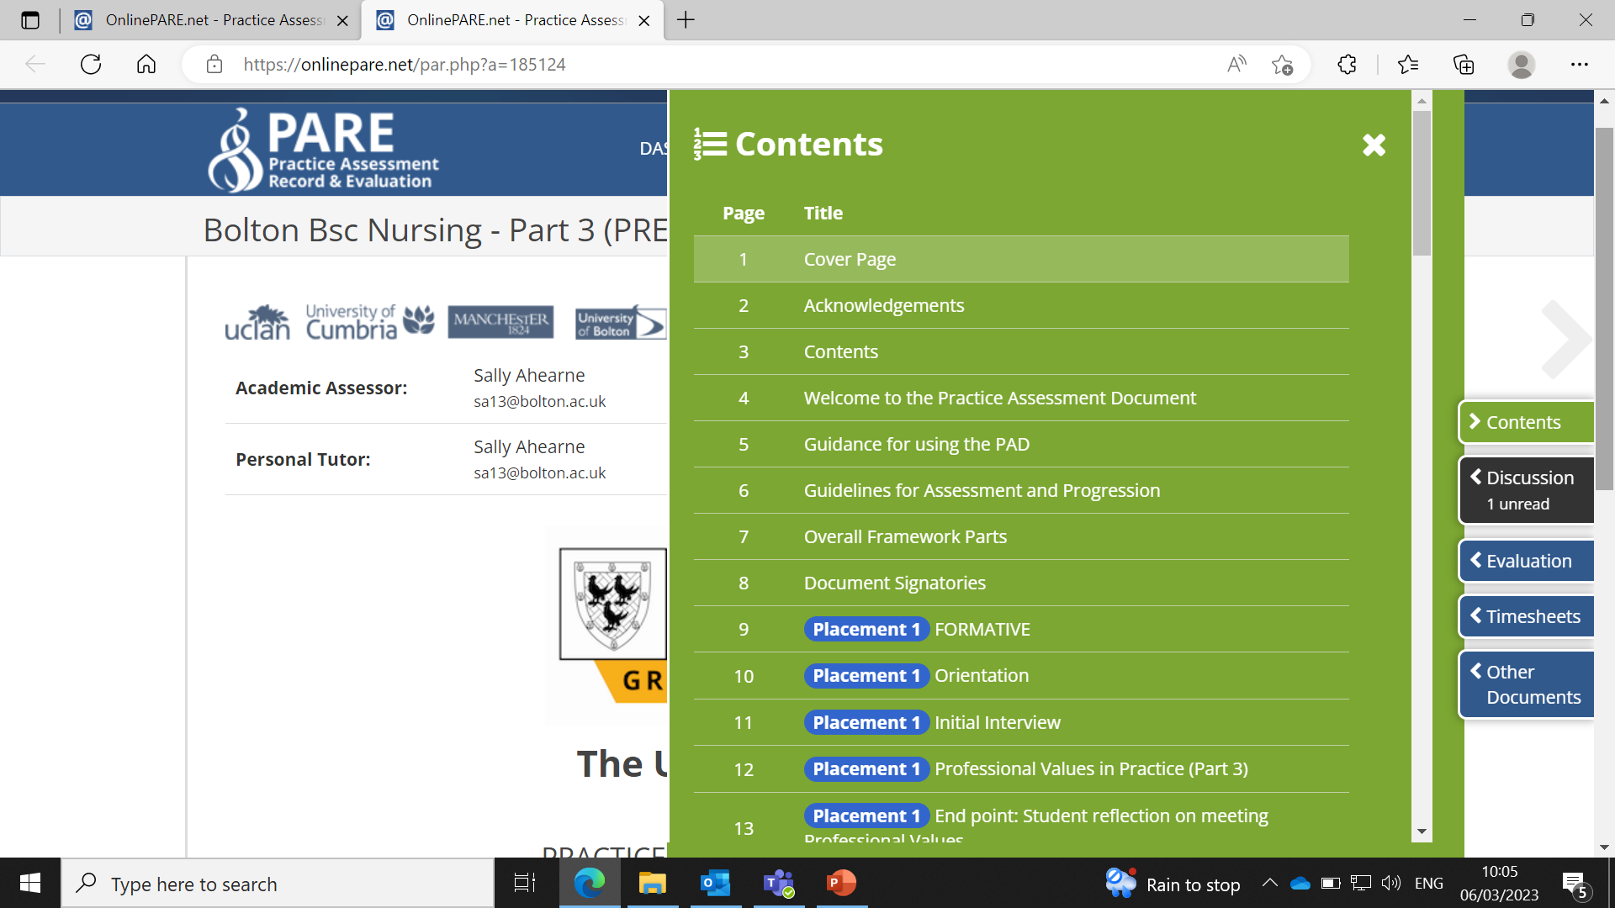
Down the right hand side you can see boxes named: Contents, discussion, evaluation, timesheets and other documents. This is the easiest way to get on to the page you require.
The discussion section is a messaging system, where anyone who has access to the students documents can write a message: such as the academic assessor, personal tutor, PEF, and where the student can then reply to these messages.
Once you click on Contents it will open all the pages that you can then access. The first few pages are information on PARE and guidance on how to use the system.
From page 9 onwards this includes the pages you will need to complete for the placement. As you scroll further you can see all of Placement 1, Placement 2, Placement 3 and Retrieval. Please complete for the correct placement which the student nurses can inform you of.

Slide 6
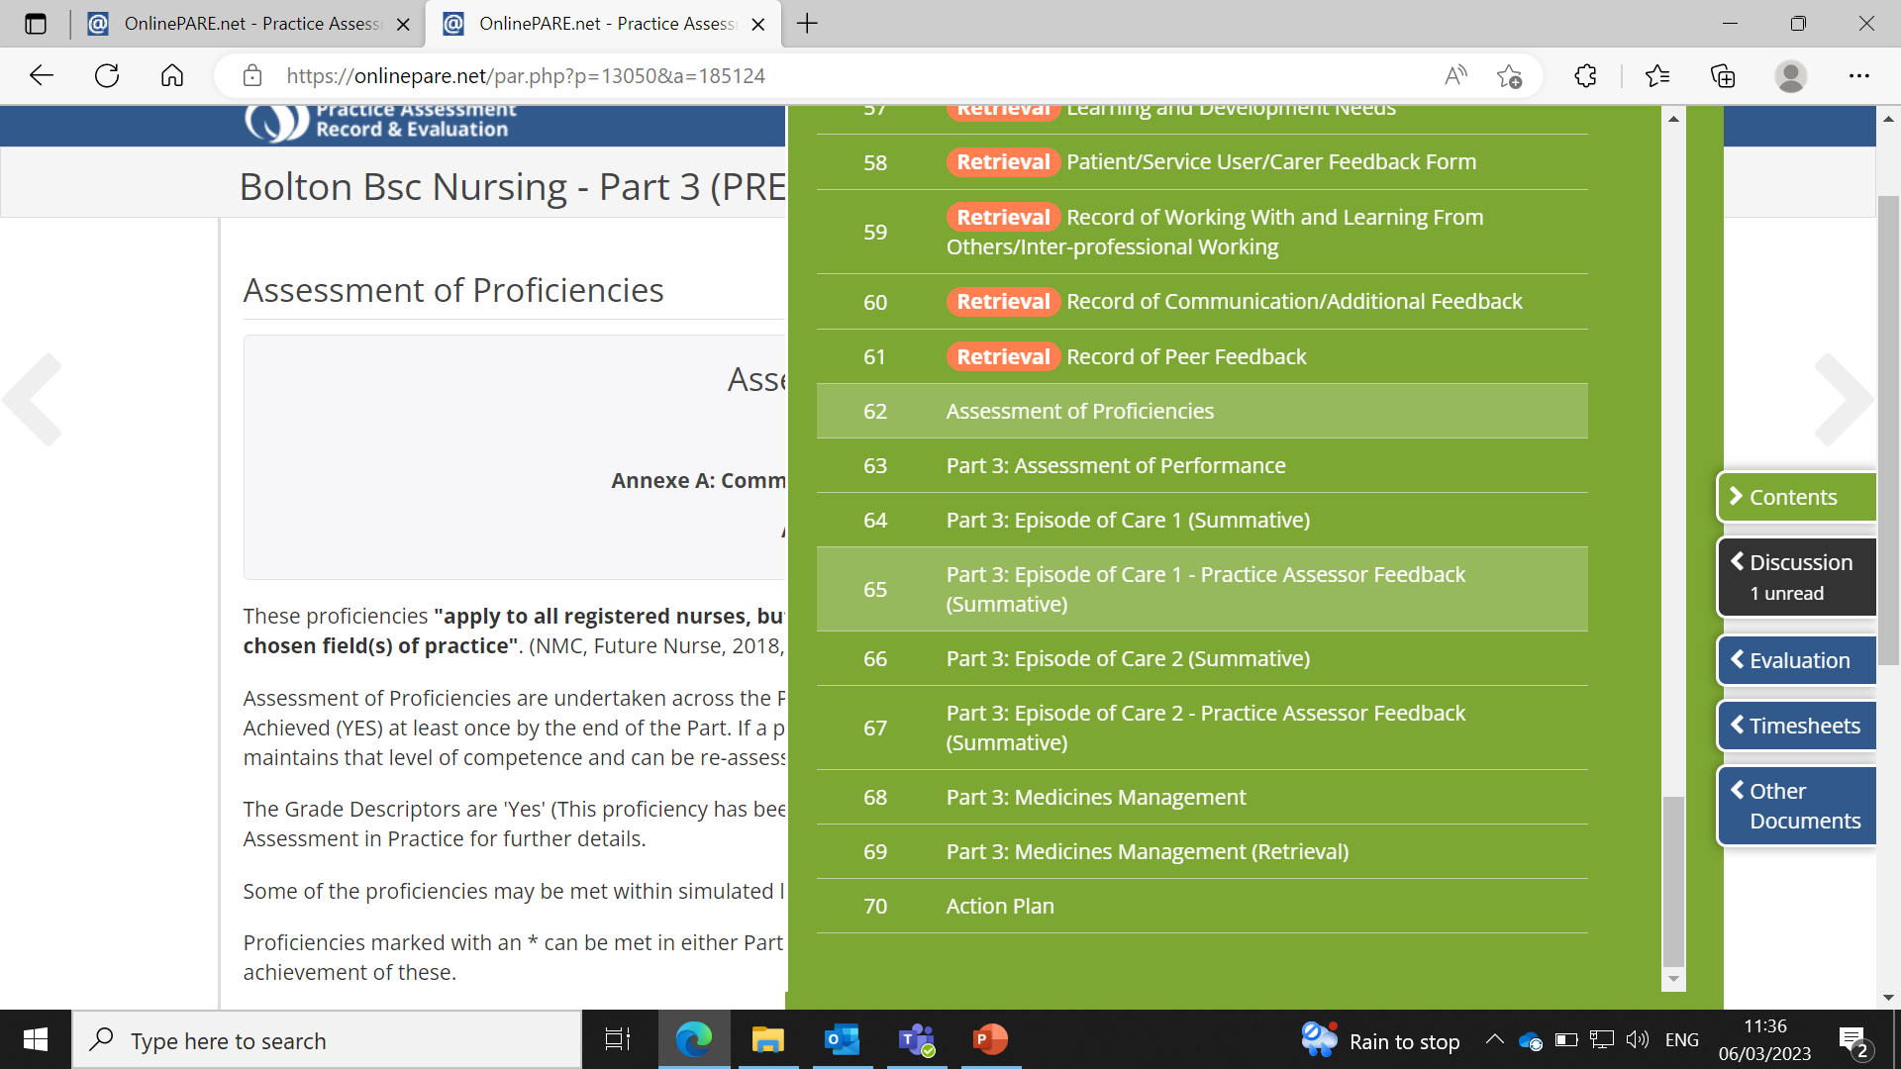
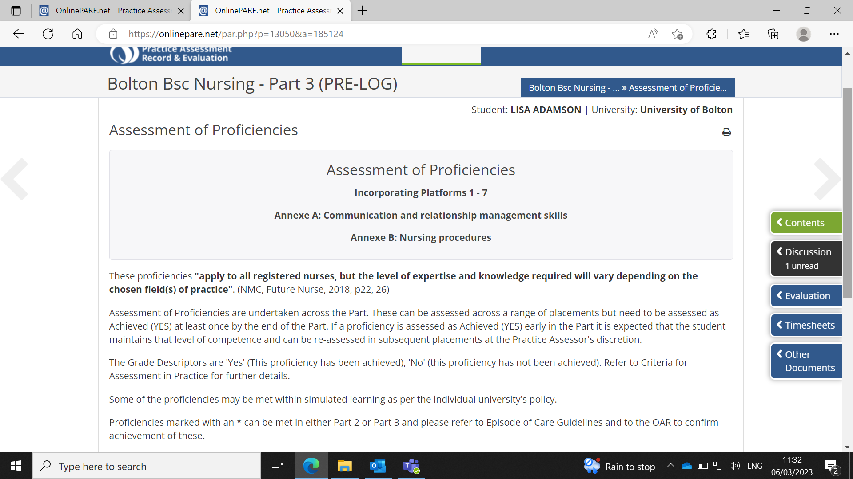
In the Contents tab, once you scroll past all the placements, at the bottom there are then sections on proficiencies, areas to complete solely for Part 3 including assessment of performance, episodes of care 1 and 2 and meds management. And the final tab is to complete an action plan.
If you click on Proficiencies, this is the initial page with details on what to do. Then click on next at the bottom and it opens up all the proficiencies that need to be met.

Slide 7
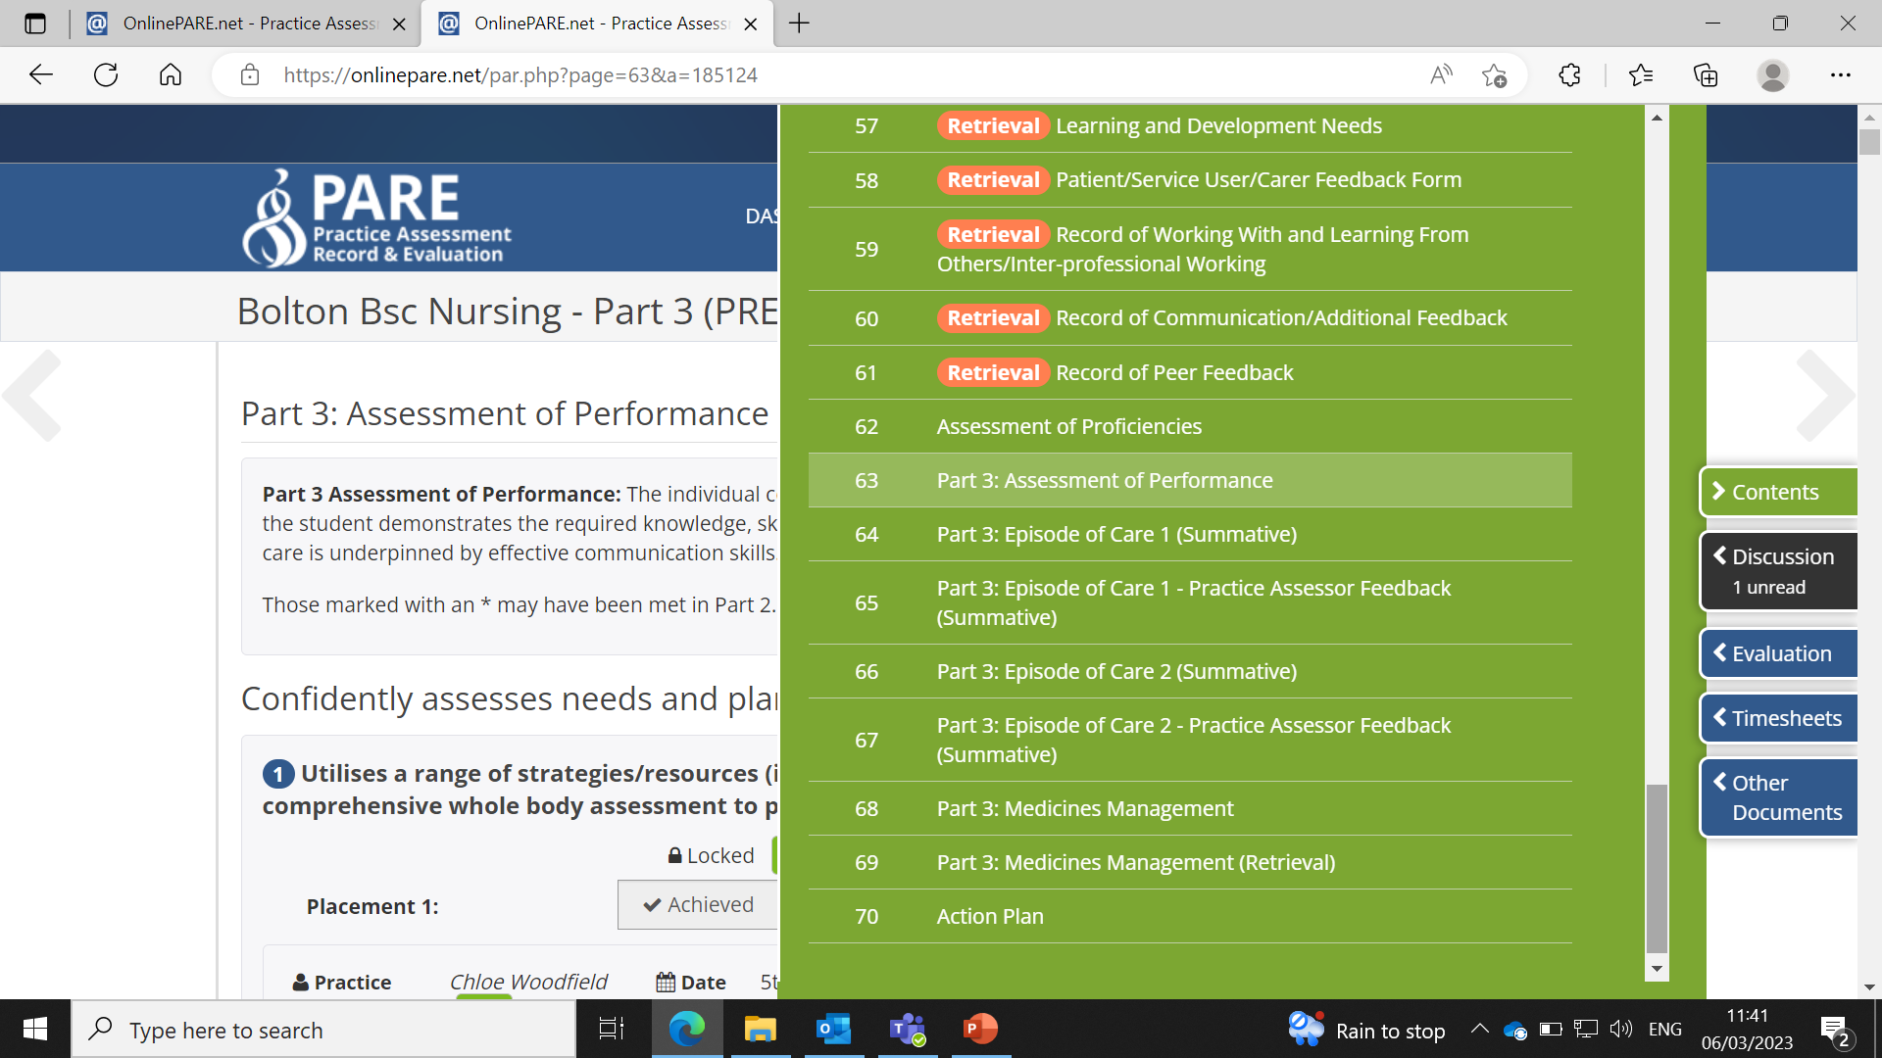
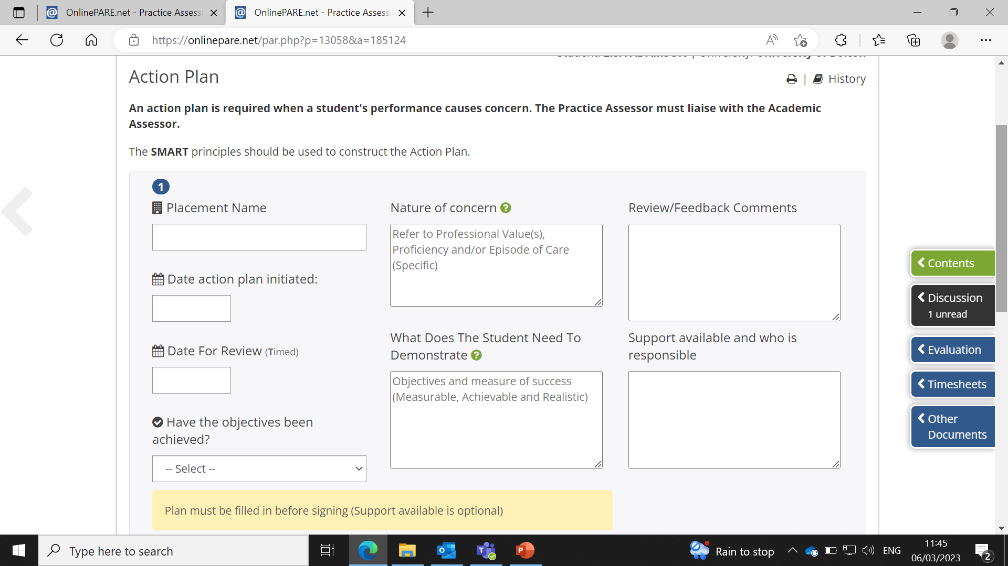
All of the sections labelled Part 3 are just specific for students in their third year of uni. These sections will then need to be completed by the end of their third year. It may be that these sections have been done before they reach you on this placement area.
The final tab is for an action plan. If a student nurse is struggling with a certain aspect of their placement then you can use this section to help provide a clear guide of how this aspect can be achieved (see action plan page to the right).

Slide 8
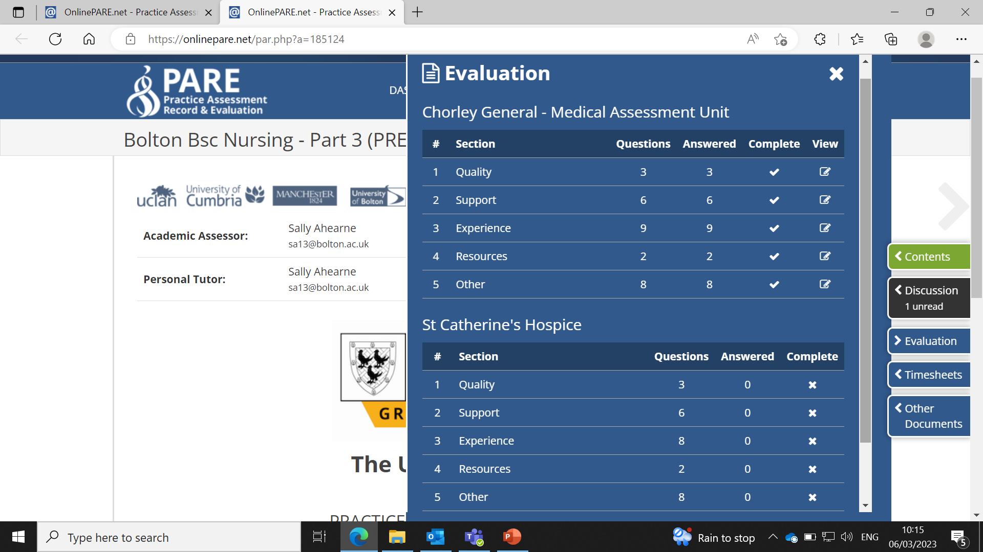
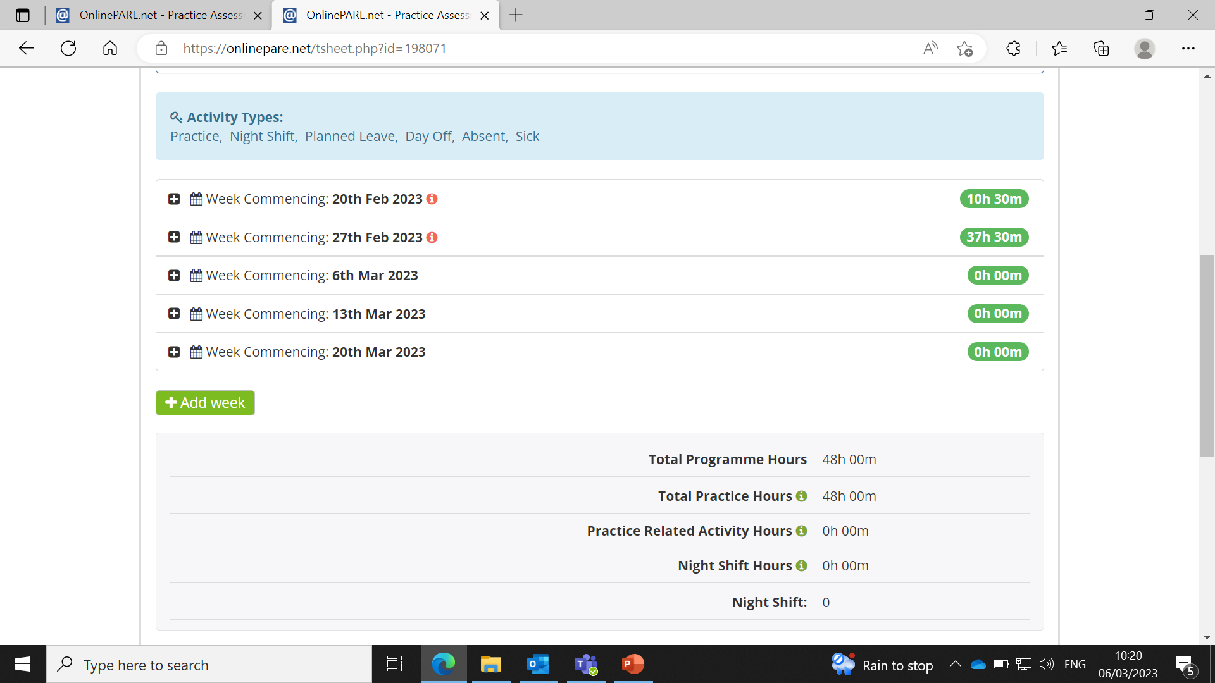
When you click on the Evaluation tab it shows you the names of placements the student has attended and the evaluations for these placements. The completed evaluations are indicated by the ticks in the ‘Completed’ column.
When you click on timesheets, this page should appear showing all weeks that the student nurse will be out on placement. As you click on each + tab, it will open that particular week.

Slide 9
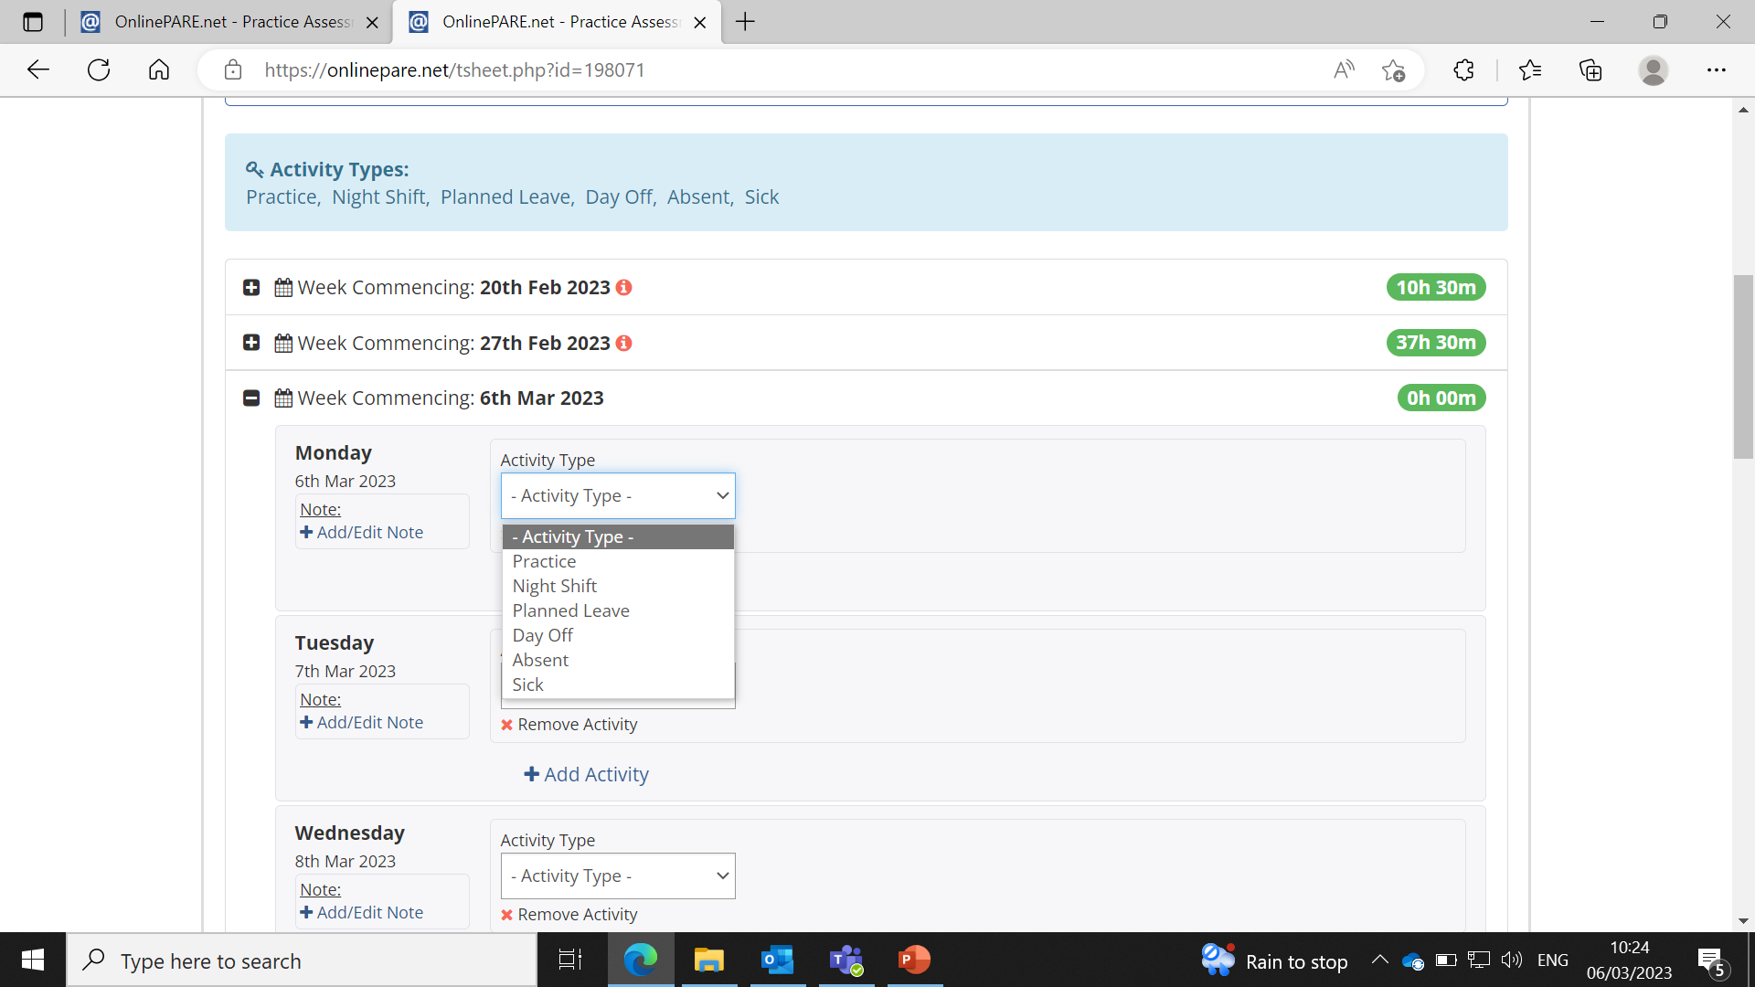
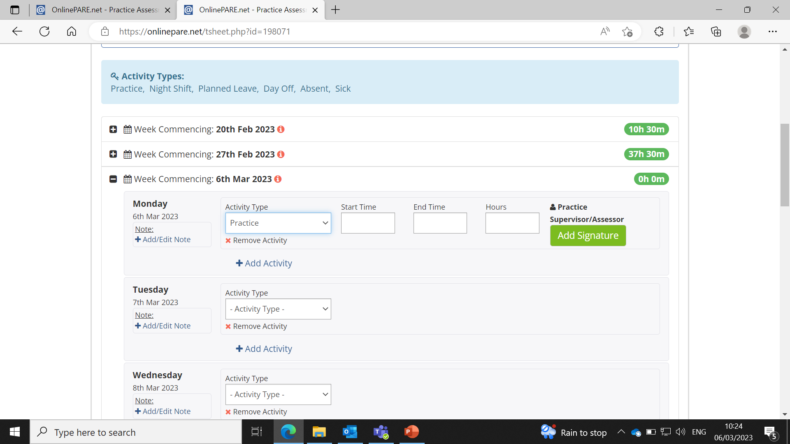
Once you have clicked on + tab it will open each day of the week. Each day needs to be completed. If you click on the Activity Type, it gives you the options of: Practice, Night shift, Planned leave, Day off, absent or sick. You have to choose one of this options and once selected you can fill in the details below.
Complete the start time and end time and it will then automatically calculate the hours. Then click on add signature to sign each day off.

Slide 10
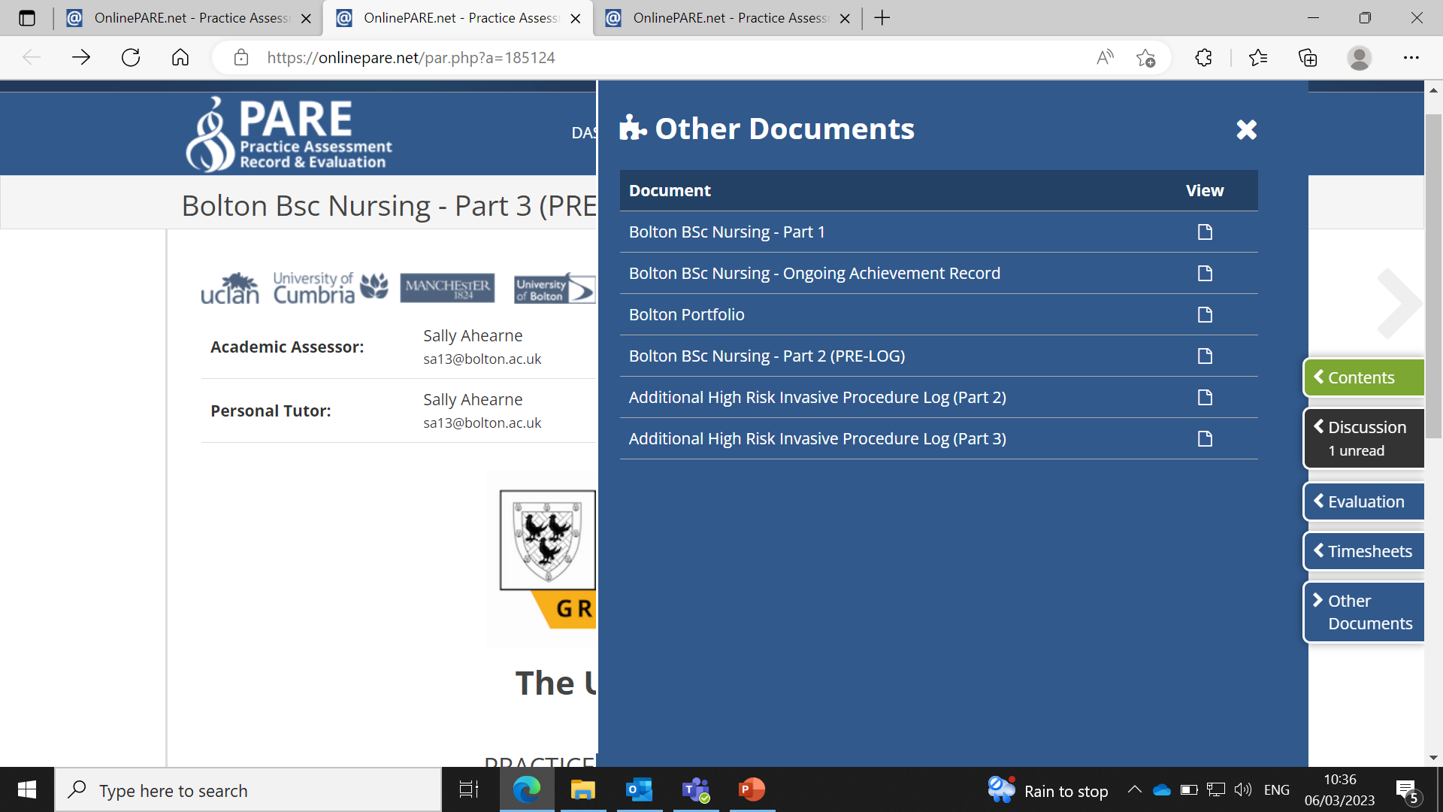
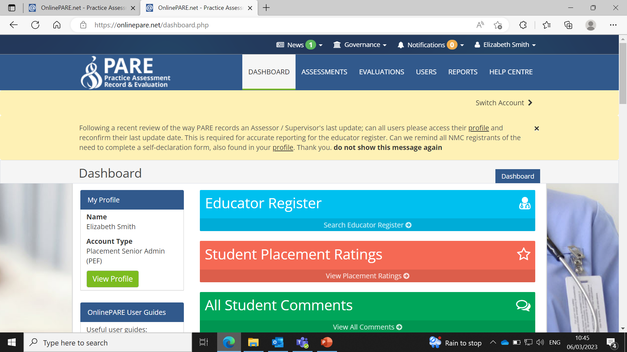
If you then click on ‘Other Documents’ down the right hand side, there is the option to look at the student nurses Ongoing achievement record, portfolio, pre-log and additional procedures. By clicking on the view tabs down the side it will then open each section in a different tab.
If you click back on dashboard, it will then bring you back to the home page. You also have the option to click on the help centre. Here, you can access frequently asked questions and also send a message to the PARE team if you are having an issue that you can’t sort.
It will ask you to ‘Create a support ticket’ at the top of the page and then just follow the options to complete the request.

Slide 11
I hope these slides on how to use PARE helps you to navigate around it easily.
The student nurses that are out on placement will also be able to show you how to use it.
If you need further guidance there is a ‘PARE Userguide’ document we can send through email so please just let us know if you would like this sending.
PEF’s
Ann Brown – ann.brown35@nhs.net
Elizabeth Smith – Elizabeth.smith160@nhs.net

