Slide 1


Social Care Workforce Forum 2023
Liz Williams
Social Care Workforce Programme Lead
Lancashire and South Cumbria ICB
Welcome
www.lscthub.co.uk/socialcare
Notes:
Training with your business in mind
Choosing to develop your workforce through apprenticeships will come with a number of advantages, a huge one being that your apprentices will be building skills that are directly relevant to your business.
Fill the skills gap
Develop and nurture your workforce then you should be in a better position to fill any skills gaps, as and when they arise.
4. A long-term investment
Another significant benefit of apprenticeships, for both employers and employees, is that they can help organisations keep their teams feeling valued, productive and motivated. A member of staff who feels as though they have been invested in by their employer is likely to be more committed to their job and loyal to the company. So not only will you retain the value of your investment for longer, but you will also produce happy, fulfilled team members.
Retain your top talent
If you have Valuable, hard-working employees within your team, then providing opportunities for growth is essential in order to retain them. There is nothing worse than stagnancy for creating an employee with itchy feet and you don’t want your best people looking for opportunities elsewhere. So whether you have a vacancy to fill or not, encouraging the development of your team can be beneficial for everyone involved.
6. Keep costs down
Did you know that the government has funding in place to help with the cost of your apprenticeships? This means that, for small businesses, choosing to up-skill your staff through apprenticeships.
Continuing professional development for existing employees
Employees who feel supported in their professional development are more motivated at work and tend to give more to their jobs. Giving your people the chance to learn new skills will help to boost their satisfaction which is great for them as individuals but also has benefits for you as a business. Research shows that not only are happy employees more productive and perform better, they are also more likely to stay with the company. This is great for businesses looking to improve talent retention (particularly for competitive roles with sought-after skills) and, in turn, enjoy the time and cost savings of not having to recruit to fill roles as often.

Slide 2
Social Care Workforce Forum 2023
Agenda
1-1.20 Welcome and Introduction
Liz Williams Lancashire & South Cumbria ICB
1.30-1.45 Sarah O’Brien
Chief Nursing Officer
Lancashire & South Cumbria ICB
1.50- 2.20 Recruitment
Panel to discuss elements of recruitment and share best practice models
Chair: Ruth Keeler
2.20- 3.10 Coffee & Cake
Marketplace & Networking
3.15-3.45 Retention
Panel to discuss elements of retention: apprenticeships, mentorship, leadership and support
Chair: Adam Purnell
3.50-4.00
Feedback / Next Steps - Liz Williams
4.00-4.30
Networking & Marketplace
Notes:
Training with your business in mind
Choosing to develop your workforce through apprenticeships will come with a number of advantages, a huge one being that your apprentices will be building skills that are directly relevant to your business.
Fill the skills gap
Develop and nurture your workforce then you should be in a better position to fill any skills gaps, as and when they arise.
4. A long-term investment
Another significant benefit of apprenticeships, for both employers and employees, is that they can help organisations keep their teams feeling valued, productive and motivated. A member of staff who feels as though they have been invested in by their employer is likely to be more committed to their job and loyal to the company. So not only will you retain the value of your investment for longer, but you will also produce happy, fulfilled team members.
Retain your top talent
If you have Valuable, hard-working employees within your team, then providing opportunities for growth is essential in order to retain them. There is nothing worse than stagnancy for creating an employee with itchy feet and you don’t want your best people looking for opportunities elsewhere. So whether you have a vacancy to fill or not, encouraging the development of your team can be beneficial for everyone involved.
6. Keep costs down
Did you know that the government has funding in place to help with the cost of your apprenticeships? This means that, for small businesses, choosing to up-skill your staff through apprenticeships.
Continuing professional development for existing employees
Employees who feel supported in their professional development are more motivated at work and tend to give more to their jobs. Giving your people the chance to learn new skills will help to boost their satisfaction which is great for them as individuals but also has benefits for you as a business. Research shows that not only are happy employees more productive and perform better, they are also more likely to stay with the company. This is great for businesses looking to improve talent retention (particularly for competitive roles with sought-after skills) and, in turn, enjoy the time and cost savings of not having to recruit to fill roles as often.

Slide 3











Market Place
Social Care Workforce Forum 2023

Slide 4

Social Care Workforce Forum 2023
Opening Remarks
Sarah O’Brien
ICB Chief Nursing Officer
Notes:
Training with your business in mind
Choosing to develop your workforce through apprenticeships will come with a number of advantages, a huge one being that your apprentices will be building skills that are directly relevant to your business.
Fill the skills gap
Develop and nurture your workforce then you should be in a better position to fill any skills gaps, as and when they arise.
4. A long-term investment
Another significant benefit of apprenticeships, for both employers and employees, is that they can help organisations keep their teams feeling valued, productive and motivated. A member of staff who feels as though they have been invested in by their employer is likely to be more committed to their job and loyal to the company. So not only will you retain the value of your investment for longer, but you will also produce happy, fulfilled team members.
Retain your top talent
If you have Valuable, hard-working employees within your team, then providing opportunities for growth is essential in order to retain them. There is nothing worse than stagnancy for creating an employee with itchy feet and you don’t want your best people looking for opportunities elsewhere. So whether you have a vacancy to fill or not, encouraging the development of your team can be beneficial for everyone involved.
6. Keep costs down
Did you know that the government has funding in place to help with the cost of your apprenticeships? This means that, for small businesses, choosing to up-skill your staff through apprenticeships.
Continuing professional development for existing employees
Employees who feel supported in their professional development are more motivated at work and tend to give more to their jobs. Giving your people the chance to learn new skills will help to boost their satisfaction which is great for them as individuals but also has benefits for you as a business. Research shows that not only are happy employees more productive and perform better, they are also more likely to stay with the company. This is great for businesses looking to improve talent retention (particularly for competitive roles with sought-after skills) and, in turn, enjoy the time and cost savings of not having to recruit to fill roles as often.

Slide 5
CNO Role & Team
CNO Role:
CHC
Reg Care
Safeguarding
Quality & safety
LD&A
CYP
Research
Professional Leadership (Nursing, AHP & Midwifery)
Key Team Members for Care Sector:
Jane Brennan (CHC, care sector, LDA)
Margaret Williams (safeguarding)
Stephen Sandford – Chief AHP
AND:
Jane Green – Chair Social Care Nursing Advisory Council
Notes:
Training with your business in mind
Choosing to develop your workforce through apprenticeships will come with a number of advantages, a huge one being that your apprentices will be building skills that are directly relevant to your business.
Fill the skills gap
Develop and nurture your workforce then you should be in a better position to fill any skills gaps, as and when they arise.
4. A long-term investment
Another significant benefit of apprenticeships, for both employers and employees, is that they can help organisations keep their teams feeling valued, productive and motivated. A member of staff who feels as though they have been invested in by their employer is likely to be more committed to their job and loyal to the company. So not only will you retain the value of your investment for longer, but you will also produce happy, fulfilled team members.
Retain your top talent
If you have Valuable, hard-working employees within your team, then providing opportunities for growth is essential in order to retain them. There is nothing worse than stagnancy for creating an employee with itchy feet and you don’t want your best people looking for opportunities elsewhere. So whether you have a vacancy to fill or not, encouraging the development of your team can be beneficial for everyone involved.
6. Keep costs down
Did you know that the government has funding in place to help with the cost of your apprenticeships? This means that, for small businesses, choosing to up-skill your staff through apprenticeships.
Continuing professional development for existing employees
Employees who feel supported in their professional development are more motivated at work and tend to give more to their jobs. Giving your people the chance to learn new skills will help to boost their satisfaction which is great for them as individuals but also has benefits for you as a business. Research shows that not only are happy employees more productive and perform better, they are also more likely to stay with the company. This is great for businesses looking to improve talent retention (particularly for competitive roles with sought-after skills) and, in turn, enjoy the time and cost savings of not having to recruit to fill roles as often.

Slide 6
Challenges & Opportunities
Pandemic response – build on how all worked together
Integrated partnership working is key for system going forward
Recognise benefits of co-production with care providers
Challenges facing providers & need for a sustainable care market
Strengthening and supporting the social care workforce – system workforce strategies
Retaining and recruiting staff in social care – what can we do together?
Winter response & support need to work as system
Financial challenges – affecting us all – find other ways to sustain & deliver TOGETHER
Notes:
Training with your business in mind
Choosing to develop your workforce through apprenticeships will come with a number of advantages, a huge one being that your apprentices will be building skills that are directly relevant to your business.
Fill the skills gap
Develop and nurture your workforce then you should be in a better position to fill any skills gaps, as and when they arise.
4. A long-term investment
Another significant benefit of apprenticeships, for both employers and employees, is that they can help organisations keep their teams feeling valued, productive and motivated. A member of staff who feels as though they have been invested in by their employer is likely to be more committed to their job and loyal to the company. So not only will you retain the value of your investment for longer, but you will also produce happy, fulfilled team members.
Retain your top talent
If you have Valuable, hard-working employees within your team, then providing opportunities for growth is essential in order to retain them. There is nothing worse than stagnancy for creating an employee with itchy feet and you don’t want your best people looking for opportunities elsewhere. So whether you have a vacancy to fill or not, encouraging the development of your team can be beneficial for everyone involved.
6. Keep costs down
Did you know that the government has funding in place to help with the cost of your apprenticeships? This means that, for small businesses, choosing to up-skill your staff through apprenticeships.
Continuing professional development for existing employees
Employees who feel supported in their professional development are more motivated at work and tend to give more to their jobs. Giving your people the chance to learn new skills will help to boost their satisfaction which is great for them as individuals but also has benefits for you as a business. Research shows that not only are happy employees more productive and perform better, they are also more likely to stay with the company. This is great for businesses looking to improve talent retention (particularly for competitive roles with sought-after skills) and, in turn, enjoy the time and cost savings of not having to recruit to fill roles as often.

Slide 7
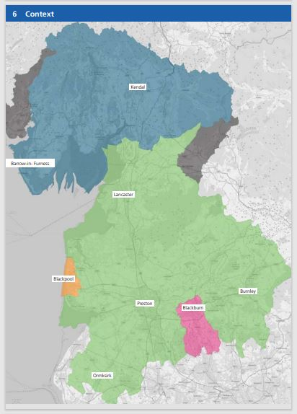
Social Care Workforce Forum 2023
Lancashire and South Cumbria:
Four place-based partnerships
1.7m population
4 Local Authorities
850+ Care providers
46,000 staff (equivalent to NHS staff)
Notes:
Training with your business in mind
Choosing to develop your workforce through apprenticeships will come with a number of advantages, a huge one being that your apprentices will be building skills that are directly relevant to your business.
Fill the skills gap
Develop and nurture your workforce then you should be in a better position to fill any skills gaps, as and when they arise.
4. A long-term investment
Another significant benefit of apprenticeships, for both employers and employees, is that they can help organisations keep their teams feeling valued, productive and motivated. A member of staff who feels as though they have been invested in by their employer is likely to be more committed to their job and loyal to the company. So not only will you retain the value of your investment for longer, but you will also produce happy, fulfilled team members.
Retain your top talent
If you have Valuable, hard-working employees within your team, then providing opportunities for growth is essential in order to retain them. There is nothing worse than stagnancy for creating an employee with itchy feet and you don’t want your best people looking for opportunities elsewhere. So whether you have a vacancy to fill or not, encouraging the development of your team can be beneficial for everyone involved.
6. Keep costs down
Did you know that the government has funding in place to help with the cost of your apprenticeships? This means that, for small businesses, choosing to up-skill your staff through apprenticeships.
Continuing professional development for existing employees
Employees who feel supported in their professional development are more motivated at work and tend to give more to their jobs. Giving your people the chance to learn new skills will help to boost their satisfaction which is great for them as individuals but also has benefits for you as a business. Research shows that not only are happy employees more productive and perform better, they are also more likely to stay with the company. This is great for businesses looking to improve talent retention (particularly for competitive roles with sought-after skills) and, in turn, enjoy the time and cost savings of not having to recruit to fill roles as often.

Slide 8

Social Care Workforce Forum 2023
Recruitment:
Chair: Ruth Keeler, Lancashire and South Cumbria ICB
LSC Careers platform www.nhscareersnw.co.uk
Ray Felters, Lancashire Adult Learning
Caroline Cosh, Clifton Homecare
Ben Turner
Sara Gaskell, Lancashire Skills & Employment Hub

Slide 9


Social Care Workforce Forum 2023
Recruitment – advertise your vacancies on our website
Fill your vacancies through our employability programme
Ruth.keeler@mbht.nhs.uk
Brittany.mollart@mbht.nhs.uk
Notes:
Training with your business in mind
Choosing to develop your workforce through apprenticeships will come with a number of advantages, a huge one being that your apprentices will be building skills that are directly relevant to your business.
Fill the skills gap
Develop and nurture your workforce then you should be in a better position to fill any skills gaps, as and when they arise.
4. A long-term investment
Another significant benefit of apprenticeships, for both employers and employees, is that they can help organisations keep their teams feeling valued, productive and motivated. A member of staff who feels as though they have been invested in by their employer is likely to be more committed to their job and loyal to the company. So not only will you retain the value of your investment for longer, but you will also produce happy, fulfilled team members.
Retain your top talent
If you have Valuable, hard-working employees within your team, then providing opportunities for growth is essential in order to retain them. There is nothing worse than stagnancy for creating an employee with itchy feet and you don’t want your best people looking for opportunities elsewhere. So whether you have a vacancy to fill or not, encouraging the development of your team can be beneficial for everyone involved.
6. Keep costs down
Did you know that the government has funding in place to help with the cost of your apprenticeships? This means that, for small businesses, choosing to up-skill your staff through apprenticeships.
Continuing professional development for existing employees
Employees who feel supported in their professional development are more motivated at work and tend to give more to their jobs. Giving your people the chance to learn new skills will help to boost their satisfaction which is great for them as individuals but also has benefits for you as a business. Research shows that not only are happy employees more productive and perform better, they are also more likely to stay with the company. This is great for businesses looking to improve talent retention (particularly for competitive roles with sought-after skills) and, in turn, enjoy the time and cost savings of not having to recruit to fill roles as often.

Slide 10
Social Care Workforce Forum 2023
Lancashire Adult Learning – Nelson & Colne College Group
Step into Care Programme – 4 weeks
  Focus on progression into employment
  Programme co-created with ICB
  Remove barriers
    Enhanced DBS, employers local to individuals, support from DWP
  Working interview
Britt Mollart - brittany.mollart@mbht.nhs.uk
Notes:
Training with your business in mind
Choosing to develop your workforce through apprenticeships will come with a number of advantages, a huge one being that your apprentices will be building skills that are directly relevant to your business.
Fill the skills gap
Develop and nurture your workforce then you should be in a better position to fill any skills gaps, as and when they arise.
4. A long-term investment
Another significant benefit of apprenticeships, for both employers and employees, is that they can help organisations keep their teams feeling valued, productive and motivated. A member of staff who feels as though they have been invested in by their employer is likely to be more committed to their job and loyal to the company. So not only will you retain the value of your investment for longer, but you will also produce happy, fulfilled team members.
Retain your top talent
If you have Valuable, hard-working employees within your team, then providing opportunities for growth is essential in order to retain them. There is nothing worse than stagnancy for creating an employee with itchy feet and you don’t want your best people looking for opportunities elsewhere. So whether you have a vacancy to fill or not, encouraging the development of your team can be beneficial for everyone involved.
6. Keep costs down
Did you know that the government has funding in place to help with the cost of your apprenticeships? This means that, for small businesses, choosing to up-skill your staff through apprenticeships.
Continuing professional development for existing employees
Employees who feel supported in their professional development are more motivated at work and tend to give more to their jobs. Giving your people the chance to learn new skills will help to boost their satisfaction which is great for them as individuals but also has benefits for you as a business. Research shows that not only are happy employees more productive and perform better, they are also more likely to stay with the company. This is great for businesses looking to improve talent retention (particularly for competitive roles with sought-after skills) and, in turn, enjoy the time and cost savings of not having to recruit to fill roles as often.

Slide 11
Social Care Workforce Forum 2023
Translating UK Care
6-week programme to support international workers in their transition to working in the care sector in the UK
Providing underpinning knowledge required to understand English traditions, values and culture
Aims to improve confidence and empower staff to feel included and able to progress within their role
Commissioned and co-designed by the Social Care Training Hub
4 Care homes
Liz Williams - e.williams18@nhs.net
Notes:
Training with your business in mind
Choosing to develop your workforce through apprenticeships will come with a number of advantages, a huge one being that your apprentices will be building skills that are directly relevant to your business.
Fill the skills gap
Develop and nurture your workforce then you should be in a better position to fill any skills gaps, as and when they arise.
4. A long-term investment
Another significant benefit of apprenticeships, for both employers and employees, is that they can help organisations keep their teams feeling valued, productive and motivated. A member of staff who feels as though they have been invested in by their employer is likely to be more committed to their job and loyal to the company. So not only will you retain the value of your investment for longer, but you will also produce happy, fulfilled team members.
Retain your top talent
If you have Valuable, hard-working employees within your team, then providing opportunities for growth is essential in order to retain them. There is nothing worse than stagnancy for creating an employee with itchy feet and you don’t want your best people looking for opportunities elsewhere. So whether you have a vacancy to fill or not, encouraging the development of your team can be beneficial for everyone involved.
6. Keep costs down
Did you know that the government has funding in place to help with the cost of your apprenticeships? This means that, for small businesses, choosing to up-skill your staff through apprenticeships.
Continuing professional development for existing employees
Employees who feel supported in their professional development are more motivated at work and tend to give more to their jobs. Giving your people the chance to learn new skills will help to boost their satisfaction which is great for them as individuals but also has benefits for you as a business. Research shows that not only are happy employees more productive and perform better, they are also more likely to stay with the company. This is great for businesses looking to improve talent retention (particularly for competitive roles with sought-after skills) and, in turn, enjoy the time and cost savings of not having to recruit to fill roles as often.

Slide 12
Social Care Workforce Forum 2023
Lancashire Adult Learning - Health & Social Care
Supporting recruitment - healthcare, social care, disabilities & counselling
CPD – First Aid & Mental Health First Aid, Food Safety, Moving & Handling
Engage with individuals in Community settings
Online College – range of accredited online learning packages
Find us in the Market place or email: hsc.lal@nelsongroup.ac.uk
Notes:
Training with your business in mind
Choosing to develop your workforce through apprenticeships will come with a number of advantages, a huge one being that your apprentices will be building skills that are directly relevant to your business.
Fill the skills gap
Develop and nurture your workforce then you should be in a better position to fill any skills gaps, as and when they arise.
4. A long-term investment
Another significant benefit of apprenticeships, for both employers and employees, is that they can help organisations keep their teams feeling valued, productive and motivated. A member of staff who feels as though they have been invested in by their employer is likely to be more committed to their job and loyal to the company. So not only will you retain the value of your investment for longer, but you will also produce happy, fulfilled team members.
Retain your top talent
If you have Valuable, hard-working employees within your team, then providing opportunities for growth is essential in order to retain them. There is nothing worse than stagnancy for creating an employee with itchy feet and you don’t want your best people looking for opportunities elsewhere. So whether you have a vacancy to fill or not, encouraging the development of your team can be beneficial for everyone involved.
6. Keep costs down
Did you know that the government has funding in place to help with the cost of your apprenticeships? This means that, for small businesses, choosing to up-skill your staff through apprenticeships.
Continuing professional development for existing employees
Employees who feel supported in their professional development are more motivated at work and tend to give more to their jobs. Giving your people the chance to learn new skills will help to boost their satisfaction which is great for them as individuals but also has benefits for you as a business. Research shows that not only are happy employees more productive and perform better, they are also more likely to stay with the company. This is great for businesses looking to improve talent retention (particularly for competitive roles with sought-after skills) and, in turn, enjoy the time and cost savings of not having to recruit to fill roles as often.

Slide 13
Social Care Workforce Forum 2023
Lancashire Adult Learning - Health & Wellbeing
Health & Well-being in the workplace
Support your workforce and improve morale by offering your employees our wide range of FREE and flexible Workplace Wellbeing sessions
Delivered online or face to face
Mindfulness & Mental Wellbeing • Desk Based Exercise & Yoga • Arts & Crafts for Wellbeing • Confidence Building • Sleep Well • Men's Health • Menopause
Benefits to your business include:
Employee satisfaction and improved wellbeing • Higher levels of performance and increased productivity • Less sickness absence •Retaining star employees • And more!
Find us in the Market place or email: Danielle.thorpe@nelsongroup.ac.uk
Notes:
Training with your business in mind
Choosing to develop your workforce through apprenticeships will come with a number of advantages, a huge one being that your apprentices will be building skills that are directly relevant to your business.
Fill the skills gap
Develop and nurture your workforce then you should be in a better position to fill any skills gaps, as and when they arise.
4. A long-term investment
Another significant benefit of apprenticeships, for both employers and employees, is that they can help organisations keep their teams feeling valued, productive and motivated. A member of staff who feels as though they have been invested in by their employer is likely to be more committed to their job and loyal to the company. So not only will you retain the value of your investment for longer, but you will also produce happy, fulfilled team members.
Retain your top talent
If you have Valuable, hard-working employees within your team, then providing opportunities for growth is essential in order to retain them. There is nothing worse than stagnancy for creating an employee with itchy feet and you don’t want your best people looking for opportunities elsewhere. So whether you have a vacancy to fill or not, encouraging the development of your team can be beneficial for everyone involved.
6. Keep costs down
Did you know that the government has funding in place to help with the cost of your apprenticeships? This means that, for small businesses, choosing to up-skill your staff through apprenticeships.
Continuing professional development for existing employees
Employees who feel supported in their professional development are more motivated at work and tend to give more to their jobs. Giving your people the chance to learn new skills will help to boost their satisfaction which is great for them as individuals but also has benefits for you as a business. Research shows that not only are happy employees more productive and perform better, they are also more likely to stay with the company. This is great for businesses looking to improve talent retention (particularly for competitive roles with sought-after skills) and, in turn, enjoy the time and cost savings of not having to recruit to fill roles as often.

Slide 14

Social Care Workforce Forum 2023
B&FC contact for T levels: Jane Mahon: Careers, Placements and Transition Manager -jane.mahon@blackpool.ac.uk 01253 504018
Requirements: 315 hrs as a minimum that can be split over the 2-year programme. This is employer-led, and can be structured in 'blocks' of time, or 1-2 days per week.
Opportunities -
Keen young people who have a desire to work in the care sector.
Able to provide hands-on support 'for free' for 1-2 years.
Future talent (many T level students become part or full time employees once their placement ends).
Progression to higher or degree apprenticeships (lots of T level students progress from the T Level to degree apprenticeships with their placement employer).
Notes:
Training with your business in mind
Choosing to develop your workforce through apprenticeships will come with a number of advantages, a huge one being that your apprentices will be building skills that are directly relevant to your business.
Fill the skills gap
Develop and nurture your workforce then you should be in a better position to fill any skills gaps, as and when they arise.
4. A long-term investment
Another significant benefit of apprenticeships, for both employers and employees, is that they can help organisations keep their teams feeling valued, productive and motivated. A member of staff who feels as though they have been invested in by their employer is likely to be more committed to their job and loyal to the company. So not only will you retain the value of your investment for longer, but you will also produce happy, fulfilled team members.
Retain your top talent
If you have Valuable, hard-working employees within your team, then providing opportunities for growth is essential in order to retain them. There is nothing worse than stagnancy for creating an employee with itchy feet and you don’t want your best people looking for opportunities elsewhere. So whether you have a vacancy to fill or not, encouraging the development of your team can be beneficial for everyone involved.
6. Keep costs down
Did you know that the government has funding in place to help with the cost of your apprenticeships? This means that, for small businesses, choosing to up-skill your staff through apprenticeships.
Continuing professional development for existing employees
Employees who feel supported in their professional development are more motivated at work and tend to give more to their jobs. Giving your people the chance to learn new skills will help to boost their satisfaction which is great for them as individuals but also has benefits for you as a business. Research shows that not only are happy employees more productive and perform better, they are also more likely to stay with the company. This is great for businesses looking to improve talent retention (particularly for competitive roles with sought-after skills) and, in turn, enjoy the time and cost savings of not having to recruit to fill roles as often.

Slide 15
Social Care Workforce Forum 2023
Feedback from Curriculum Manager for Society, Health and Childhood:
As a T level placement provider:
You can engage with colleges to inform the way they deliver the curriculum, e.g. support them to embed current & good practice from the sector to help drive highly skilled young people to your industry.
"Providing our T Level students with a social care placement alongside a clinical placement has been an invaluable addition to their programme of learning. Exposing students to the broad range of settings, service users and professionals across the breadth of the care sector has meant that our students have developed concrete understanding of the intricacies of the sector's infrastructure, they have been able to recognise the adaptations needed when providing care in different environments, and have garnered a greater appreciation of the interrelationship between the health and social care industries".
Notes:
Training with your business in mind
Choosing to develop your workforce through apprenticeships will come with a number of advantages, a huge one being that your apprentices will be building skills that are directly relevant to your business.
Fill the skills gap
Develop and nurture your workforce then you should be in a better position to fill any skills gaps, as and when they arise.
4. A long-term investment
Another significant benefit of apprenticeships, for both employers and employees, is that they can help organisations keep their teams feeling valued, productive and motivated. A member of staff who feels as though they have been invested in by their employer is likely to be more committed to their job and loyal to the company. So not only will you retain the value of your investment for longer, but you will also produce happy, fulfilled team members.
Retain your top talent
If you have Valuable, hard-working employees within your team, then providing opportunities for growth is essential in order to retain them. There is nothing worse than stagnancy for creating an employee with itchy feet and you don’t want your best people looking for opportunities elsewhere. So whether you have a vacancy to fill or not, encouraging the development of your team can be beneficial for everyone involved.
6. Keep costs down
Did you know that the government has funding in place to help with the cost of your apprenticeships? This means that, for small businesses, choosing to up-skill your staff through apprenticeships.
Continuing professional development for existing employees
Employees who feel supported in their professional development are more motivated at work and tend to give more to their jobs. Giving your people the chance to learn new skills will help to boost their satisfaction which is great for them as individuals but also has benefits for you as a business. Research shows that not only are happy employees more productive and perform better, they are also more likely to stay with the company. This is great for businesses looking to improve talent retention (particularly for competitive roles with sought-after skills) and, in turn, enjoy the time and cost savings of not having to recruit to fill roles as often.

Slide 16



Social Care Workforce Forum 2023
Add your logo
Notes:
Training with your business in mind
Choosing to develop your workforce through apprenticeships will come with a number of advantages, a huge one being that your apprentices will be building skills that are directly relevant to your business.
Fill the skills gap
Develop and nurture your workforce then you should be in a better position to fill any skills gaps, as and when they arise.
4. A long-term investment
Another significant benefit of apprenticeships, for both employers and employees, is that they can help organisations keep their teams feeling valued, productive and motivated. A member of staff who feels as though they have been invested in by their employer is likely to be more committed to their job and loyal to the company. So not only will you retain the value of your investment for longer, but you will also produce happy, fulfilled team members.
Retain your top talent
If you have Valuable, hard-working employees within your team, then providing opportunities for growth is essential in order to retain them. There is nothing worse than stagnancy for creating an employee with itchy feet and you don’t want your best people looking for opportunities elsewhere. So whether you have a vacancy to fill or not, encouraging the development of your team can be beneficial for everyone involved.
6. Keep costs down
Did you know that the government has funding in place to help with the cost of your apprenticeships? This means that, for small businesses, choosing to up-skill your staff through apprenticeships.
Continuing professional development for existing employees
Employees who feel supported in their professional development are more motivated at work and tend to give more to their jobs. Giving your people the chance to learn new skills will help to boost their satisfaction which is great for them as individuals but also has benefits for you as a business. Research shows that not only are happy employees more productive and perform better, they are also more likely to stay with the company. This is great for businesses looking to improve talent retention (particularly for competitive roles with sought-after skills) and, in turn, enjoy the time and cost savings of not having to recruit to fill roles as often.

Slide 17
Social Care Workforce Forum 2023
We Listened to Businesses
Difficult to find out what support is out there.
Haven’t enough time to find out who to talk to and chase them.
Would love to ‘give back’ and work with schools and colleges but don’t know where to start or support your future workforce
You find out about a great project or support on offer and say – why did I not know about this before!
Add your logo
Notes:
Training with your business in mind
Choosing to develop your workforce through apprenticeships will come with a number of advantages, a huge one being that your apprentices will be building skills that are directly relevant to your business.
Fill the skills gap
Develop and nurture your workforce then you should be in a better position to fill any skills gaps, as and when they arise.
4. A long-term investment
Another significant benefit of apprenticeships, for both employers and employees, is that they can help organisations keep their teams feeling valued, productive and motivated. A member of staff who feels as though they have been invested in by their employer is likely to be more committed to their job and loyal to the company. So not only will you retain the value of your investment for longer, but you will also produce happy, fulfilled team members.
Retain your top talent
If you have Valuable, hard-working employees within your team, then providing opportunities for growth is essential in order to retain them. There is nothing worse than stagnancy for creating an employee with itchy feet and you don’t want your best people looking for opportunities elsewhere. So whether you have a vacancy to fill or not, encouraging the development of your team can be beneficial for everyone involved.
6. Keep costs down
Did you know that the government has funding in place to help with the cost of your apprenticeships? This means that, for small businesses, choosing to up-skill your staff through apprenticeships.
Continuing professional development for existing employees
Employees who feel supported in their professional development are more motivated at work and tend to give more to their jobs. Giving your people the chance to learn new skills will help to boost their satisfaction which is great for them as individuals but also has benefits for you as a business. Research shows that not only are happy employees more productive and perform better, they are also more likely to stay with the company. This is great for businesses looking to improve talent retention (particularly for competitive roles with sought-after skills) and, in turn, enjoy the time and cost savings of not having to recruit to fill roles as often.

Slide 18
Social Care Workforce Forum 2023
SKILLS PLEDGE AIMS
One place to support you to find out more about a set of current skills and training support and projects.
Experts will get in touch with you, you only need to sign up to begin the process.
Get recognition for your engagement with the Skills Pledges which contribute to upskilling, recruiting and inspiring the people of Lancashire.
Add your logo
Notes:
Training with your business in mind
Choosing to develop your workforce through apprenticeships will come with a number of advantages, a huge one being that your apprentices will be building skills that are directly relevant to your business.
Fill the skills gap
Develop and nurture your workforce then you should be in a better position to fill any skills gaps, as and when they arise.
4. A long-term investment
Another significant benefit of apprenticeships, for both employers and employees, is that they can help organisations keep their teams feeling valued, productive and motivated. A member of staff who feels as though they have been invested in by their employer is likely to be more committed to their job and loyal to the company. So not only will you retain the value of your investment for longer, but you will also produce happy, fulfilled team members.
Retain your top talent
If you have Valuable, hard-working employees within your team, then providing opportunities for growth is essential in order to retain them. There is nothing worse than stagnancy for creating an employee with itchy feet and you don’t want your best people looking for opportunities elsewhere. So whether you have a vacancy to fill or not, encouraging the development of your team can be beneficial for everyone involved.
6. Keep costs down
Did you know that the government has funding in place to help with the cost of your apprenticeships? This means that, for small businesses, choosing to up-skill your staff through apprenticeships.
Continuing professional development for existing employees
Employees who feel supported in their professional development are more motivated at work and tend to give more to their jobs. Giving your people the chance to learn new skills will help to boost their satisfaction which is great for them as individuals but also has benefits for you as a business. Research shows that not only are happy employees more productive and perform better, they are also more likely to stay with the company. This is great for businesses looking to improve talent retention (particularly for competitive roles with sought-after skills) and, in turn, enjoy the time and cost savings of not having to recruit to fill roles as often.

Slide 19
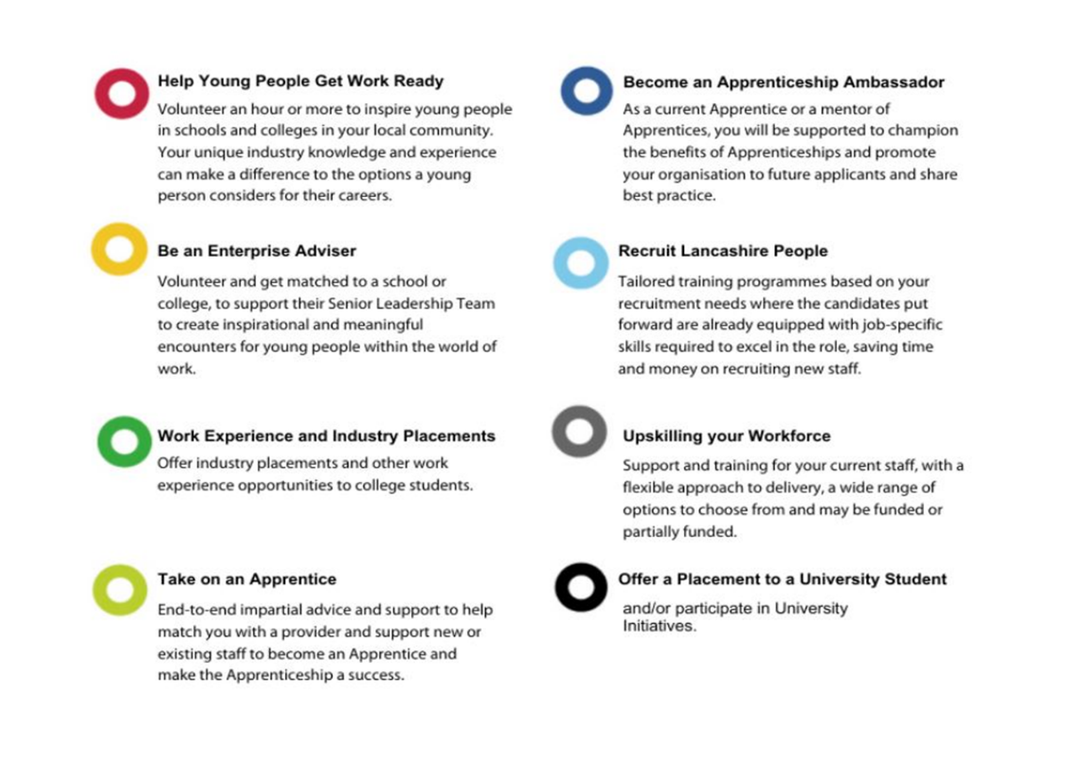

Social Care Workforce Forum 2023
Notes:
Training with your business in mind
Choosing to develop your workforce through apprenticeships will come with a number of advantages, a huge one being that your apprentices will be building skills that are directly relevant to your business.
Fill the skills gap
Develop and nurture your workforce then you should be in a better position to fill any skills gaps, as and when they arise.
4. A long-term investment
Another significant benefit of apprenticeships, for both employers and employees, is that they can help organisations keep their teams feeling valued, productive and motivated. A member of staff who feels as though they have been invested in by their employer is likely to be more committed to their job and loyal to the company. So not only will you retain the value of your investment for longer, but you will also produce happy, fulfilled team members.
Retain your top talent
If you have Valuable, hard-working employees within your team, then providing opportunities for growth is essential in order to retain them. There is nothing worse than stagnancy for creating an employee with itchy feet and you don’t want your best people looking for opportunities elsewhere. So whether you have a vacancy to fill or not, encouraging the development of your team can be beneficial for everyone involved.
6. Keep costs down
Did you know that the government has funding in place to help with the cost of your apprenticeships? This means that, for small businesses, choosing to up-skill your staff through apprenticeships.
Continuing professional development for existing employees
Employees who feel supported in their professional development are more motivated at work and tend to give more to their jobs. Giving your people the chance to learn new skills will help to boost their satisfaction which is great for them as individuals but also has benefits for you as a business. Research shows that not only are happy employees more productive and perform better, they are also more likely to stay with the company. This is great for businesses looking to improve talent retention (particularly for competitive roles with sought-after skills) and, in turn, enjoy the time and cost savings of not having to recruit to fill roles as often.

Slide 20
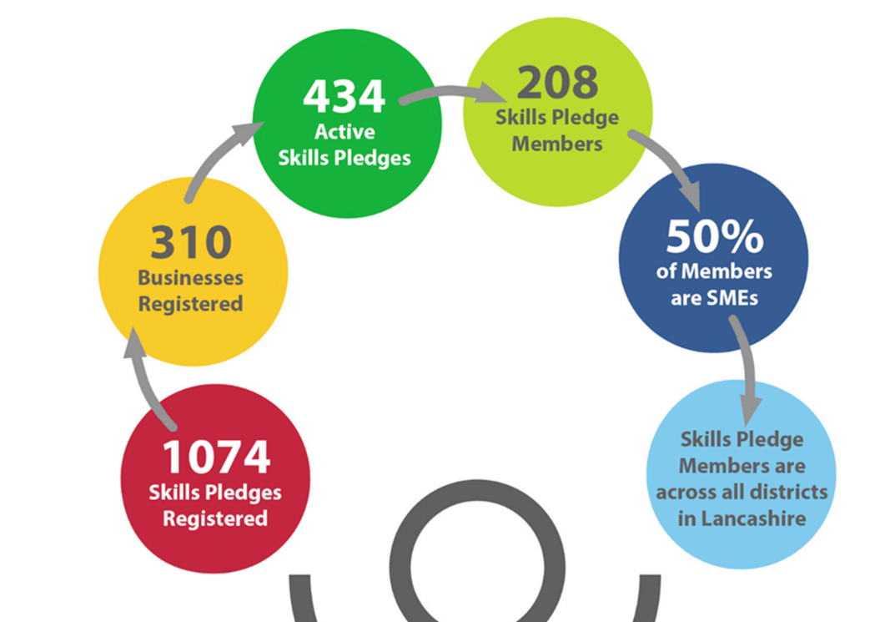
Social Care Workforce Forum 2023
Notes:
Training with your business in mind
Choosing to develop your workforce through apprenticeships will come with a number of advantages, a huge one being that your apprentices will be building skills that are directly relevant to your business.
Fill the skills gap
Develop and nurture your workforce then you should be in a better position to fill any skills gaps, as and when they arise.
4. A long-term investment
Another significant benefit of apprenticeships, for both employers and employees, is that they can help organisations keep their teams feeling valued, productive and motivated. A member of staff who feels as though they have been invested in by their employer is likely to be more committed to their job and loyal to the company. So not only will you retain the value of your investment for longer, but you will also produce happy, fulfilled team members.
Retain your top talent
If you have Valuable, hard-working employees within your team, then providing opportunities for growth is essential in order to retain them. There is nothing worse than stagnancy for creating an employee with itchy feet and you don’t want your best people looking for opportunities elsewhere. So whether you have a vacancy to fill or not, encouraging the development of your team can be beneficial for everyone involved.
6. Keep costs down
Did you know that the government has funding in place to help with the cost of your apprenticeships? This means that, for small businesses, choosing to up-skill your staff through apprenticeships.
Continuing professional development for existing employees
Employees who feel supported in their professional development are more motivated at work and tend to give more to their jobs. Giving your people the chance to learn new skills will help to boost their satisfaction which is great for them as individuals but also has benefits for you as a business. Research shows that not only are happy employees more productive and perform better, they are also more likely to stay with the company. This is great for businesses looking to improve talent retention (particularly for competitive roles with sought-after skills) and, in turn, enjoy the time and cost savings of not having to recruit to fill roles as often.

Slide 21
Social Care Workforce Forum 2023
Benefits for Business
One door to receive support from experts with extensive networks
Funded courses to upskill staff, from bespoke numeracy courses to Skills Bootcamps offering technical training
Support to recruit and widen the recruitment pool
Build a future pipeline of talent
Provides evidence of meeting social value outcomes in Lancashire
External validation of Corporate Social Responsibility activity
Positive publicity for businesses
Gain connections with Lancashire’s Universities
Notes:
Training with your business in mind
Choosing to develop your workforce through apprenticeships will come with a number of advantages, a huge one being that your apprentices will be building skills that are directly relevant to your business.
Fill the skills gap
Develop and nurture your workforce then you should be in a better position to fill any skills gaps, as and when they arise.
4. A long-term investment
Another significant benefit of apprenticeships, for both employers and employees, is that they can help organisations keep their teams feeling valued, productive and motivated. A member of staff who feels as though they have been invested in by their employer is likely to be more committed to their job and loyal to the company. So not only will you retain the value of your investment for longer, but you will also produce happy, fulfilled team members.
Retain your top talent
If you have Valuable, hard-working employees within your team, then providing opportunities for growth is essential in order to retain them. There is nothing worse than stagnancy for creating an employee with itchy feet and you don’t want your best people looking for opportunities elsewhere. So whether you have a vacancy to fill or not, encouraging the development of your team can be beneficial for everyone involved.
6. Keep costs down
Did you know that the government has funding in place to help with the cost of your apprenticeships? This means that, for small businesses, choosing to up-skill your staff through apprenticeships.
Continuing professional development for existing employees
Employees who feel supported in their professional development are more motivated at work and tend to give more to their jobs. Giving your people the chance to learn new skills will help to boost their satisfaction which is great for them as individuals but also has benefits for you as a business. Research shows that not only are happy employees more productive and perform better, they are also more likely to stay with the company. This is great for businesses looking to improve talent retention (particularly for competitive roles with sought-after skills) and, in turn, enjoy the time and cost savings of not having to recruit to fill roles as often.

Slide 22
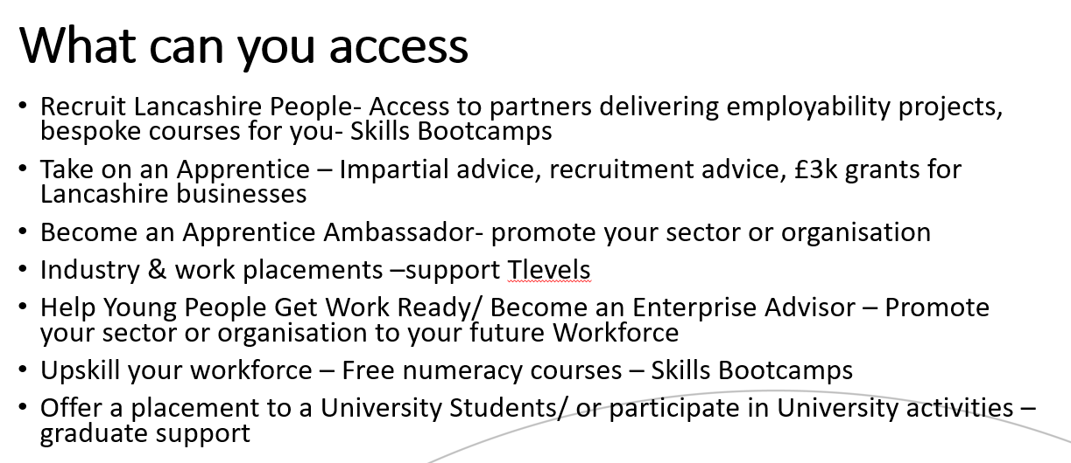
Social Care Workforce Forum 2023
Notes:
Training with your business in mind
Choosing to develop your workforce through apprenticeships will come with a number of advantages, a huge one being that your apprentices will be building skills that are directly relevant to your business.
Fill the skills gap
Develop and nurture your workforce then you should be in a better position to fill any skills gaps, as and when they arise.
4. A long-term investment
Another significant benefit of apprenticeships, for both employers and employees, is that they can help organisations keep their teams feeling valued, productive and motivated. A member of staff who feels as though they have been invested in by their employer is likely to be more committed to their job and loyal to the company. So not only will you retain the value of your investment for longer, but you will also produce happy, fulfilled team members.
Retain your top talent
If you have Valuable, hard-working employees within your team, then providing opportunities for growth is essential in order to retain them. There is nothing worse than stagnancy for creating an employee with itchy feet and you don’t want your best people looking for opportunities elsewhere. So whether you have a vacancy to fill or not, encouraging the development of your team can be beneficial for everyone involved.
6. Keep costs down
Did you know that the government has funding in place to help with the cost of your apprenticeships? This means that, for small businesses, choosing to up-skill your staff through apprenticeships.
Continuing professional development for existing employees
Employees who feel supported in their professional development are more motivated at work and tend to give more to their jobs. Giving your people the chance to learn new skills will help to boost their satisfaction which is great for them as individuals but also has benefits for you as a business. Research shows that not only are happy employees more productive and perform better, they are also more likely to stay with the company. This is great for businesses looking to improve talent retention (particularly for competitive roles with sought-after skills) and, in turn, enjoy the time and cost savings of not having to recruit to fill roles as often.

Slide 23
Social Care Workforce Forum 2023
Website
www.LancashireSkillsPledge.co.uk
Social Media
LinkedIn @Lancashire Skills Pledge
Twitter @LancSkillsHub
#SkillsPledge #UpskillingLancashire #InspiringLancashire
Notes:
Training with your business in mind
Choosing to develop your workforce through apprenticeships will come with a number of advantages, a huge one being that your apprentices will be building skills that are directly relevant to your business.
Fill the skills gap
Develop and nurture your workforce then you should be in a better position to fill any skills gaps, as and when they arise.
4. A long-term investment
Another significant benefit of apprenticeships, for both employers and employees, is that they can help organisations keep their teams feeling valued, productive and motivated. A member of staff who feels as though they have been invested in by their employer is likely to be more committed to their job and loyal to the company. So not only will you retain the value of your investment for longer, but you will also produce happy, fulfilled team members.
Retain your top talent
If you have Valuable, hard-working employees within your team, then providing opportunities for growth is essential in order to retain them. There is nothing worse than stagnancy for creating an employee with itchy feet and you don’t want your best people looking for opportunities elsewhere. So whether you have a vacancy to fill or not, encouraging the development of your team can be beneficial for everyone involved.
6. Keep costs down
Did you know that the government has funding in place to help with the cost of your apprenticeships? This means that, for small businesses, choosing to up-skill your staff through apprenticeships.
Continuing professional development for existing employees
Employees who feel supported in their professional development are more motivated at work and tend to give more to their jobs. Giving your people the chance to learn new skills will help to boost their satisfaction which is great for them as individuals but also has benefits for you as a business. Research shows that not only are happy employees more productive and perform better, they are also more likely to stay with the company. This is great for businesses looking to improve talent retention (particularly for competitive roles with sought-after skills) and, in turn, enjoy the time and cost savings of not having to recruit to fill roles as often.

Slide 24
Social Care Workforce Forum 2023
Tea, Coffee & Cake
Marketplace & networking
Wordsearch
Notes:
Training with your business in mind
Choosing to develop your workforce through apprenticeships will come with a number of advantages, a huge one being that your apprentices will be building skills that are directly relevant to your business.
Fill the skills gap
Develop and nurture your workforce then you should be in a better position to fill any skills gaps, as and when they arise.
4. A long-term investment
Another significant benefit of apprenticeships, for both employers and employees, is that they can help organisations keep their teams feeling valued, productive and motivated. A member of staff who feels as though they have been invested in by their employer is likely to be more committed to their job and loyal to the company. So not only will you retain the value of your investment for longer, but you will also produce happy, fulfilled team members.
Retain your top talent
If you have Valuable, hard-working employees within your team, then providing opportunities for growth is essential in order to retain them. There is nothing worse than stagnancy for creating an employee with itchy feet and you don’t want your best people looking for opportunities elsewhere. So whether you have a vacancy to fill or not, encouraging the development of your team can be beneficial for everyone involved.
6. Keep costs down
Did you know that the government has funding in place to help with the cost of your apprenticeships? This means that, for small businesses, choosing to up-skill your staff through apprenticeships.
Continuing professional development for existing employees
Employees who feel supported in their professional development are more motivated at work and tend to give more to their jobs. Giving your people the chance to learn new skills will help to boost their satisfaction which is great for them as individuals but also has benefits for you as a business. Research shows that not only are happy employees more productive and perform better, they are also more likely to stay with the company. This is great for businesses looking to improve talent retention (particularly for competitive roles with sought-after skills) and, in turn, enjoy the time and cost savings of not having to recruit to fill roles as often.

Slide 25

Social Care Workforce Forum 2023
Retention:
Chair: Adam Purnell, Institute of Health and Social Care Management
Dawn Werra, Lancashire and South Cumbria ICB
India Lee, Ellie Vareli, Risedale Care Homes
Caroline Cosh, Julie Fernandez, Clifton Homecare
Amanda Buchanan, Department for Work & Pensions

Slide 26

Social Care Workforce Forum 2023
Coaching – discussion between coach and coachee – focusing on how the coachee can discover answers for themselves.
Supervision – managers reviewing work and providing support.
Mentorship – relationship between 2 people, where the more experienced person is able to pass on their knowledge and skills to a more junior individual. Helps the junior person to identify opportunities; i.e. career development.
Reverse mentoring – bottom up mentoring; to address cultural shifts; ensuring diversity and inclusion.
Legacy mentoring – something we have always done in social care; shadowing!
Notes:
Training with your business in mind
Choosing to develop your workforce through apprenticeships will come with a number of advantages, a huge one being that your apprentices will be building skills that are directly relevant to your business.
Fill the skills gap
Develop and nurture your workforce then you should be in a better position to fill any skills gaps, as and when they arise.
4. A long-term investment
Another significant benefit of apprenticeships, for both employers and employees, is that they can help organisations keep their teams feeling valued, productive and motivated. A member of staff who feels as though they have been invested in by their employer is likely to be more committed to their job and loyal to the company. So not only will you retain the value of your investment for longer, but you will also produce happy, fulfilled team members.
Retain your top talent
If you have Valuable, hard-working employees within your team, then providing opportunities for growth is essential in order to retain them. There is nothing worse than stagnancy for creating an employee with itchy feet and you don’t want your best people looking for opportunities elsewhere. So whether you have a vacancy to fill or not, encouraging the development of your team can be beneficial for everyone involved.
6. Keep costs down
Did you know that the government has funding in place to help with the cost of your apprenticeships? This means that, for small businesses, choosing to up-skill your staff through apprenticeships.
Continuing professional development for existing employees
Employees who feel supported in their professional development are more motivated at work and tend to give more to their jobs. Giving your people the chance to learn new skills will help to boost their satisfaction which is great for them as individuals but also has benefits for you as a business. Research shows that not only are happy employees more productive and perform better, they are also more likely to stay with the company. This is great for businesses looking to improve talent retention (particularly for competitive roles with sought-after skills) and, in turn, enjoy the time and cost savings of not having to recruit to fill roles as often.

Slide 27
Social Care Workforce Forum 2023
Rachelle Alty - National Preceptorship Programme; Northwest Regional Lead – NHS England
07917 975289
r.alty@nhs.net
Notes:
Training with your business in mind
Choosing to develop your workforce through apprenticeships will come with a number of advantages, a huge one being that your apprentices will be building skills that are directly relevant to your business.
Fill the skills gap
Develop and nurture your workforce then you should be in a better position to fill any skills gaps, as and when they arise.
4. A long-term investment
Another significant benefit of apprenticeships, for both employers and employees, is that they can help organisations keep their teams feeling valued, productive and motivated. A member of staff who feels as though they have been invested in by their employer is likely to be more committed to their job and loyal to the company. So not only will you retain the value of your investment for longer, but you will also produce happy, fulfilled team members.
Retain your top talent
If you have Valuable, hard-working employees within your team, then providing opportunities for growth is essential in order to retain them. There is nothing worse than stagnancy for creating an employee with itchy feet and you don’t want your best people looking for opportunities elsewhere. So whether you have a vacancy to fill or not, encouraging the development of your team can be beneficial for everyone involved.
6. Keep costs down
Did you know that the government has funding in place to help with the cost of your apprenticeships? This means that, for small businesses, choosing to up-skill your staff through apprenticeships.
Continuing professional development for existing employees
Employees who feel supported in their professional development are more motivated at work and tend to give more to their jobs. Giving your people the chance to learn new skills will help to boost their satisfaction which is great for them as individuals but also has benefits for you as a business. Research shows that not only are happy employees more productive and perform better, they are also more likely to stay with the company. This is great for businesses looking to improve talent retention (particularly for competitive roles with sought-after skills) and, in turn, enjoy the time and cost savings of not having to recruit to fill roles as often.

Slide 28


SOCIAL CARE TRAINING HUB APPRENTICESHIPS
Dawn Werra
Project Manager for Social Care Apprenticeship

Slide 29


Project Manager For Social Care Apprenticeships
My Role
Support on the development of apprenticeships expansion in the care sector within Lancashire and South Cumbria
This will involve working in partnership with key stakeholders to develop career pathways for social care staff.
Within my role, I will be promoting opportunities and offering guidance and support to all social care providers
Apprenticeship career pathways available starting from level 2 all the way up to level 7
Funding available including Levy Transfers

Slide 30

Apprenticeships
Apprenticeships are designed to help individuals develop the skills and knowledge required for a rewarding career and employers to build a workforce with future ready skills
Apprenticeships can be used for current staff development and to recruit and develop a new employee
Anyone over the age of 16 can apply for an apprenticeship
An apprenticeship is a job with training.
Through an apprenticeship, an apprentice will gain the technical knowledge, practical experience and wider skills and behaviours that they need for their job and future career
The standards are written by employer-led groups
This puts employers in the driving seat and ensures apprentices' learning is relevant to the workplace

Slide 31
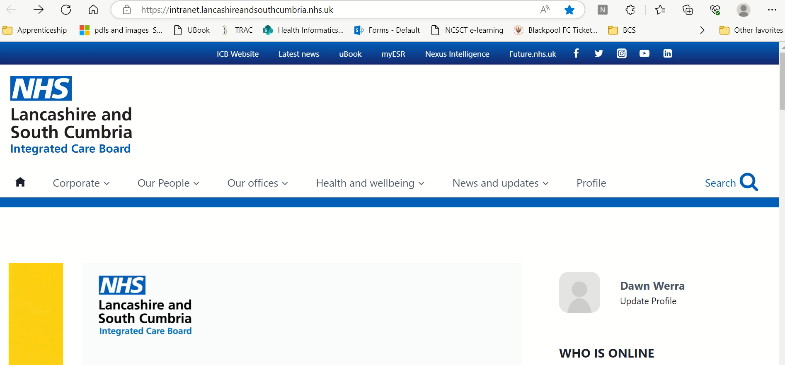
Social Care Training Hub Apprenticeship Website
Social Care Apprenticeships - Lancashire and South Cumbria Training Hub (lscthub.co.uk)

Slide 32
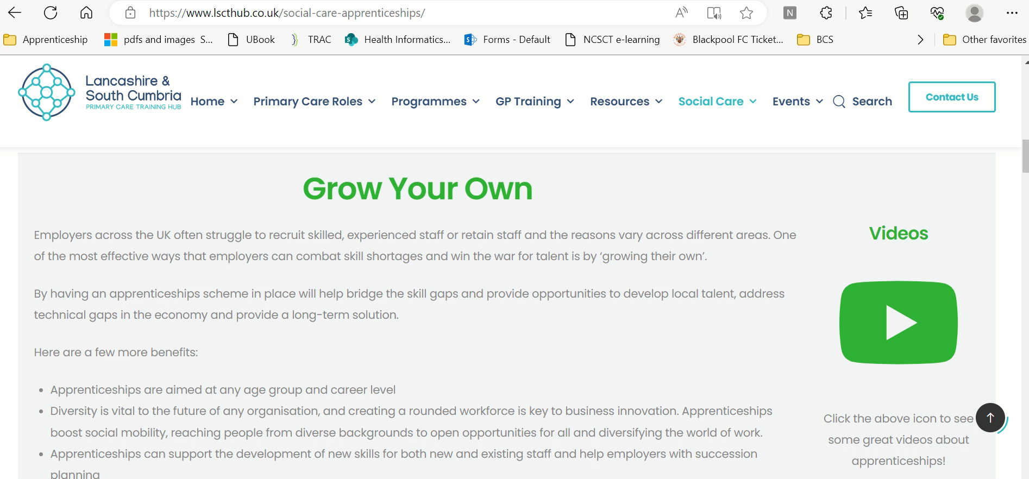
Grow Your Own
One of the most effective ways that employers can combat skill shortages and win the war for talent is by ‘growing their own’.
Benefits
Apprenticeships are aimed at any age group and career level
Tailored training that meets your business needs
Fill the skills gap
A long-term investment -teams feeling valued, productive and motivated
Retain your top talent
Keep costs down – Government funded training
Continuing professional development for existing employees
Apprenticeships are an ideal tool for succession planning
Notes:
Training with your business in mind
Choosing to develop your workforce through apprenticeships will come with a number of advantages, a huge one being that your apprentices will be building skills that are directly relevant to your business.
Fill the skills gap
Develop and nurture your workforce then you should be in a better position to fill any skills gaps, as and when they arise.
4. A long-term investment
Another significant benefit of apprenticeships, for both employers and employees, is that they can help organisations keep their teams feeling valued, productive and motivated. A member of staff who feels as though they have been invested in by their employer is likely to be more committed to their job and loyal to the company. So not only will you retain the value of your investment for longer, but you will also produce happy, fulfilled team members.
Retain your top talent
If you have Valuable, hard-working employees within your team, then providing opportunities for growth is essential in order to retain them. There is nothing worse than stagnancy for creating an employee with itchy feet and you don’t want your best people looking for opportunities elsewhere. So whether you have a vacancy to fill or not, encouraging the development of your team can be beneficial for everyone involved.
6. Keep costs down
Did you know that the government has funding in place to help with the cost of your apprenticeships? This means that, for small businesses, choosing to up-skill your staff through apprenticeships.
Continuing professional development for existing employees
Employees who feel supported in their professional development are more motivated at work and tend to give more to their jobs. Giving your people the chance to learn new skills will help to boost their satisfaction which is great for them as individuals but also has benefits for you as a business. Research shows that not only are happy employees more productive and perform better, they are also more likely to stay with the company. This is great for businesses looking to improve talent retention (particularly for competitive roles with sought-after skills) and, in turn, enjoy the time and cost savings of not having to recruit to fill roles as often.

Slide 33
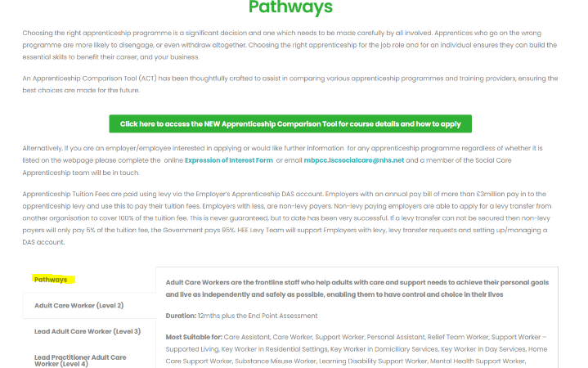
Pathways & Apprenticeship Compassion Tool (ACT)
Choosing the right apprenticeship needs to be made carefully by all involved
There are 15 different routes e.g. Care Services, Health & Science, Catering and Hospitality, Business and Administration, Digital
Each route will have a number of apprenticeship standards to choose from ranging from Level 2 – Level 7
Apprenticeship Comparison Tool (ACT) has been designed to assist you in comparing various apprenticeship programmes and training providers, ensuring the best choices
Adult Care Worker
Level 2
Lead Adult Care Worker
Level 3
Lead Practitioner in Adult Care
Level 4
Leader in Adult Care
Level 5
Nursing Associate or Assistant Practitioner Level 5
Registered Nurse Level 6
Occupational Therapist
Level 6
Learning and Skills Mentor
Level 4

Slide 34

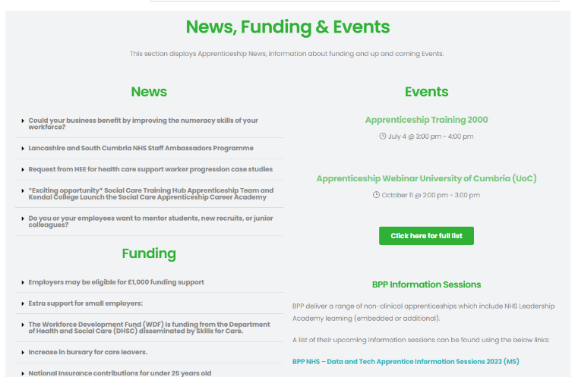

Other Sections

Slide 35









Lancashire and South Cumbria
Apprenticeship Awards 2023
Let's Share Success!
We invite you to be involved, where you can highlight the remarkable work from your talented apprentices, supportive employers and the mentors who have wholeheartedly supported them throughout their journey
Join us as we proudly showcase the profound impact apprenticeship programs have in the Social Care sector
Notes:
Here, you'll can provide heartfelt words of recognition, captivating images capturing their invaluable roles, and even the proud moments of your apprentices clutching their well-deserved apprenticeship certificates or awards.

Slide 36
Social Care Workforce Forum 2023
How Universal Credit can help support your business
Notes:
Training with your business in mind
Choosing to develop your workforce through apprenticeships will come with a number of advantages, a huge one being that your apprentices will be building skills that are directly relevant to your business.
Fill the skills gap
Develop and nurture your workforce then you should be in a better position to fill any skills gaps, as and when they arise.
4. A long-term investment
Another significant benefit of apprenticeships, for both employers and employees, is that they can help organisations keep their teams feeling valued, productive and motivated. A member of staff who feels as though they have been invested in by their employer is likely to be more committed to their job and loyal to the company. So not only will you retain the value of your investment for longer, but you will also produce happy, fulfilled team members.
Retain your top talent
If you have Valuable, hard-working employees within your team, then providing opportunities for growth is essential in order to retain them. There is nothing worse than stagnancy for creating an employee with itchy feet and you don’t want your best people looking for opportunities elsewhere. So whether you have a vacancy to fill or not, encouraging the development of your team can be beneficial for everyone involved.
6. Keep costs down
Did you know that the government has funding in place to help with the cost of your apprenticeships? This means that, for small businesses, choosing to up-skill your staff through apprenticeships.
Continuing professional development for existing employees
Employees who feel supported in their professional development are more motivated at work and tend to give more to their jobs. Giving your people the chance to learn new skills will help to boost their satisfaction which is great for them as individuals but also has benefits for you as a business. Research shows that not only are happy employees more productive and perform better, they are also more likely to stay with the company. This is great for businesses looking to improve talent retention (particularly for competitive roles with sought-after skills) and, in turn, enjoy the time and cost savings of not having to recruit to fill roles as often.

Slide 37


Slide 38
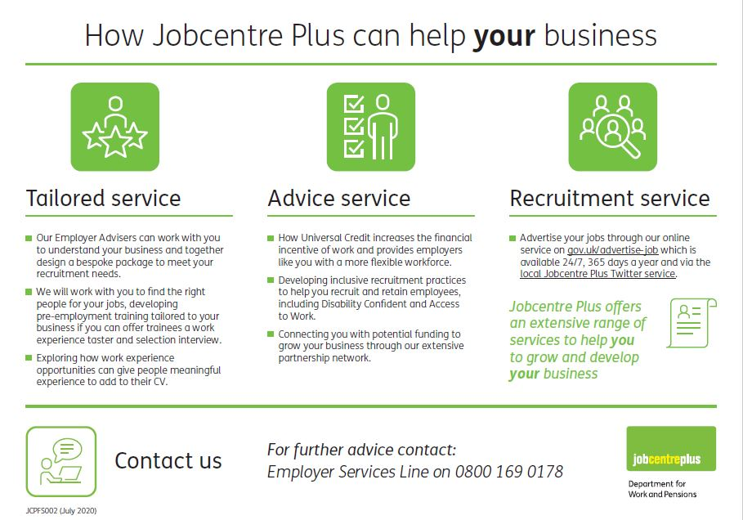

Slide 39
In-Work Progression: Engagement with Employers
February 2023
The Department for Work and Pensions is committed to supporting Universal Credit Claimants at a time of cost-of-living pressures. We want everyone to be able to find a job, progress in work and thrive in the labour market, whoever they are and wherever they live.
Claimant Journey
What is the In-Work Progression Offer?
Our intention is to support those with a very low incomes from work to help them access opportunities to increase their earnings. This will be done through supportive conversations and activities at a pace that suits the circumstances of our claimants, who may have caring responsibilities, health conditions or other barriers.
The support is currently available on a voluntary basis for certain UC claimants and is provided by Jobcentre Plus work coaches. From September 2023 onwards, we will start to require some claimants to engage with this support.
There will be no one-size-fits-all approach, and no claimant will be expected to change jobs if it is not in their best interests. Instead, the work coach will provide tailored support to claimants, to help them understand the steps they can take in the short and medium term to increase their earnings.
Who are the District Progression Leads?
We are currently rolling out a network of thirty-seven Progression Leads, one in each Jobcentre Plus District in Great Britain. They will spearhead the Department’s new focus on supporting working Universal Credit claimants to progress in work and increase their earnings.
District Progression Leads will work with key partners, including local government, employers, and skills providers to identify and develop local progression opportunities, and to overcome barriers that limit progression of employees.
Employer Support | District Progression Lead | Claimant Support | Work Coaches
District Progression Leads are there to help employers consider new and practical working practices to aid employee progression, enhancing existing employee retention rates and attracting new staff. They can help them think creatively about how to support their staff – for example, if additional hours or upward progression opportunities are not immediately available, employers could consider re-designing the claimant’s existing role to make it more stretching and fulfilling, giving them additional skills and experience to add to their CV. | Work Coaches understand their claimant’s unique circumstances and how best to support them. If there are no opportunities for a claimant to increase their earnings in their current job or sector, then other options could be explored, such as re-training in order to enter a company/sector with better progression opportunities or finding a job with better pay or more hours on offer. For some, the focus will be on developing skills or confidence in the first instance. ​
Progression Lead is Amanda Buchanan contact on amanda.buchanan@dwp.gov.uk

Slide 40

Older workers are a huge asset to our country and our economy. We aim to support them to get into work. An age-inclusive workforce makes business sense too.
Our 50 PLUS Champions will work with leading employers across the country to connect job-ready people with the vast number of opportunities out there.
DWP is also supporting older jobseekers, delivering the Jobcentre Mid-Life MOT service which supports people to take stock and make plans for their work, wealth and well-being into the future.
Flexible working. Working in a flexible way can be a good bridge into retirement for individuals. Offering flexible working can be a good way for you to keep your older employees’ valuable skills and experience. Timewise have created a toolkit to support individuals with flexible working in the long term.
Mid-life MOT. You may want to consider offering your employees a mid-life MOT which allows people in mid-life to take stock and make plans for their job, health and finances. This can help to shape their future at work.
Age friendly employer Pledge. The Centre for Ageing Better Age-Friendly Employer Pledge is a nationwide programme for employers who recognise the importance and value of older workers. Employers commit to improving work for people in their 50’s and 60’s and taking the necessary action to help them flourish in a multigenerational workforce. Age-friendly Employer Pledge | Centre for Ageing Better (ageing-better.org.uk) Contact dawn.orourke@dwp.gov.uk

Slide 41
How to get the latest information
Understanding Universal Credit - website includes the latest guidance and messages on Universal Credit for employers and employees
How Jobcentre Plus can help employers - summary of the extensive range of services Jobcentre Plus offers to help employers to grow and develop their business
Employers Helpline – contact details for employers to receive Jobcentre Plus support
Help for Households – gives information about the range of support available around cost of living including links to payment information
Cost of Living Factsheet – Latest updates on gov.uk
Benefits Calculators – Independent and free advice about benefits, and how work may increase your earnings
Disability Confident - Guidance on becoming Disability Confident & identification of vacancies with supportive employers
Access to Work - Access to Work can help your employee get or stay in work if they have a physical or mental health condition or disability

Slide 42
Social Care Workforce Forum 2023
Thank you!
Marketplace and networking until 4.30
Notes:
Training with your business in mind
Choosing to develop your workforce through apprenticeships will come with a number of advantages, a huge one being that your apprentices will be building skills that are directly relevant to your business.
Fill the skills gap
Develop and nurture your workforce then you should be in a better position to fill any skills gaps, as and when they arise.
4. A long-term investment
Another significant benefit of apprenticeships, for both employers and employees, is that they can help organisations keep their teams feeling valued, productive and motivated. A member of staff who feels as though they have been invested in by their employer is likely to be more committed to their job and loyal to the company. So not only will you retain the value of your investment for longer, but you will also produce happy, fulfilled team members.
Retain your top talent
If you have Valuable, hard-working employees within your team, then providing opportunities for growth is essential in order to retain them. There is nothing worse than stagnancy for creating an employee with itchy feet and you don’t want your best people looking for opportunities elsewhere. So whether you have a vacancy to fill or not, encouraging the development of your team can be beneficial for everyone involved.
6. Keep costs down
Did you know that the government has funding in place to help with the cost of your apprenticeships? This means that, for small businesses, choosing to up-skill your staff through apprenticeships.
Continuing professional development for existing employees
Employees who feel supported in their professional development are more motivated at work and tend to give more to their jobs. Giving your people the chance to learn new skills will help to boost their satisfaction which is great for them as individuals but also has benefits for you as a business. Research shows that not only are happy employees more productive and perform better, they are also more likely to stay with the company. This is great for businesses looking to improve talent retention (particularly for competitive roles with sought-after skills) and, in turn, enjoy the time and cost savings of not having to recruit to fill roles as often.

