Slide 1
The NHS People Promise
Support offers for NHS Staff

Slide 2
What is the NHS People Promise?
The NHS People Promise is a promise we must all make to each other – to work together to improve the experience of working in the NHS for everyone.
The themes and words that make up Our People Promise have come from those who work in the
NHS. People in different healthcare roles and organisations have made it clear what matters most to them, and what would make the greatest difference in improving their experience in the workplace. This is what we should all be able to say about working in the NHS, by 2024.
For many, some parts of the People Promise will already match our current experience but for others, it may still feel out of reach. We must all pledge to work together to make these ambitions a reality for all of us, within the next four years.

Slide 3
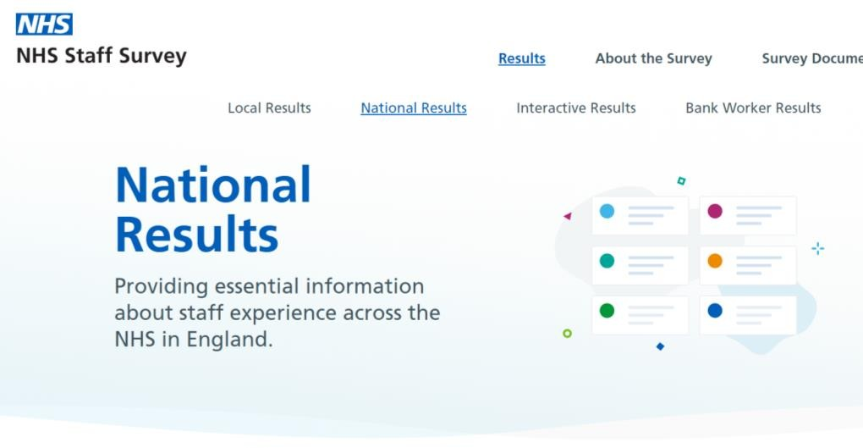
How do we measure progress against the NHS People Promise?
Our NHS people are best placed to say when progress has been made for those who work in the NHS. As such, the annual NHS Staff Survey has been redesigned to align with Our People Promise from 2021. This Staff Survey is currently being rolled out across general practice, and will eventually be available to all contractor groups in primary care.
We use the NHS Staff Survey as the principal way to measure progress and enable teams and departments,
as well as whole organisations, to see their progress and take action to improve things for their workforce.
We also work with Integrated Care Systems and individual organisations to hear examples of how they are supporting their workforce against the NHS People Promise – a number of whom you will be hearing from today.

Slide 4
The national offer to all NHS people
All of the latest support can be found via: www.england.nhs.uk/people
You can also contact the national team
By email: ournhspeople.hwb@nhs.net By Twitter: @people_nhs
Support options include:
Support for individuals including access to a local staff mental health hubs, text support, free access to mental health and wellbeing apps, counselling options and lifestyle support guides
Support for teams through learning and development opportunities for leaders and line managers such as coaching, counselling and mentoring programmes
Support for your organisation which covers the various health and wellbeing programmes, toolkits and frameworks available to you

Slide 5
Who has access to the support offers?
All our NHS people have access to the national health and wellbeing offers and all of our offers are completely free to access.
For primary care this includes anyone providing primary care services, across all four sectors of primary care. This includes:
General practice staff, including personalised care roles
Dentistry
Optometry
Pharmacy

Slide 6
Supporting your mental health and wellbeing
Staff support service
If you would like to speak to someone through text, you can access confidential, free support by texting FRONTLINE to 85258, available 24/7. This support service is here for you when you’ve had a tough day, are feeling worried or overwhelmed. Whatever your worries, trained advisers can help with signposting and confidential advice. Text: FRONTLINE to 85258 (24/7 via text)
Staff mental health support programme
Many ICSs are offering staff access to a dedicated mental health and wellbeing hubs which can provide rapid access to evidence based mental health services and psychosocial support where needed. Staff with complex needs, such as addiction, can also access support through the national enhanced mental health service, delivered by NHS Practitioner Health Service.
Spiritual and faith based counselling
A confidential and free faith based counselling service is available to staff of all beliefs and none. The sessions are delivered by professional counsellors who are sensitive to religious and non-religious spiritualities. The provider will also try to match clients with a counsellor by ethnicity if requested. To find out more about the service, which is delivered by the Association of Christian Counsellors, and to self- refer please follow this link.

Slide 7
A dedicated coaching offer for primary care

Slide 8
‘Looking After You’ Suite of Support Offers
 | Looking After You Too | This coaching focuses on you and your wellbeing. You can talk about things like the pressures and challenges you are facing, how you are thinking and feeling, and coping with the demands of your role.
 | Looking After Your Team | This coaching for leaders and managers is orientated towards supporting you to develop practical strategies and make small improvements that enable healthy team working.
 | Looking After Your Team Virtual Away Day (NEW) | Staff working in primary care can now book a free two or four hour virtual way day for up to eight team members. A highly skilled coach will support you to design a session to suit your objectives and to ensure the session focuses on your team needs.
 | Looking After Your Career | This is an opportunity to focus on you and your career. The coaching is designed to support you to take practical steps, take more control over your career direction and proactively advance it.
 | Peer wellbeing sessions (Launching Soon) | The facilitated peer wellbeing sessions aim to bring people together with a trained coach to discuss and plan how to improve and maintain wellbeing. Each group will be made up of six-eight people that will meet
 | fortnightly for four weeks.

Slide 9
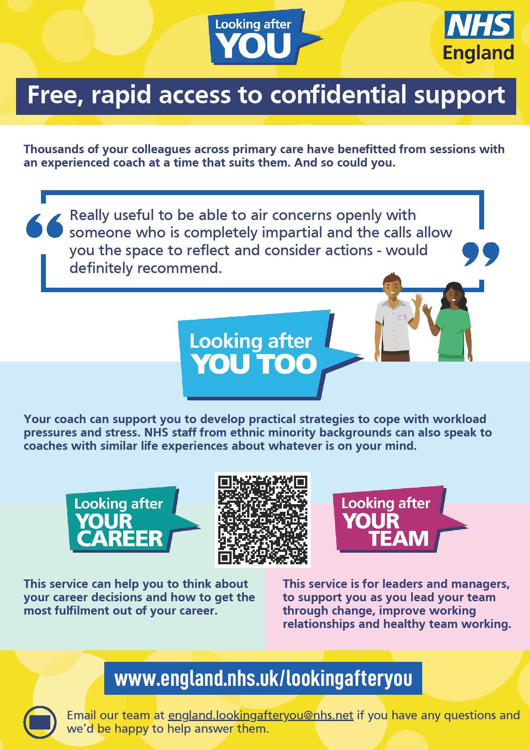
How to book a session
The coaching offers are confidential and free.
The coaching offers are available to all clinical and non-clinical primary care workforce either employed
by the NHS or contracted to deliver work on behalf of the
NHS.
Primary care staff can find out more and book a coaching session here: https://www.england.nhs.uk/lookingafteryou
You can also download our poster and share with your colleagues:
www.england.nhs.uk/publication/looking-after-you-
coaching-support-poster

Slide 10
Supporting your mental health through our digital health and wellbeing apps
Headspace
Unmind
Unmind is a mental health platform that empowers staff to proactively improve their mental wellbeing. It includes digital programmes designed to help with stress, sleep, coping, connection, fulfilment and nutrition.
Free access has now been extended until 31 December 2023.
Stay Alive
The Stay Alive app is a suicide prevention resource for the UK, packed full of useful information and tools to help you stay safe in crisis. You can use it if you are having thoughts of suicide or if you are concerned about someone else who may
be considering suicide.
Headspace is a science-backed app in mindfulness and meditation, providing unique tools and resources to help reduce stress, build resilience, and aid better sleep.
Free access has now been
extended until 31 December 2023.
Findout more: www.england.nhs.uk/ supporting-our-nhs-people/support-now/wellbeing-apps/

Slide 11
Financial wellbeing support
Financial concerns have consistently been one of the top reasons that colleagues contact staff support services. As such, we’ve partnered with the Money Helper (formerly known as the Money Advice Service) to bring you financial support to help you manage your finances at home.
NHS staff support line telephone support line
NHS colleagues can call this dedicated support line for free and impartial money advice from Monday to Friday,
8am to 6pm.
Call: 0800 448 0826
WhatsApp
Add +44 7701 342 744 to your WhatsApp and send the Money Advice Service’s national support team a message
for help with sorting out your debts, credit questions and pensions guidance.
Webchat
You can also chat to one of the Money Advice Service team via their online portal.
Find out more: https://www.england.nhs.uk/supporting-our-nhs-people/support-now/financial-support/

Slide 12
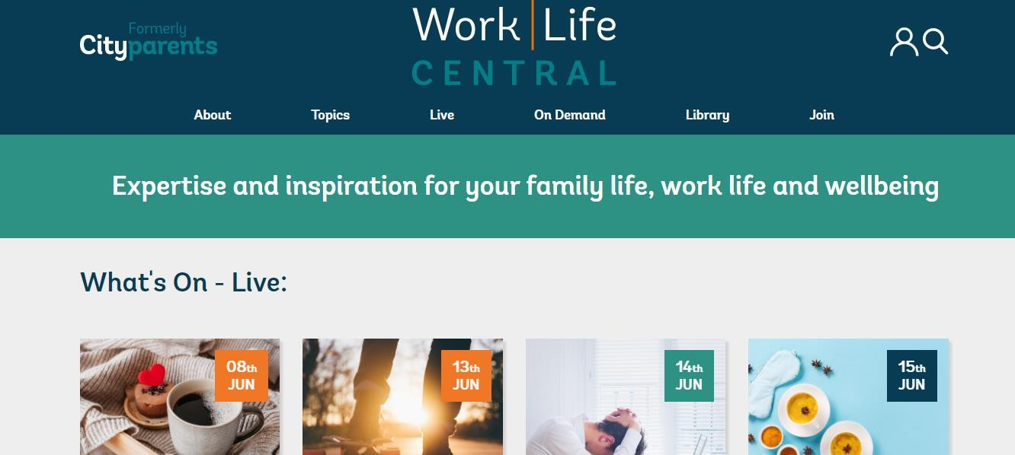
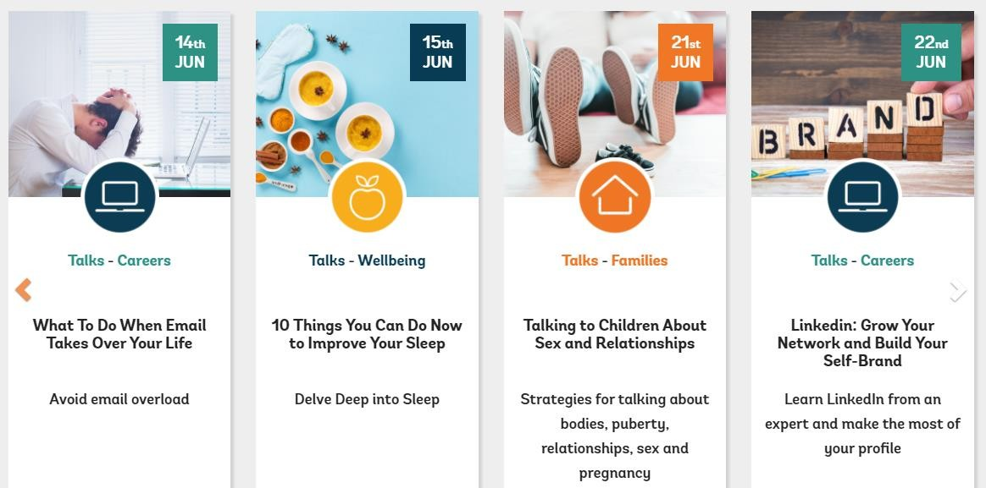
Supporting you to manage your work-life balance
WorkLife Central (formerly Cityparents)
WorkLife Central are offering all NHS colleagues access to their online programme that includes positive and practical support, delivered through expert-led webinars and seminars, as well as advice, peer insights, online articles, blogs and podcasts on specific topics such as health and wellbeing, bereavement and others.
They aim to help members develop skills, enhance family life, improve wellbeing and support work-life balance. This app is free to NHS colleagues until 31 March 2024.
Find out more: www.england.nhs.uk/supporting-our-nhs-people/support-now/wellbeing- apps/

Slide 13
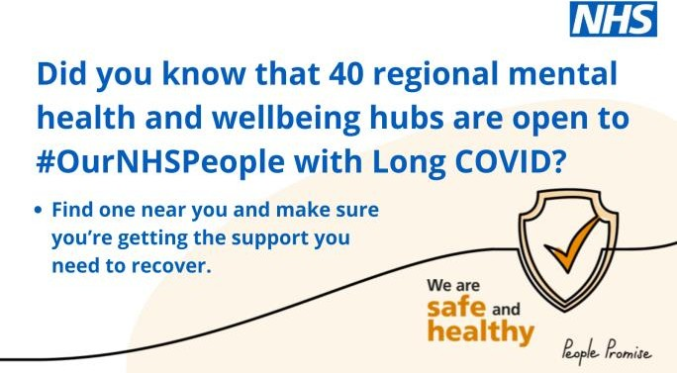
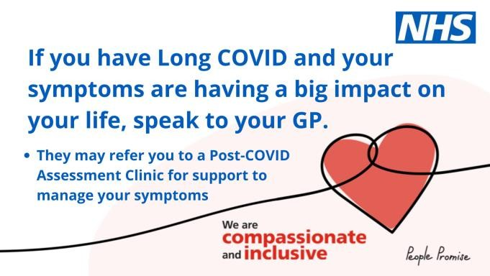
Support for those with Long Covid
Recovering from Long Covid can be a lengthy process and colleagues will need to be supported to recover at their own pace. The NHS has a range of support offers and services available to NHS colleagues to support with their health and wellbeing, including support for Long Covid symptoms:
Guidelines on best practice when supporting colleagues affected by Long Covid: https://www.england.nhs.uk/publication/guidelines-for-supporting-our- nhs-people-affected-by-long-covid/
Access to Occupational Health and Wellbeing services and local Employee
Assistance Programmes through your employing organisations.
Dedicated rapid assessment through the staff mental health and wellbeing hubs in place provide proactive outreach and assessment services, including rapid clinical assessment and supported onward referral to mental health services and psychological support where needed.
Access to a range of health and wellbeing offers through the national support programme, including free access to a range of mental health and wellbeing apps, talking therapies through the Samaritans helpline and a range of coaching and counselling offers.
All patients across the country have access to support via online rehab services
at Your COVID Recovery | Supporting your recovery after COVID-19.
Find out more: www.england.nhs.uk/supporting-our-nhs-people/support-now/supporting-long-covid/

Slide 14
Support for those going through the Menopause
Good menopause care has both direct and indirect impacts on workforce retention levels, productivity, and absenteeism. Ensuring staff get the support they need is an important part of retaining experienced talent and skills. It would also minimise the impact of a person’s symptoms, health and wellbeing issues, and productivity on patient outcomes, their work, personal life, and relationships.
The NHS has a range of support offers and services available to NHS colleagues to support with their health and wellbeing, including support for those experiencing symptoms of the menopause:
National guidance on how to support staff going through the menopause
For colleagues off work due to menopause related symptoms, line managers are encouraged to maintain regular contact to support and connect during the absence.
Offer regular wellbeing conversations to check in with colleagues and explore if making any reasonable adjustments to their working pattern would support them.
There are a number of local or national menopause support groups and peer networks that colleagues can join to meet others who are experiencing similar challenges.
You can also find tips for managers and leaders on how to support colleagues affected by the menopause in the
‘Supporting colleagues in late career’ chapter of our retention guide for line managers and employers.
Find out more: https://www.england.nhs.uk/supporting-our-nhs-people/support-now/supporting-colleagues-affected-by-the-menopause/

Slide 15
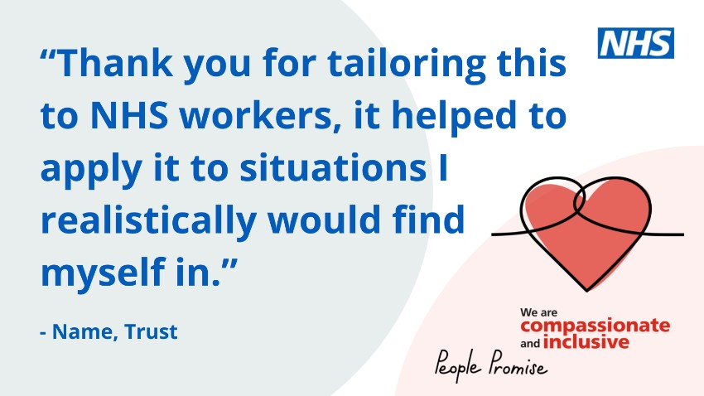
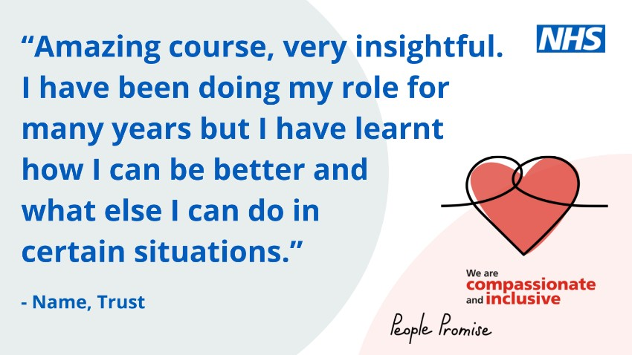
Handling difficult situations – Caring for yourself and others with compassion e-learning
A newly-developed e-learning course for frontline, patient- facing NHS colleagues in clinical and non-clinical roles.
The training aims to help upskill colleagues in how to handle difficult situations with compassion, using appropriate communication techniques and active listening skills, whilst very much focussing on how to keep yourself well if you feel affected by a situation.
Skills learnt in the training could be used in a wide range of difficult situations, including where patients may present in a challenging or distressed manner, during instances of uncivil behaviour or when speaking about difficult topics of conversation with colleagues.
Find out more: https://www.england.nhs.uk/supporting-our-nhs-people/support-
now/handling-difficult-situations-with-compassion-training-programme/

Slide 16
Supporting your team
The following pages outline the national learning and development programmes that aim to help you
become a better leader, in order to better support your colleagues.
Please do feel free to share this pack with other leaders across your organisation.

Slide 17
Having safe and effective wellbeing conversations
Taking the time to ask your colleagues how they are is incredibly important. Alongside the national guidance and resources already published (including case studies, example personal action plans and a supporting animation), we have
launched a national training programme that has been designed to support our NHS colleagues in having safe and effective
wellbeing conversations, as set out in the NHS People Plan.
You can read our guidance on implementing wellbeing conversations and watch a supporting animation that guides line managers through wellbeing conversations.
You can also view three case studies from NHS organisations who have rolled out wellbeing conversations and want to share the benefits of doing so, as well as a staff experience video on how wellbeing conversations helped them personally and why they are important.
Alongside the above guidance, NHS England and NHS Improvement have launched a national training programme that has been designed to support NHS colleagues in having safe and effective wellbeing conversations. The training is aimed at line managers and colleagues across the NHS who would like additional support in safely and confidently holding a wellbeing conversation. Feedback from the initial cohort delivered in 2021/22 was incredibly positive, with 88.9% of delegates who completed the post course survey reporting that they felt confident or very confident to initiate a wellbeing conversation after attending the training. To read more about this training programme and to view available dates, please click here.
Sessions are available until May 2023.
Find out more: www.england.nhs.uk/supporting-our-nhs-people/health-and-wellbeing- programmes/wellbeing-conversations/

Slide 18
Managing with compassion
All NHS colleagues have access to the Mersey Care NHS Foundation Trust’s free online Just and Learning Culture training and additional accredited learning packages to help ensure their organisation has a fair, open and learning culture. The Restorative Just Culture – Virtual Community of Practice is an online community of practice for the Restorative Just Culture community where the user can engage with other colleagues on good practice and current thinking.
Feeling safe to speak up can boost psychological health and wellbeing. The above training aims to support the creation of environments where staff feel empowered to take learning from instances when things do not go as expected, in a way that minimises the negative impacts on individuals and teams, whilst aiding the development of a culture that focuses on health and wellbeing, compassion, restoration
and learning. Since implementing this programme within their organisation, Mersey Care have seen a significant reduction in disciplinary investigations, dismissals and suspensions - leading to a substantial reduction in costs.

Slide 19
Bespoke support for senior leaders
The Executive Suite has been designed to support senior leaders working across the health and care system (CEO, AO, Chair, PCN Clinical Director, NED, Lay members, Executive Directors or equivalent).
The suite includes a comprehensive package of supportive offers and resources that are designed to support you to remain a resilient leader, continue to thrive in your role, and set cultures that value the importance of health and wellbeing. This includes:
Seminars from internationally renowned and prominent health and care experts
Access to virtual Action Learning Sets
Curated resources
Accessto 1:1 psychological support
Accessto mentoring
Career development support
Signposting to regional support offers
Findout more: https://people.nhs.uk/executivesuite/

Slide 20
Online health and wellbeing guides
Health and wellbeingguides
We’ve worked with a team of experts to develop a range of short guides to help support you with skills and new ways to improve your experience of work. Our guides cover topics such as getting a good night of sleep, personal resilience, support for line managers, guidance on how to be a compassionate leader during a bereavement and tips on how to run your own 10 minute Pause Space.
We have also recently published a new and comprehensive ‘Looking after your team’s health and
wellbeing guide’ which focussed on looking after whole teams.
Find out more: www.england.nhs.uk/supporting-our-nhs-people/How-to-guides/

Slide 21
Development opportunities for Health and Wellbeing Champions
The NHS People Plan sets out the national ambition to enable NHS colleagues to create cultures of wellbeing across their organisation. This includes inviting NHS organisations to implement a network of Health and Wellbeing Champions.
In order to support organisations in rolling out and supporting the development of their Health and Wellbeing Champions across the NHS, NHS England are offering Champions across the NHS free access to a range of development opportunities and national support offers. This includes:
Free access to a national e-learning module that helps you understand the role and remit of a Champion
A monthly development programme, hosted by the national team and free for Champions to attend, to talk through specific topics and meet other Champions (see following page for details)
A regular bulletin to share ideas, best practice and learning opportunities
Priority access to a range of training and personal development opportunities
A dedicated, closed forum on Future NHS to share ideas and questions and network with other Champions

Slide 22
Thank you all for attending today.
Please feel free to contact our team for any support you and your organisations require.

